Slide 1
Maths Counts Insights into Lesson Study

Slide 2
Presentation Secondary School: Listowel:
Jacqueline Normile, Norma Dowling and Elaine Hickey.
Sixth Year.
Associating derivatives with slopes of tangent lines.

Slide 3
Insights into Lesson Study
Introduction: Focus of Lesson
Student Learning : What we learned about students’ understanding based on data collected
Teaching Strategies: What we noticed about our own teaching
Strengths & Weaknesses of adopting the Lesson Study process

Slide 4
Introduction
Topic investigated: Associate derivatives with slopes of tangent lines.
How we planned the lesson: Maths Team got together and we looked at, and discussed
Planning lesson
Prior knowledge
What we wanted to teach
What we wanted the students to know at the end.
Interested in: Strategies to improve learning and understanding.
Resources used: The Teaching and Learning Plan, the syllabus, whiteboards, rulers, pencils, coloured markers, activity sheet and PowerPoint’s.

Slide 5
Introduction
Prior Knowledge:
Students understand:
Rate of change and slope are equivalent.
The difference between the average rate of change and the instantaneous rate of change.
Transformation of Quadratic Functions.

Slide 6
Introduction
Why did we choose to focus on this mathematical area?
The class had started the calculus section of the course and this Teaching and Learning plan provided a solid foundation from which to continue.

Slide 7
Introduction
Enduring understandings:
Students will be able to analyse this information and present their findings in mathematical form.
The aim of this lesson study was for students to understand why we associate derivatives with tangent lines.
Students should be able to apply their knowledge and skills to solve problems.

Slide 8
Learning Outcomes:
Students will understand:
The slope function of a quadratic function allows us to predict the slope of the function at any point.
Slope functions may be determined by examining the pattern of the slopes of tangents to the function.
Slope functions may be determined by a simple rule.

Slide 9
Reflections on the Lesson
Student Learning : What we learned about students’ understanding based on data collected
Teaching Strategies: What we noticed about our own teaching

Slide 10
Student Learning
Data Collected from the Lesson:
Academic e.g. samples of students’ work
Motivation
Social Behaviour

Slide 11
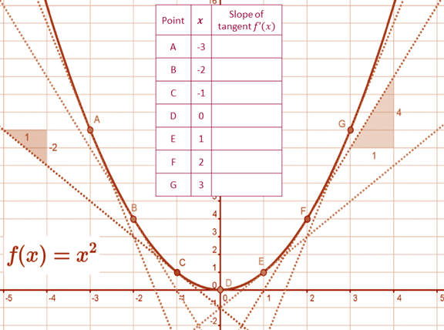
Activity from T&L Plan
We handed this activity to the class and told them they were to fill in the table, individually, and see if there was a discernible pattern.
Then they collaborated in pairs and in small groups.
One person then reported from each group on their findings.

Slide 12
Common misconceptions: 1
Students found the slope of the secant of two adjacent points, rather than the tangent.
See next 2 slides

Slide 13
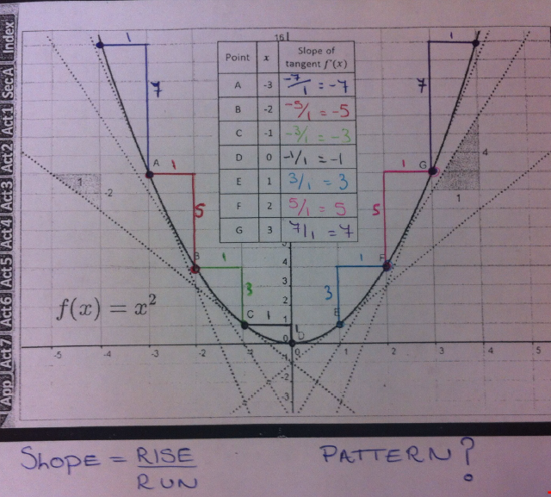

Slide 14
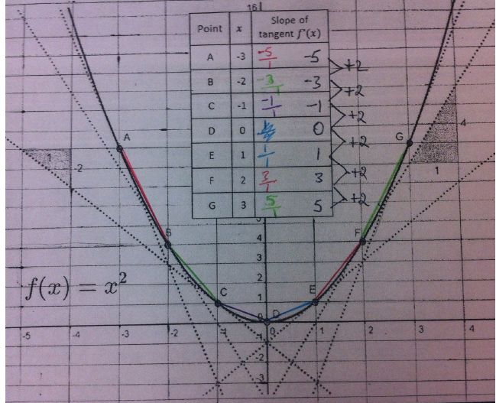

Slide 15
Common misconceptions: 2
Students found the slope of the secant from the origin to the point of interest, rather than the tangent.
See next 2 slides

Slide 16
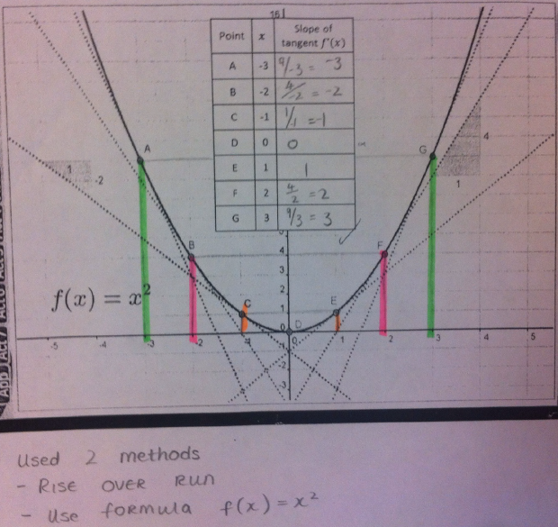

Slide 17
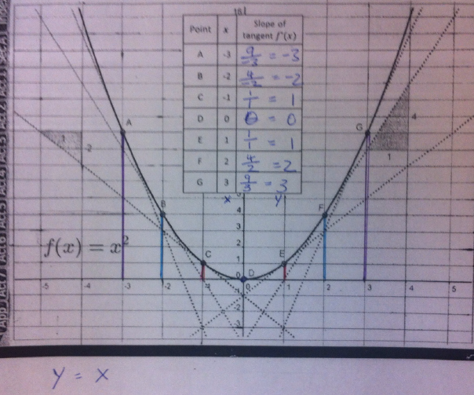

Slide 18
Common misconceptions: 3
When students used the formula,
they took run as a negative distance, rather than a negative movement.
See next slide

Slide 19
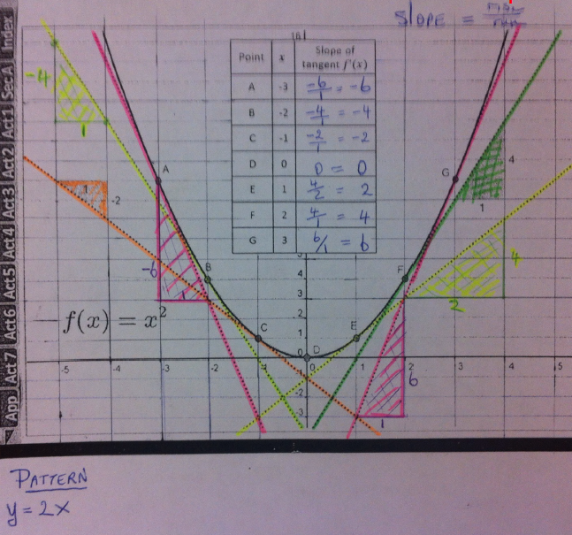

Slide 20
Student Understanding: 1
What we learned about the way different students understand the content of this topic?
Students saw two points and found the slope using these two points, rather than the tangents.
See next 4 slides

Slide 25
Student Understanding: 2
What we learned about the way different students understand the content of this topic?
Students were able to identify a pattern in the work.
From the pattern students were able to derive a formula i.e. a slope function.
Students understood the connection between the slope of the tangents and the slope function.
See next 3 slides

Slide 26
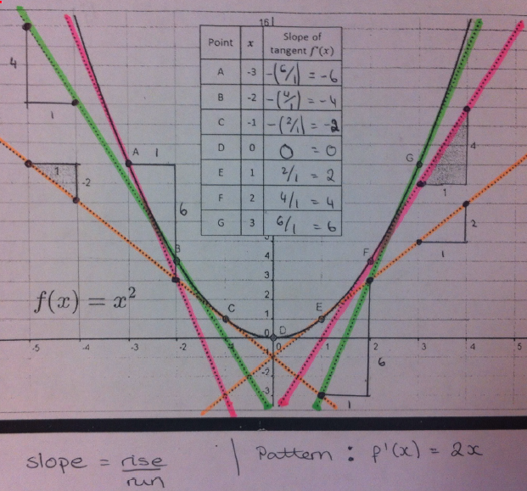

Slide 27
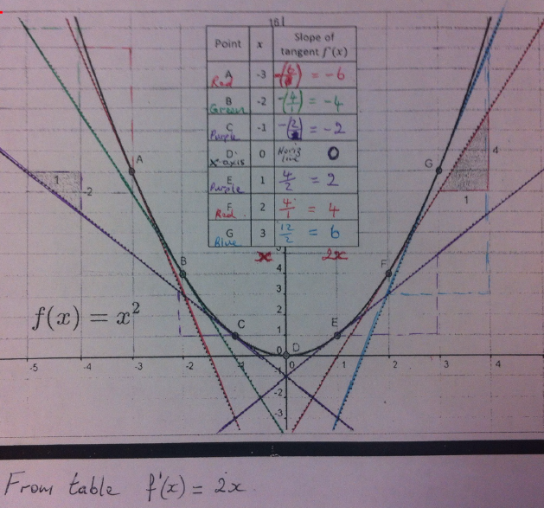

Slide 29
Addressing Misconceptions
Recommendations
In future when we teaching rates of change we should put more emphasis on
The idea of a constant rate of change.
The secant line is used to find average rate of change, for non-linear functions.
The tangent line is used to find instantaneous rate of change, for non-linear functions.

Slide 30
Further Recommendation
Before teaching this lesson again the students should have good prior knowledge of
Patterns
Slopes of linear functions
Rates of Change

Slide 31
Teaching Strategies
What did I notice about my own teaching?
To be fluent in the correct mathematical language.
To be organised – timing, resources.
Increased level of sound.
Wait time – give the students time to complete activity and then discuss activity and findings.

Slide 32
Teaching Strategies
Was it difficult to facilitate and sustain communication and collaboration during the lesson?
No.
We gave students a task to complete.
They collaborated in pairs initially.
Then in groups of four.

Slide 33
Teaching Strategies
Was it difficult to ask questions to provoke students’ deep thinking?
We circulated the classroom and listened to the progress.
We encouraged students to ask each other questions.
We noticed different members of a group had different results.
We asked them to discuss this with each other.
Students had to tease out which piece of work they thought was correct.

Slide 34
Teaching Strategies
How did I assess what students knew and understood during the lesson?
A member from each group reported back with their conclusions using the visualiser.
Some Questioning used during the lesson
Why did the group decide that this was the best answer?
What was wrong with the other answers?

Slide 35
Teaching Strategies
How did I put closure to the lesson?
Having seen examples of work we asked the class which piece of work they thought was correct.
We also asked what were the common misconceptions.
We then showed a fully correct example of the activity on the visualiser, including the correct pattern for the slope function.
We then graphed the f’(x) = 2x function and asked the class what type of function this was.
The class recognised it was linear.

Slide 36
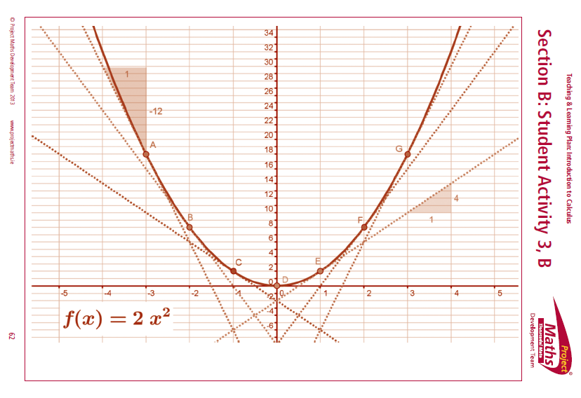
Teaching Strategies
Homework:
Each student was asked to fill in the table, formulate a pattern i.e. slope function and graph the slope function for different quadratic functions, such as:
x² + 1
x² – 1
2x²
2x² + 1
2x² – 2

Slide 37
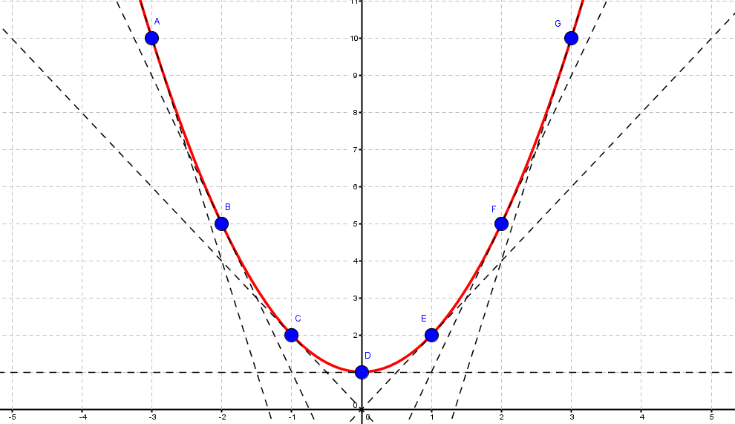
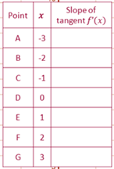
Student Homework: Example 1
f(x) = x² + 1

Slide 38
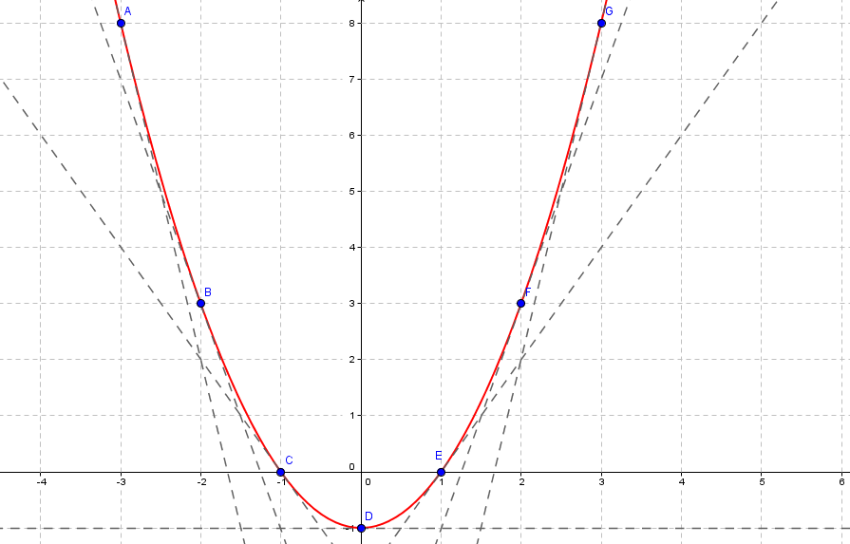
Student Homework: Example 2
f(x) = x² – 1

Slide 39
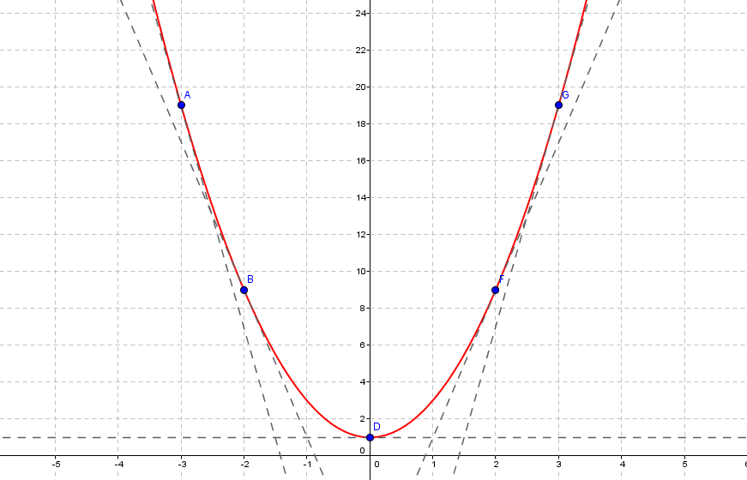
Student Homework: Example 3
f(x) = 2x² + 1

Slide 40
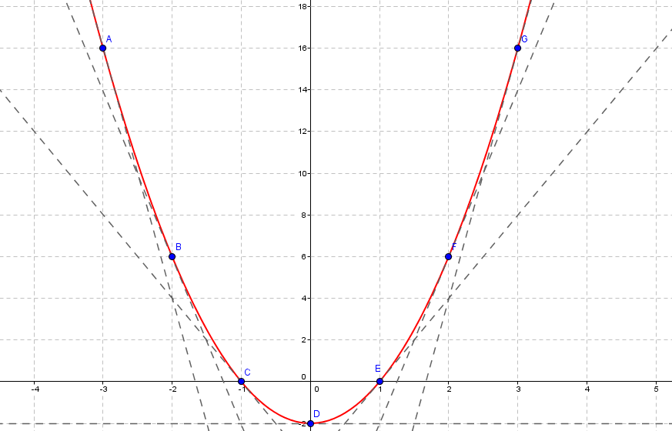
Student Homework: Example 4
f(x) = 2x² – 2

Slide 41
Next Lesson
Students used the visualiser to display their homework
They noticed that all quadratic functions gave rise to linear slope functions
We asked students could they come up with a general formula for deriving the slope function based on the homework
We then introduced the derivative formula as a simpler method for finding the slope function.
Derivative function = Slope function

Slide 42
Reflections on Lesson Study Process
Greatly improved communication, collaboration and collegiality between members of the Maths Team.
Increased my confidence.
Increased my knowledge of more varied teaching methodologies.

Slide 43
Reflections on Lesson Study Process
Recommendations as to how Lesson Study could be integrated into a school context.
Written lesson studies are very time consuming.
We found it to be a great learning experience.
It has thought us the importance of sitting down and talking about the content of a topic and how to teach it – even for five minutes.
Sharing of labour.
The importance of a common approach.

Slide 44
Presentation Secondary School: Listowel:
Thank You
Jacqueline Normile, Norma Dowling and Elaine Hickey.

