Slide 1
Maths Counts Insights into Lesson Study

Slide 2
St Columba’s Comprehensive, Glenties
Kathleen Molloy and Laura Craig
6th yr HL
GeoGebra and solving modulus inequalities

Slide 3
Insights into Lesson Study
Introduction: Focus of Lesson
Student Learning : What we learned about students’ understanding based on data collected
Teaching Strategies: What we noticed about our own teaching
Strengths & Weaknesses of adopting the Lesson Study process

Slide 4
Introduction
Why did we decide to focus on this topic?
Traditionally the absolute value function had not been well understood by students when using only algebraic procedures.
We wanted students to apply mental, graphic and numeric methods to questions such as:
Solve: $\left|x−5\right|<4,xεR$

Slide 5
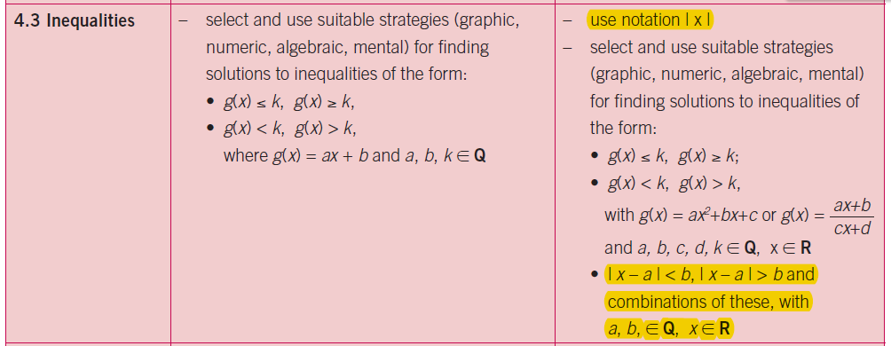
Introduction and learning outcomes
These were the learning outcomes we set out to achieve.

Slide 6
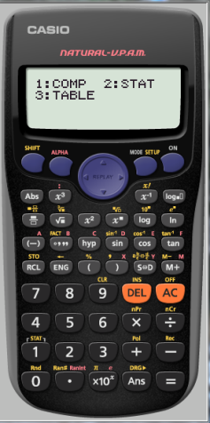
Introduction
Topic investigated :Solving modulus equations and inequalities
How we planned the lesson
Resources used :
Prior knowledge
Worksheets
Calculator (abs function and Table Mode)
Number-line
GeoGebra

Slide 7
Introduction
Enduring understandings
Use of multi-representations when solving problems i.e. mental, numerical, graphical, algebraic
Use of the calculator as a problem solving tool
Demystifying the absolute value function
Use of GeoGebra to verify student work

Slide 8
Student Learning
Data Collected from the Lesson:
Academic e.g. samples of students’ work
Motivation
Social Behaviour

Slide 9
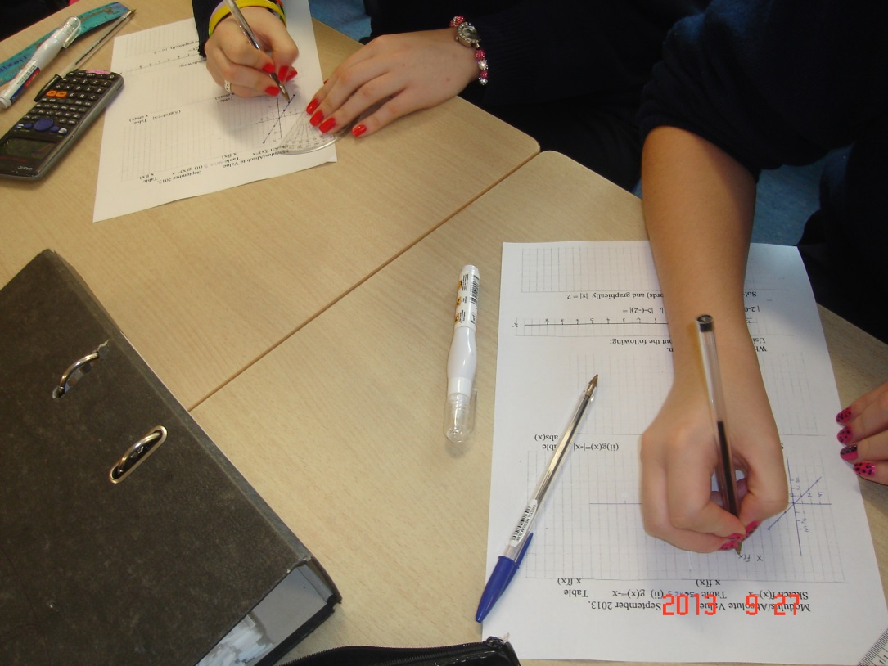
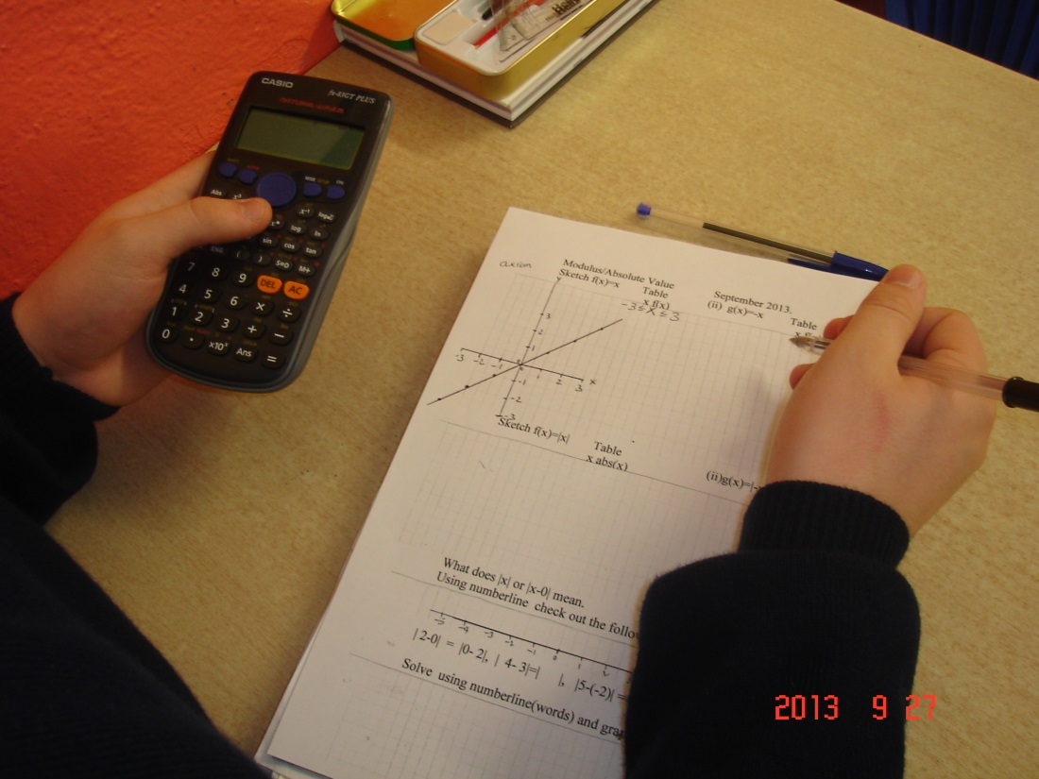
Student work
Graphing $f\left(x\right)=x,x ε R$

Slide 10
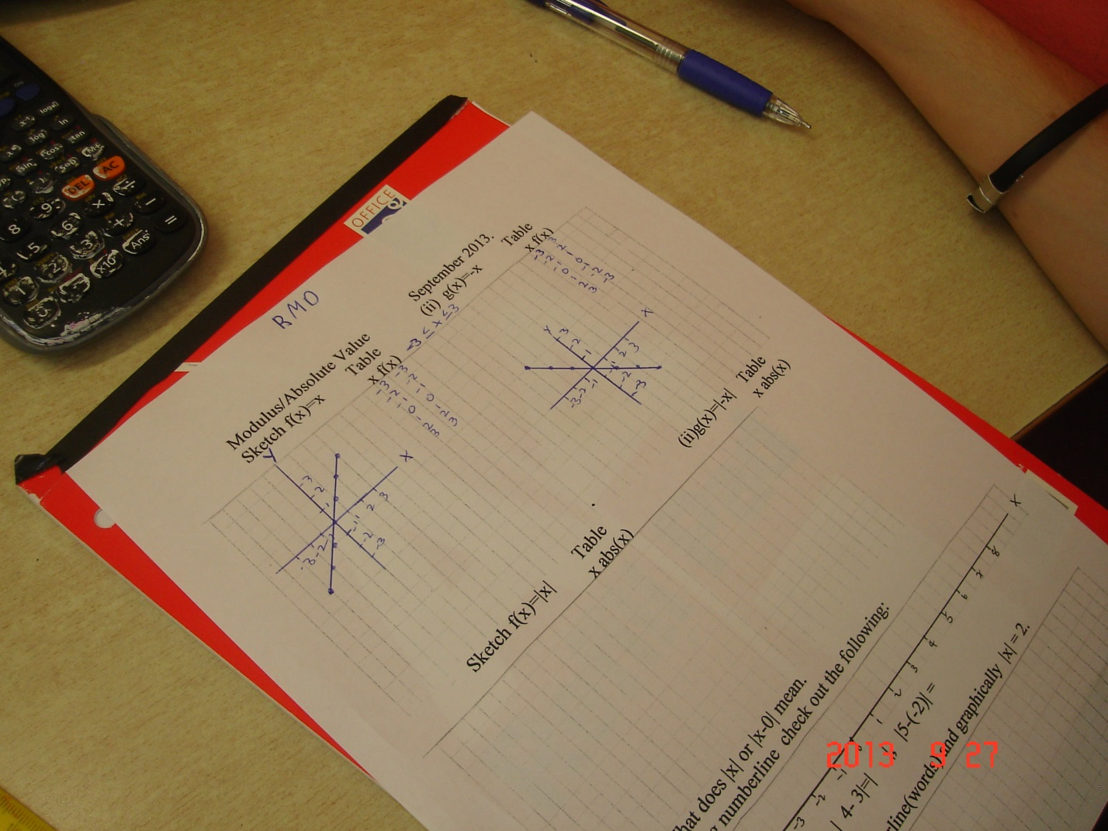
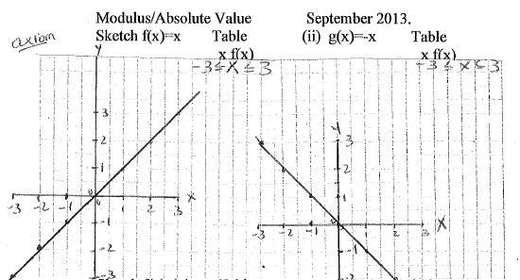
Student work
Graphing $f\left(x\right)=x, and g\left(x\right)=−x, x ε R$
Some students showed tables and some didn’t.
This student has referred to axiom 1
(Two point axiom)

Slide 11
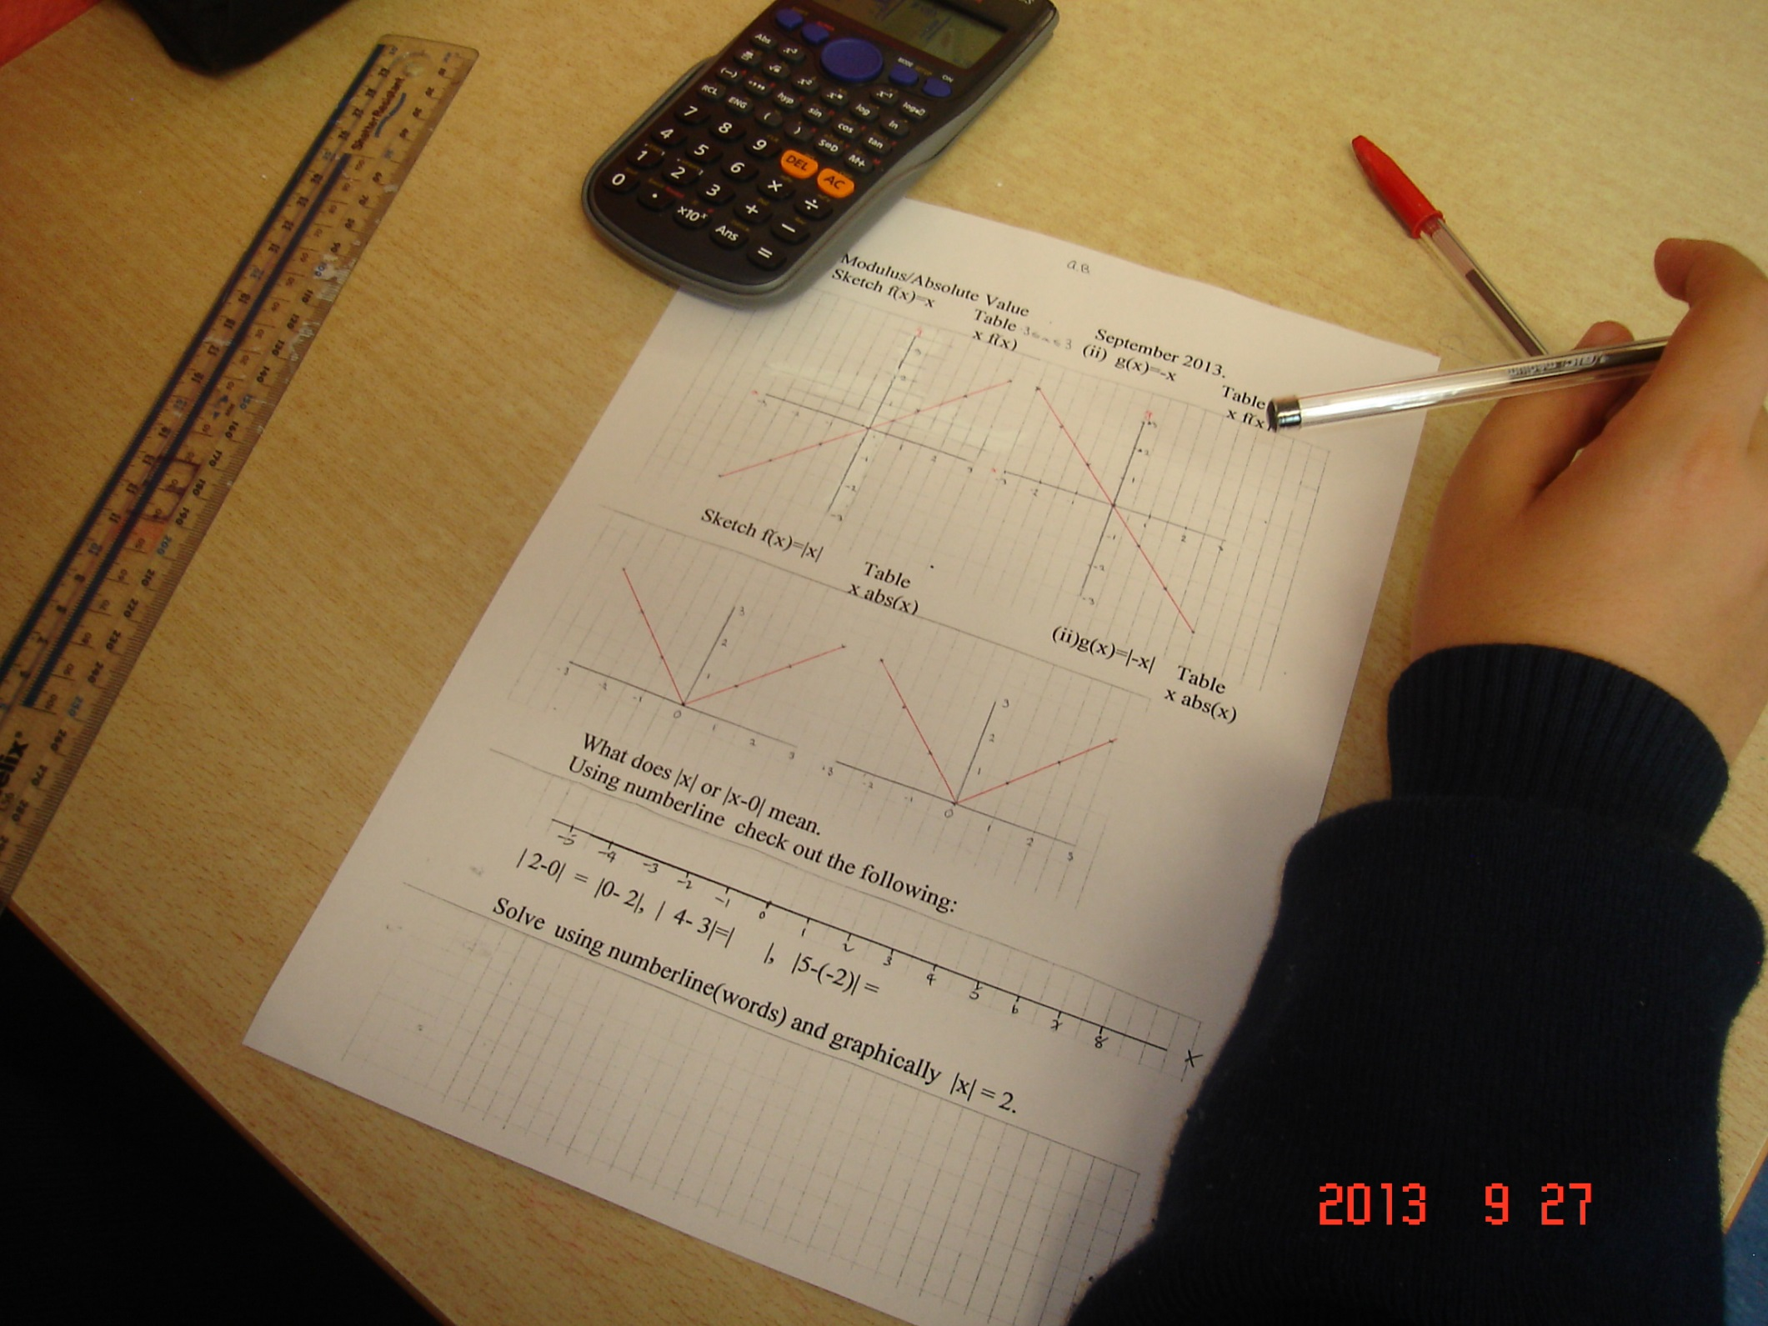
Graphs of :
$$f\left(x\right)=x$$
$$g(x) = −x$$
$$h\left(x\right)=\left|x\right|$$
$$k\left(x\right)=\left|−x\right|$$
showing that
$|x|=|−x|$
|x|=x, x>0
|x|=-x, x<0

Slide 12
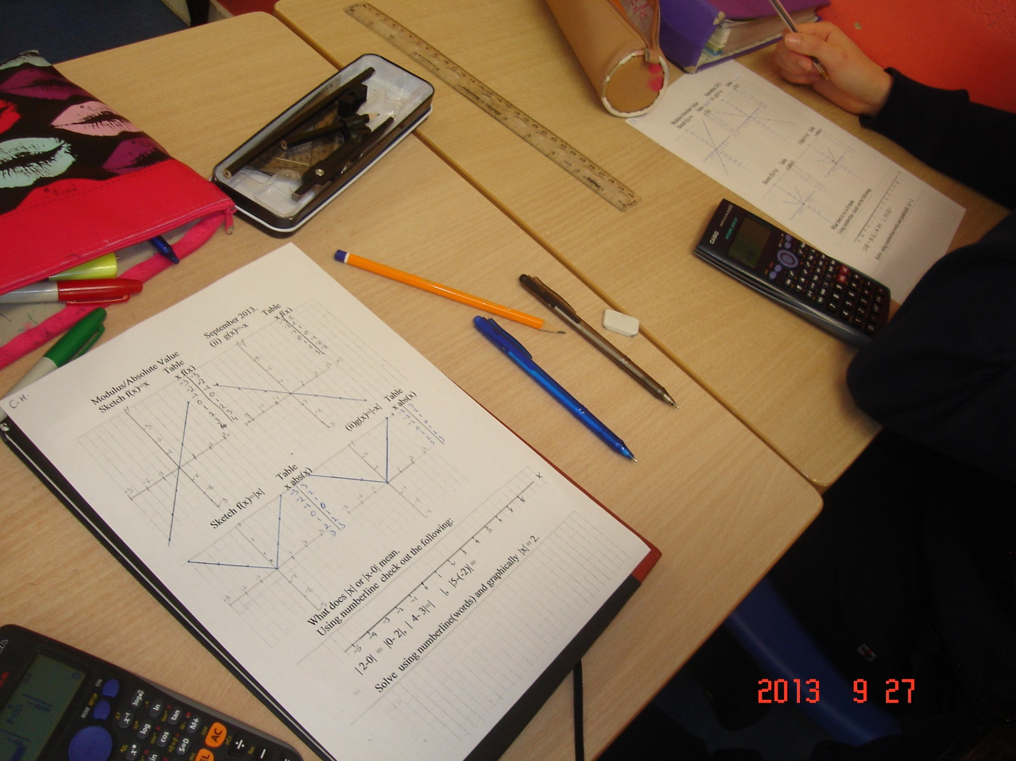
Graphs of :
$$f\left(x\right)=x$$
$$g(x) = −x$$
$$h\left(x\right)=\left|x\right|$$
$$k\left(x\right)=\left|−x\right|$$
showing that
$|x|=|−x|$

Slide 13
Student work

Slide 14
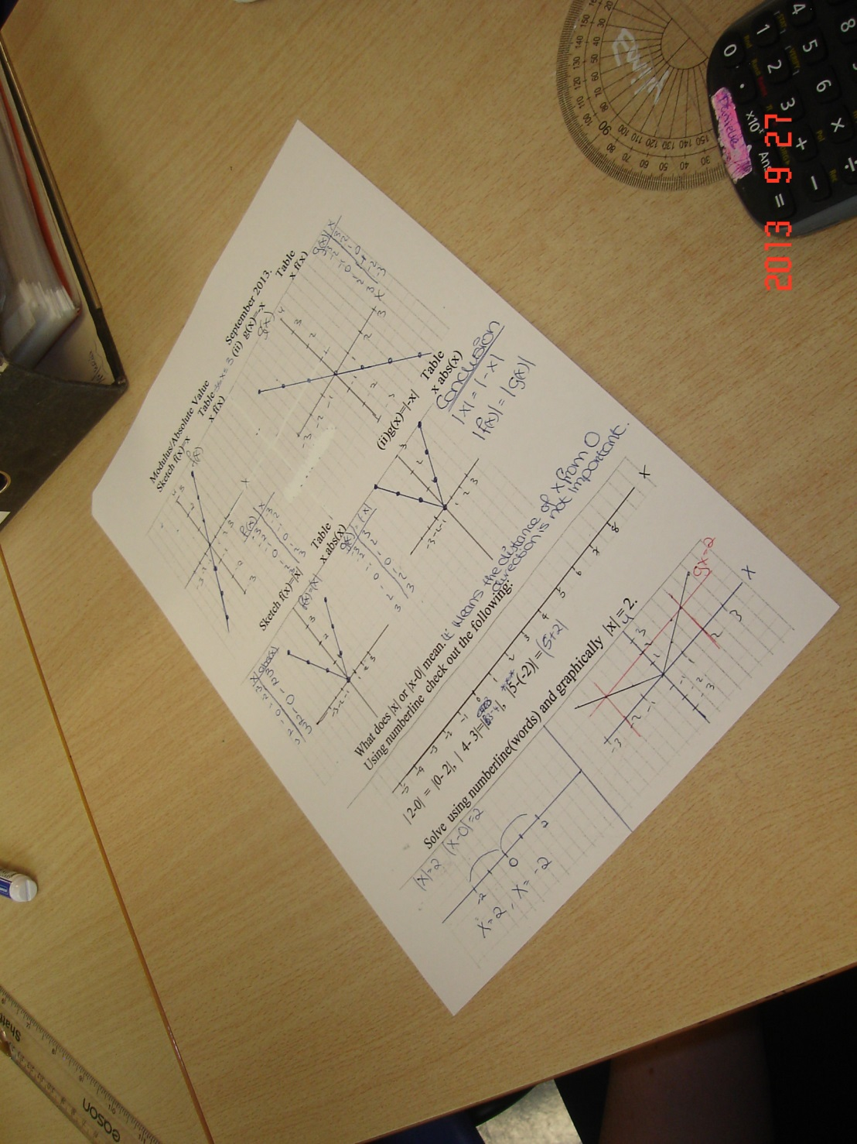
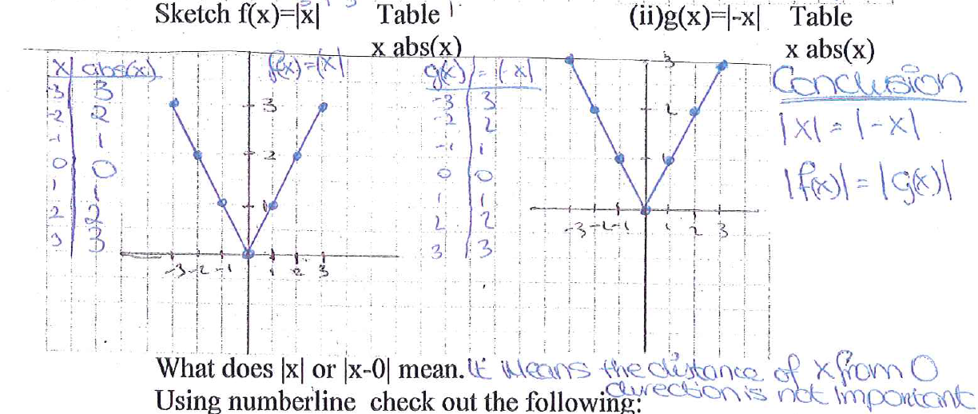
Student work

Slide 15
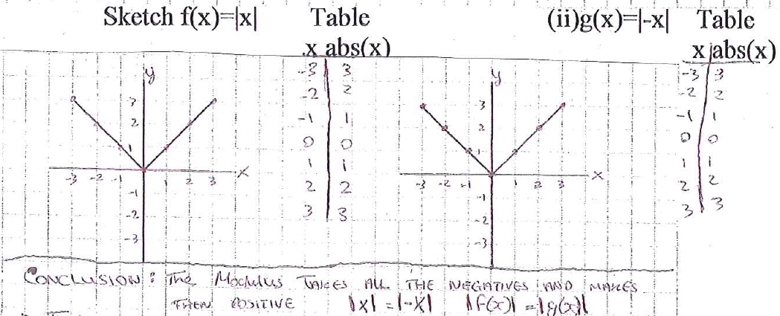
Student work

Slide 16
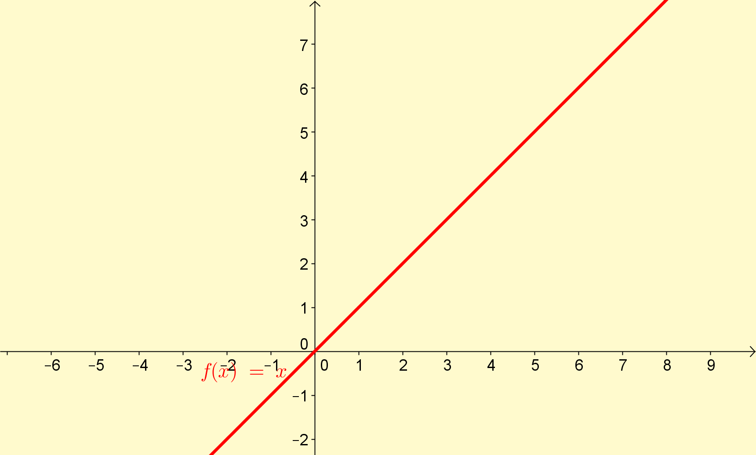
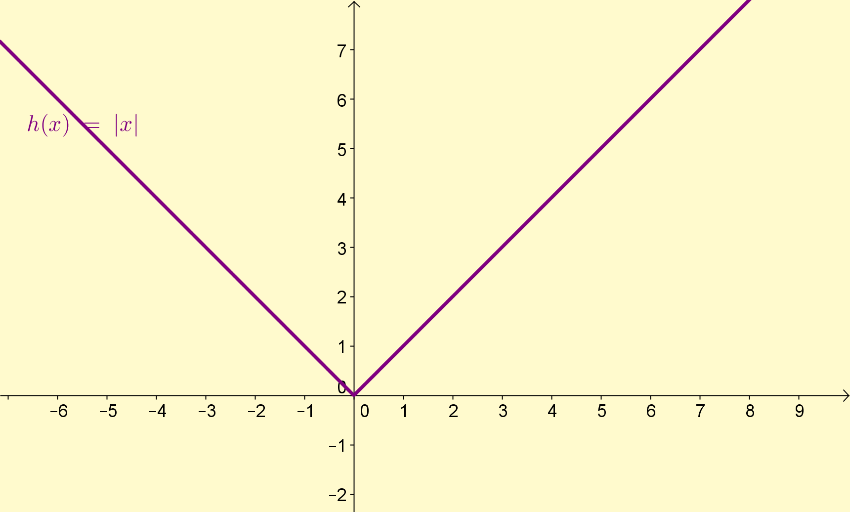
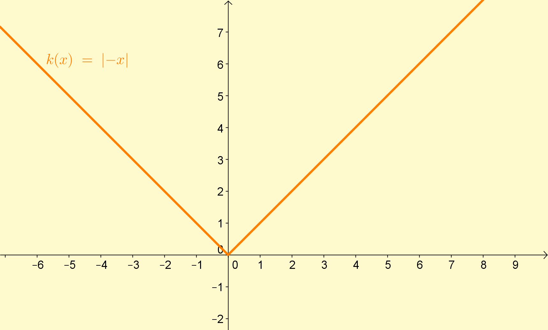
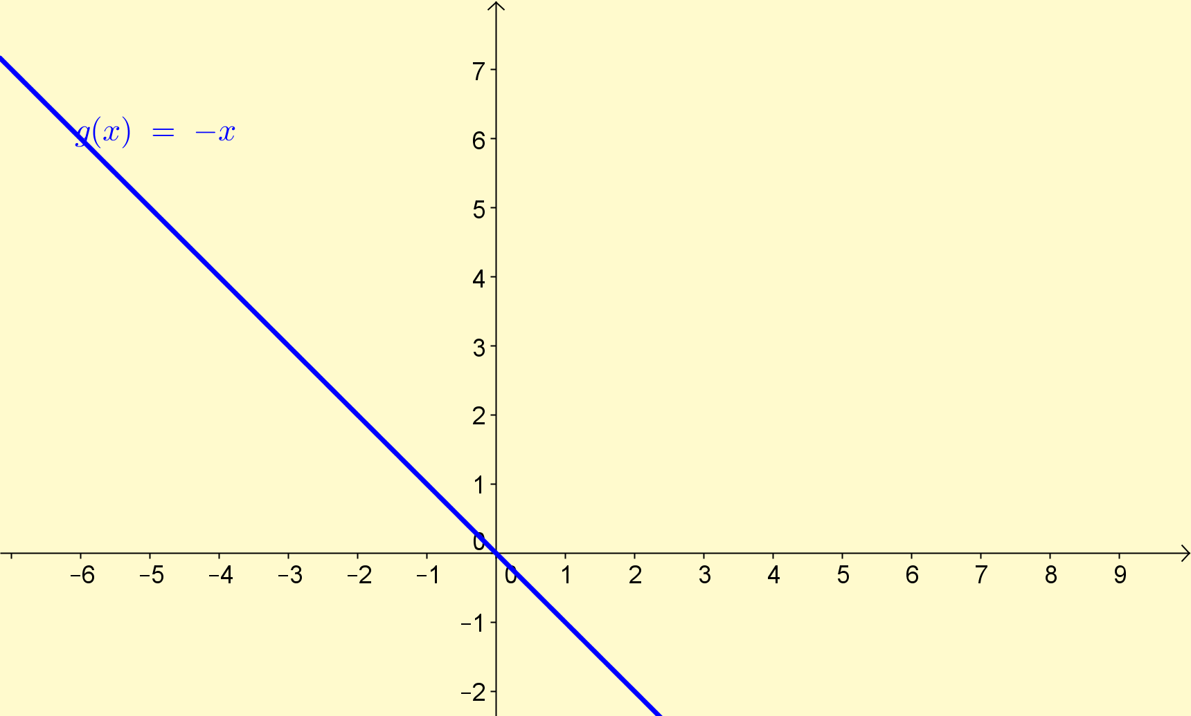
Using GeoGebra to support the learning

Slide 17
Student work

Slide 19
Student work
Using this graph from the previous slide solve $|x|>2$
Misconception related to the logical connectors “AND” and “OR”:

Slide 20
Student work

Slide 21
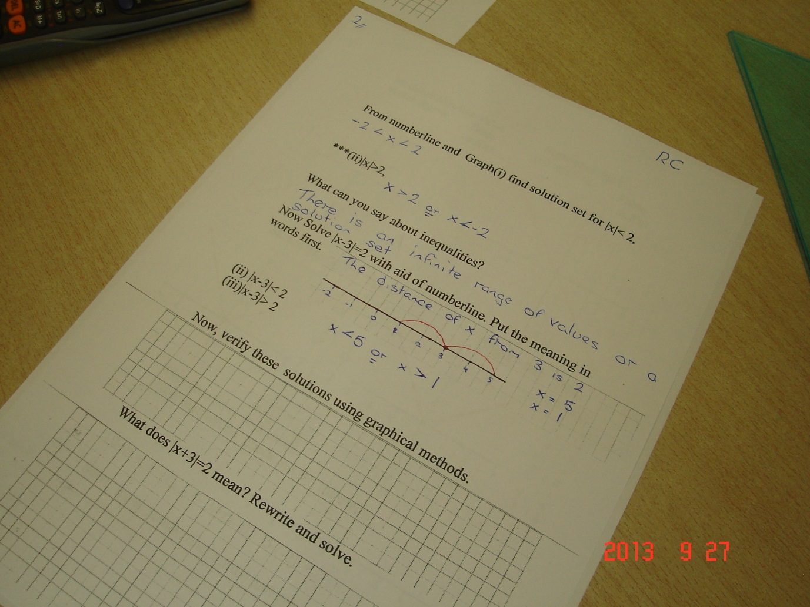
Solve $\left|x−3\right|=2$

Slide 22
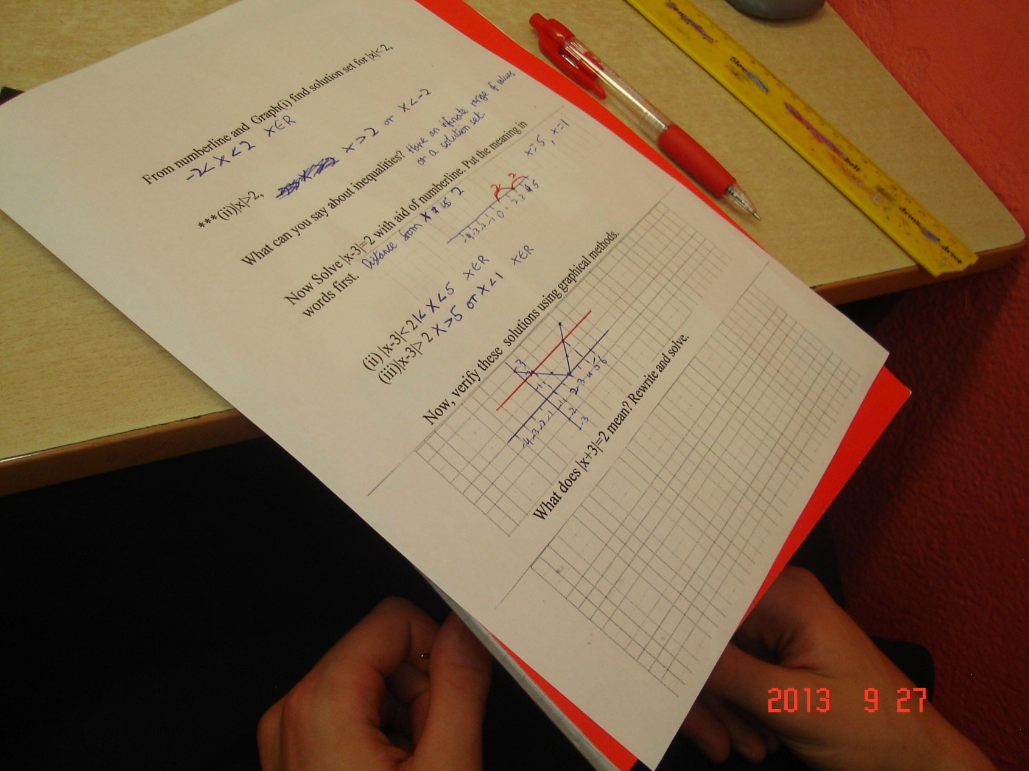
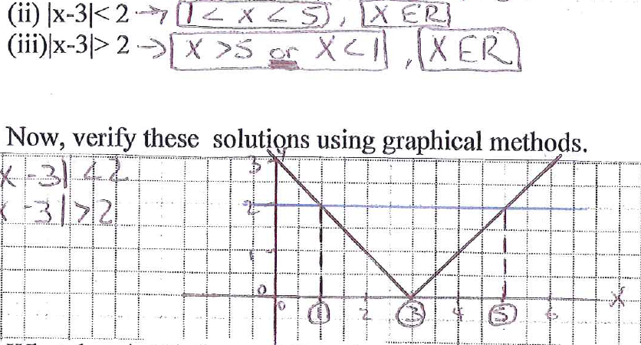
Student work
Solve: $\left|x−3\right|>2, x∈R$
Solve: $\left|x−3\right|<2, x∈R$
Verbal
Graph of |x-3|:Horizontal shift of |x| three units to the right

Slide 23
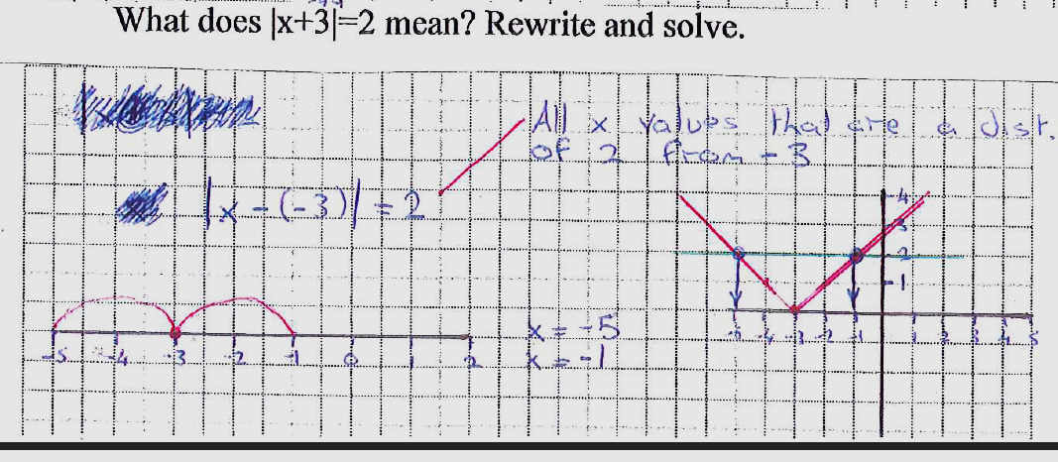
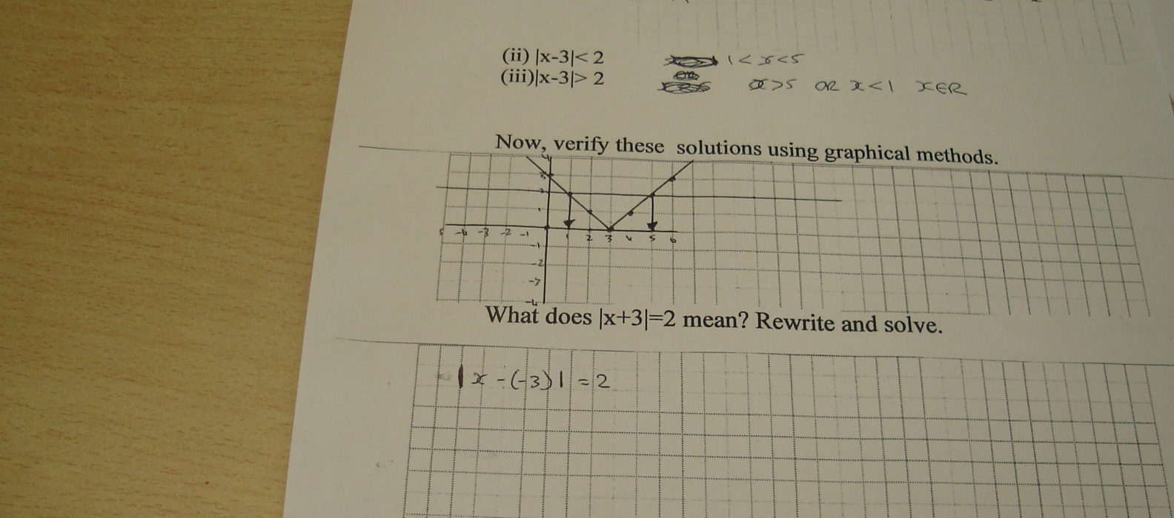
Student work
Solve $\left|x+3\right|=2$
Graph of |x+3|: Horizontal shift of |x| three units to the left

Slide 24
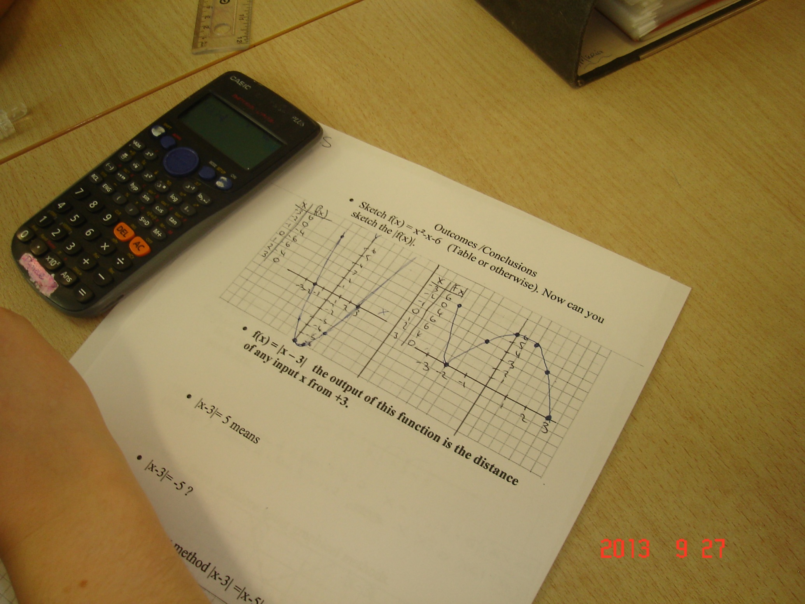

Slide 28
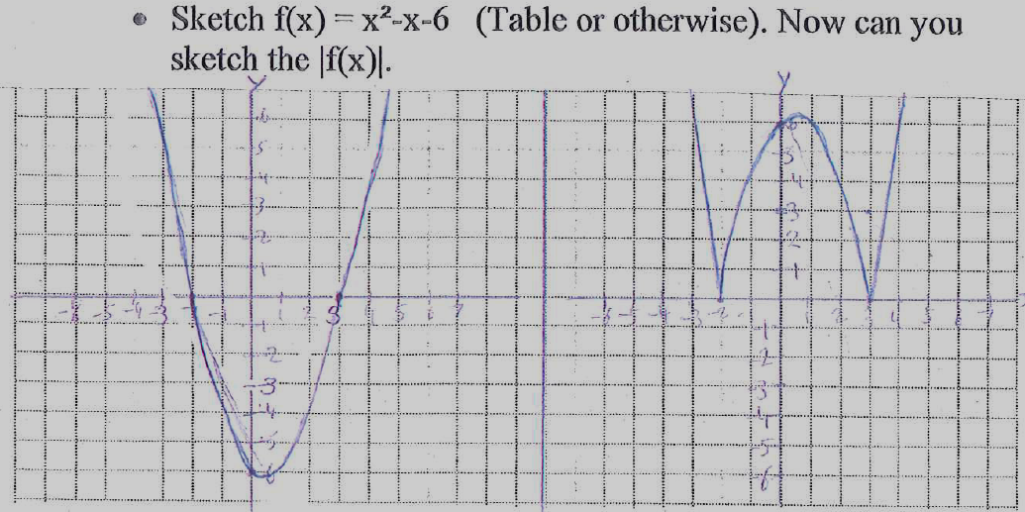

Slide 29
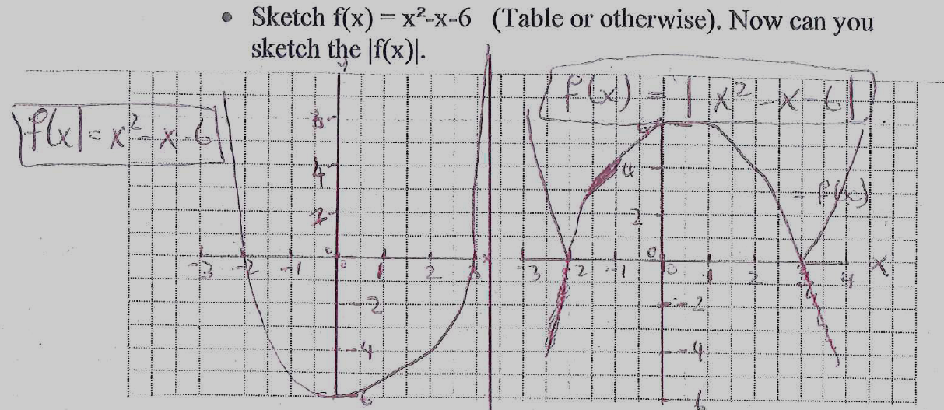

Slide 30
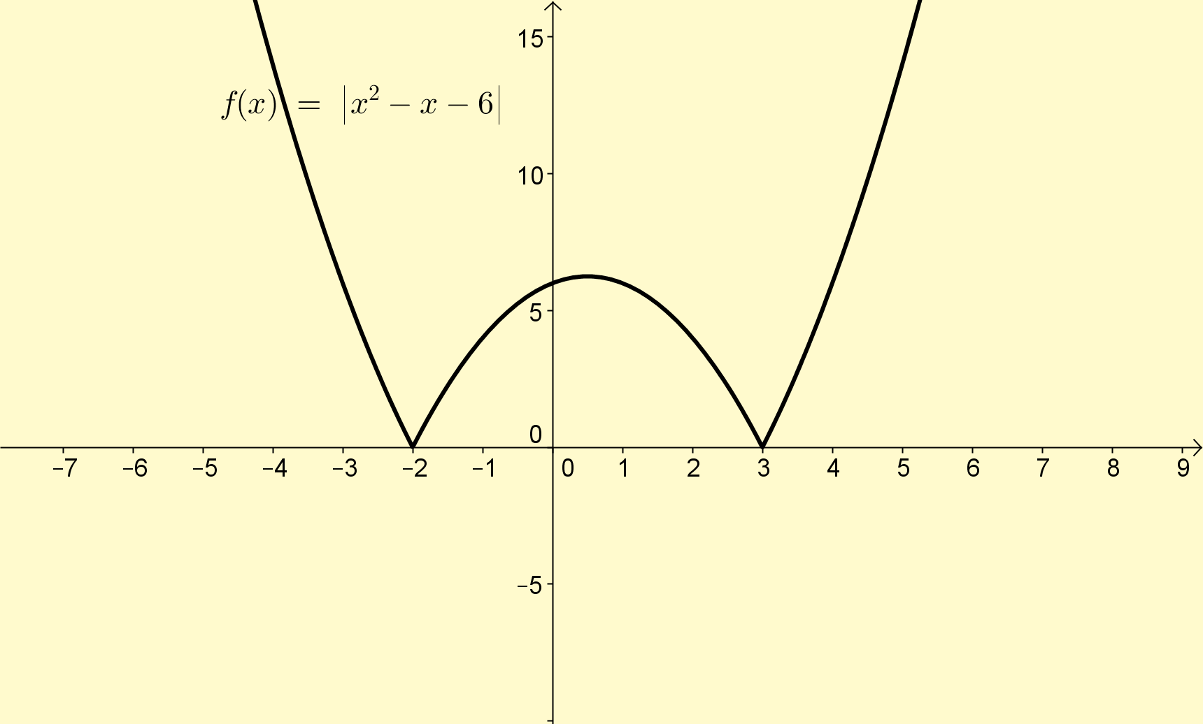
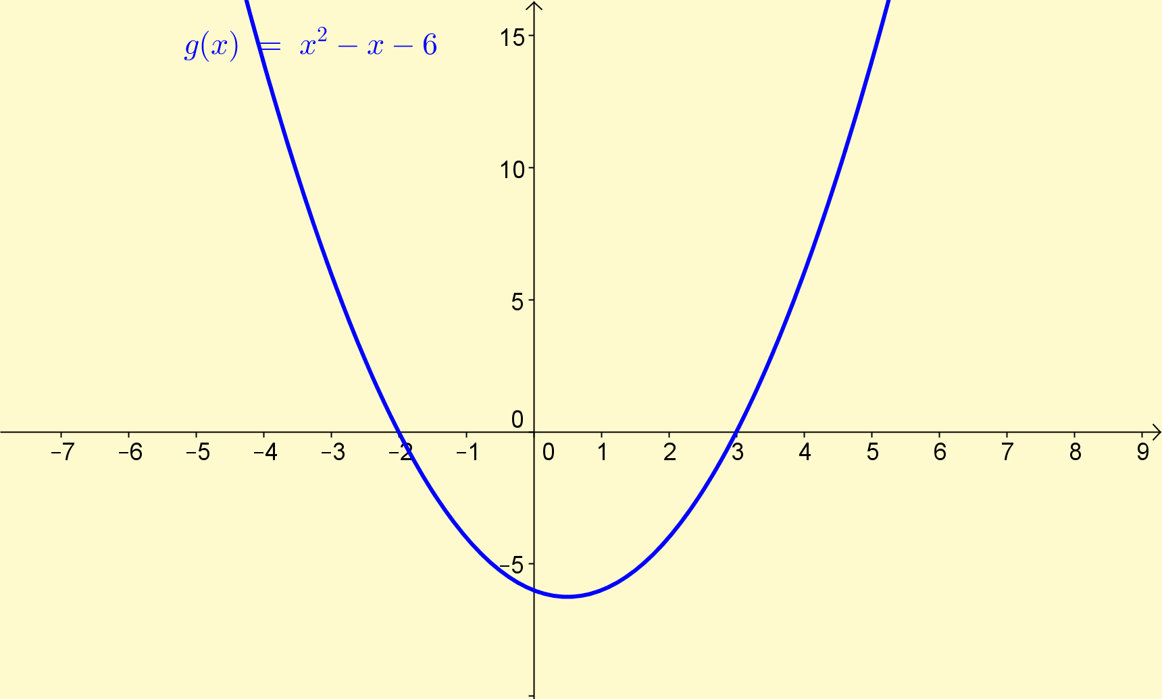

Slide 31
Student work
Solve $\left|x−3\right|=−5$
Axiom 2: The distance |AB| is never negative
??
Misconception

Slide 32
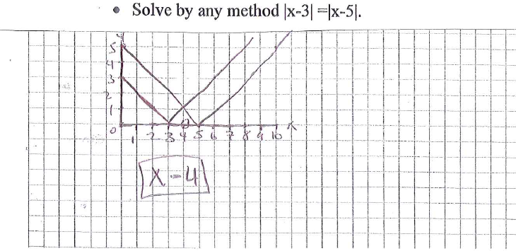
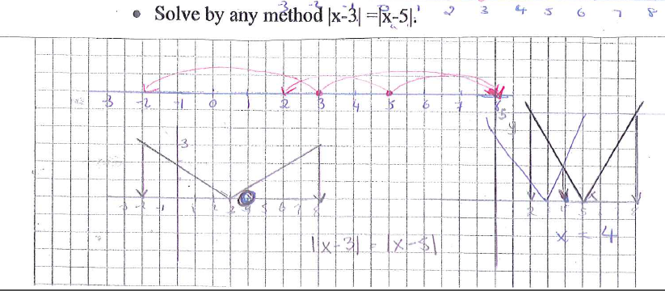
Student work

Slide 33
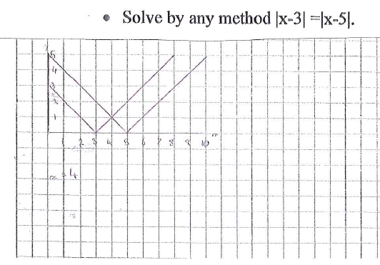
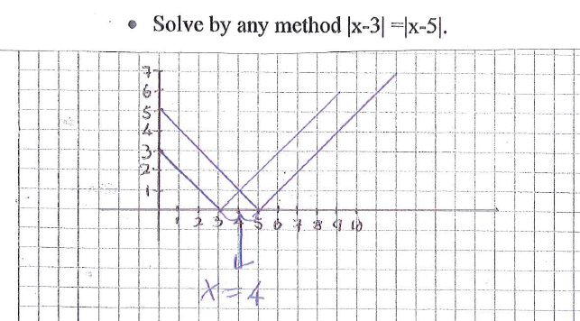
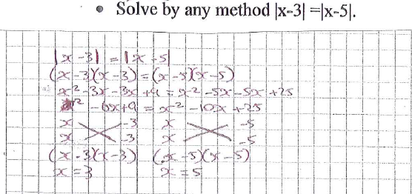
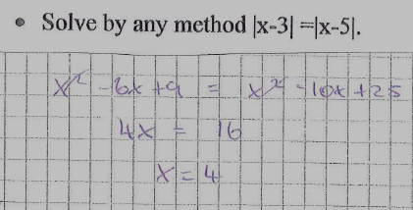
Student work
Repeat student
correct

Slide 34
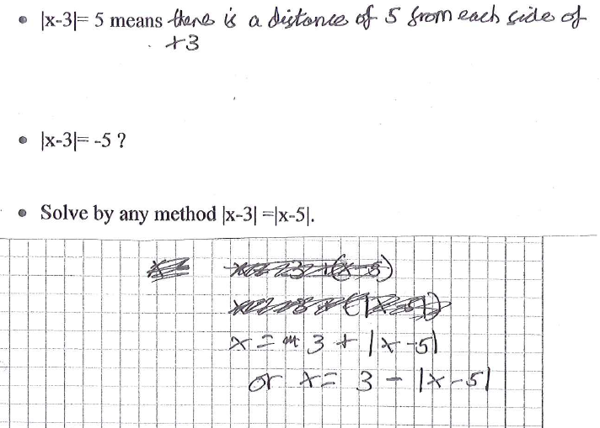

Slide 35
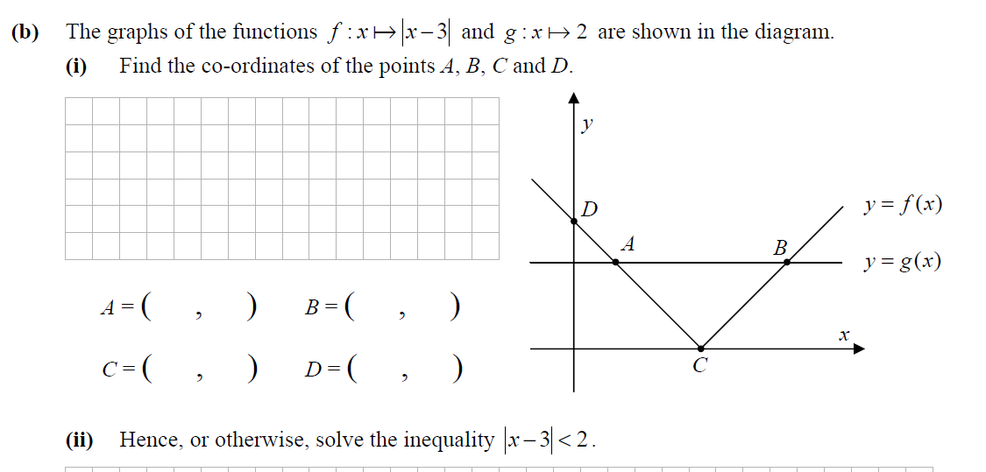
Sample paper 2012 LCHL
Students did this question using conceptual understanding

Slide 36
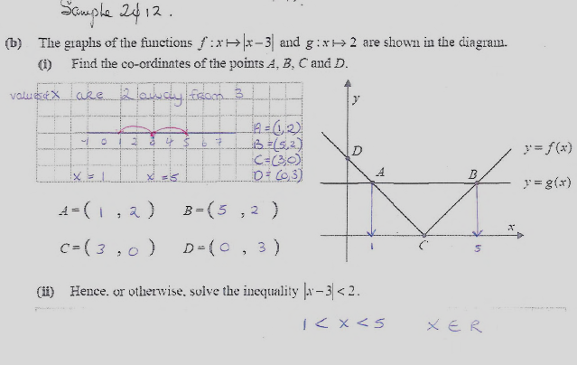
Student work

Slide 37
Student work

Slide 38
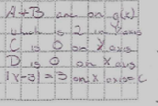
Student work
Showing reasoning

Slide 39
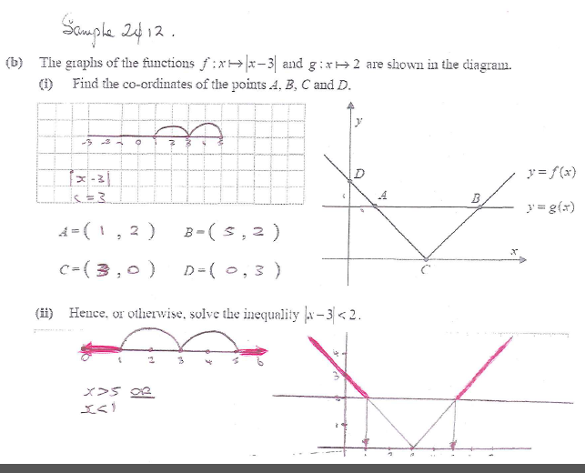
Student work
CMC
Misunderstanding the inequality sign

Slide 40
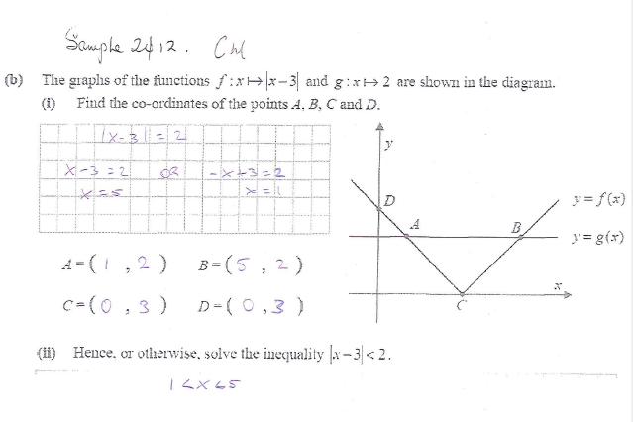
Student work

Slide 41
Effective Student Understanding
What effective understanding of this topic looks like:
Students can verbalise what questions involving modulus equations and modulus inequalities mean.
Students can solve inequalities of the form:
$\left|x−a\right|<b and \left|x−a\right|>b$
and combinations of these, $m$entally, graphically and algebraically

Slide 42
Addressing Misconceptions
Recommendations
The adjustments you have made or would make in the future:
Spend some time revising the inequality notation especially their use in conveying the logic of “AND” and “OR”
Move the modulus of a quadratic graph to an earlier point in the lesson (observer suggestion)
More examples of the interpretation of non-algebraic modulus expressions, with a number line to describe each one

Slide 43
Teaching Strategies
Was it difficult to facilitate and sustain communication and collaboration during the lesson?
No. The worksheet facilitated a natural progression of difficulty keeping students very engaged throughout the lesson. ( Student comment to the observer:- “It was intense!!)

Slide 44
Teaching Strategies
How did I engage and sustain students’ interest and attention during the lesson?
Students had a complete plan for the lesson from the start which allowed them to discover the meaning of absolute value
The work built on prior knowledge to start with but then progressively built on insights gained in the lesson
Questioning throughout as opposed to “telling” moved the lesson forward

Slide 45
Teaching Strategies
How did I assess what students knew and understood during the lesson?
I observed how students completed the worksheet tasks and asked them to make conclusions.
Being able to complete the outcome and conclusions sheet and homework question below showed understanding of the concept.

Slide 46
Reflections on Lesson Study Process
Strengths & Weaknesses
As a mathematics team how has Lesson Study impacted on the way we work with other colleagues?
Greater sharing of ideas on pedagogy
Greater awareness of students’ difficulties in understanding concepts
Greater awareness of need for multi – representations especially the visual/graphical and the verbal
The benefits of the feedback from an observer who solely concentrates on students’ learning
It requires time set aside specifically for this purpose
The time spent planning freed up the teacher during the class
This plan is now available for future classes

Slide 47
Reflections on Lesson Study Process
Strengths & Weaknesses
Personally, how has Lesson Study supported my growth as a teacher?
I gained from the support, the sharing of ideas and the atmosphere of constructive criticism generated by the process
New ways of teaching old concepts!

Slide 48
Reflections on Lesson Study Process
Strengths & Weaknesses
Recommendations as to how Lesson Study could be integrated into a school context.
Incorporate into overall self evaluation process for the Mathematics department
Undertake during Croke Park hours

