Slide 2
Index
Section A: | To introduce geometric sequences (also known as geometric progressions) (GPs) and gain an understanding of the formula $T_{n} = ar^{n−1}$
Section B: | To further explore the concepts of geometric sequences including challenging student exercises
Section C | To explore the characteristic $\frac{T_{n+1}}{T_{n}}$= $\frac{T_{n+2}}{T_{n+1}}$

Slide 3
Section A: Introduction
What is a sequence?
Sequences can be finite or infinite.
Can you give me examples of sequences?
Are all sequences arithmetic?
Can you give me examples of sequences that are not arithmetic?
Do the first three questions in Section A: Student Activity 1 and use the results of these to complete Question 4.
Lesson interaction

Slide 4
Section A: Student Activity 1
1. Nigel saves €2 in the first week of the New Year, if he doubles the amount he saves every week after that, how much will he save in the 2nd, 3rd , 4th and 5th week of the year?
a. Complete the following table and explain your reasoning:
2. The price of an item trebles on the first day of every month. It costs
€2.00 on the 1st January, calculate its cost on the first day of the following four months
a. Complete the following table and explain how you got your calculations:
Week No. | 1st Week | 2nd Week | 3rd Week | 4th Week | 5th Week
Amount Saved
Date. | 1st February | 1st March | 1st April | 1st May
Cost

Slide 5
Section A: Student Activity 1
3. A town had a population of 100. In January 2010, A new factory was being built in the town and consequently, the local authority expected that the town’s population would increase by 20% year-on-year for the next 5 years.
a. Explain clearly how the town’s population in January 2011 is calculated?
b. Complete the following table and explain your reasoning:
4. Examine the completed tables from the previous three questions.
a. Do the numbers you calculated follow any particular pattern in each table?
b. Can you generate a formula to calculate the entries in each of the tables?
Date. | January 2011 | January 2012 | January 2013 | January 2014 | January 2015
Population

Slide 6
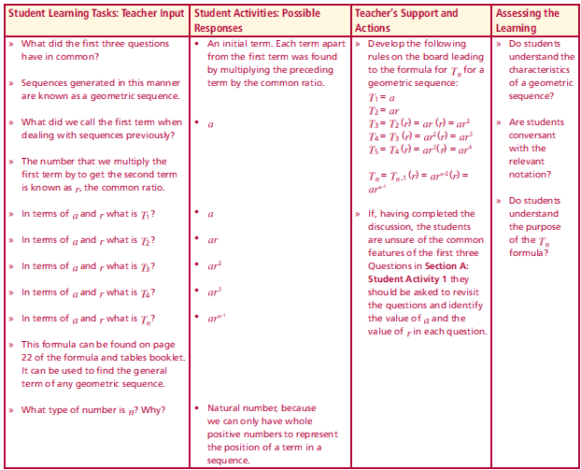
Section A: Student Activity 1
What did the first three questions have in common?
Sequences generated in this manner are known as a geometric sequence.
What did we call the first term when dealing with sequences previously?
The number that we multiply the first term by to get the second term is known as r, the common ratio.
In terms of a and r what is T₁ ?
In terms of a and r what is T₂ ?
In terms of a and r what is T₃ ?
In terms of a and r what is T₄ ?
In terms of a and r what is T_{n} ?
This formula can be found on page 22 of the formula and tables booklet. It can be used to find the general term of any geometric sequence.
What type of number is n? Why?
Lesson interaction
Page 22
Page 23

Slide 7
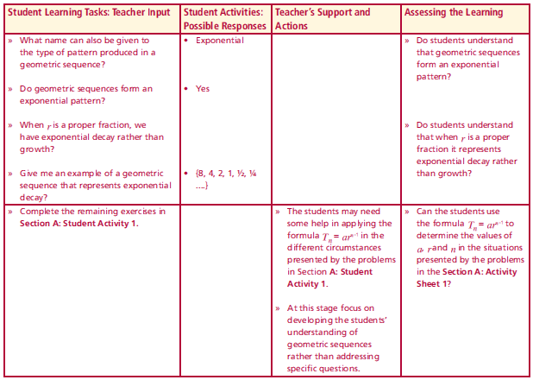
Section A: Student Activity 1
What name can also be given to the type of pattern produced in a geometric sequence?
Do geometric sequences form an exponential pattern?
When r is a proper fraction, we have exponential decay rather than growth?
Give an example of a geometric sequence that represents exponential decay?
Complete the remaining exercises in Section A: Student Activity 1.
Lesson interaction

Slide 8
Section A: Student Activity 1
1. Nigel saves€2 in the first week of the New Year, if he doubles the amount he saves every week after that, how much will he save in the 2nd, 3rd , 4th and 5th week of the year?
2. The price of an item trebles on the first day of every month. It costs
€2.00 on the 1st January, calculate its cost on the first day of the following four months
5. Assuming the patterns in Questions 1 and 2 (above) continue, complete the table below. It is not necessary to evaluate the powers.
For question 1 above what does T₅₀ mean?
Question 1 | Amount saves in the 50th month | Amount saves in the 100th month
Question 2 | Population in January 2020 | Population in January 2040

Slide 9
Section A: Student Activity 1
6. Find $T1 ,T2 ,T3 ,T5 ,T10$and $T100$ of a geometric sequence where $a = 3$and $r =2$. It is not necessary to evaluate the powers.
7. Find $T1 ,T2 ,T3 ,T5 ,T10$and $T100$ of a geometric sequence where $a =1024$and $r =\frac{1}{2}$.
8. A ball is dropped from a height of 4 metres. The ball bounces to 75% of its
previous height after each sequential bounce. How high does the ball bounce on the 1st 2nd , 3rd , 4th and 5th bounce correct to 2 decimal places?
a. Complete the following table.
b. Represent the information on a graph.
$$T1$$ | $$T2$$ | $$T3$$ | $$T5$$ | $$T10$$ | $$T100$$
$$T1$$ | $$T2$$ | $$T3$$ | $$T5$$ | $$T10$$ | $$T100$$
1st Bounce | 2nd Bounce | 3rd Bounce | 4th Bounce | 5th Bounce

Slide 10
Section A: Student Activity 1
9. Seven houses each contain seven cats. Each cat kills seven mice. Each mouse had eaten seven ears of grain. Each ear of grain would have produced seven hekats of wheat. (The hekat was an ancient Egyptian volume unit used to measure grain, bread, and beer.) © http://www.daviddarling.info/encyclopedia/R/Rhind_papyrus.html
Complete the table below and describe the type of sequence formed by numbers.
b. Give the general formula that could be used to generate these numbers.
10. A local club lottery offers a standard first prize of €50 and there is one draw each week. If there is no winner the prize doubles for the following week. This pattern continues until the first prize is won. How much would the first prize be worth if there was no winner for (a) six consecutive weeks and (b) six consecutive months? Show your calculations.
11. If €1,000 is invested at 5% compound interest (assume for this problem the
interest accrues on the anniversary of lodgement date.) How much will be in the
account after 4 years? Show your calculations.
Houses | Cats | Mice | Ears of Grain | Hekats

Slide 11
Section A: Student Activity 1
12. When a coin is tossed there are two possible outcomes, if it is tossed twice
there are four possible outcomes and so on. How many outcomes are there
if the coin is tossed three times? Now complete the table below, (show your
calculations):
13. An antique costing €4,000 appreciates each year by 6% of the value it was at the beginning of that year. Find its value after 11 years. Show your calculations.
14. The value of a car depreciates at an annual rate of 5%. If the car initially cost
€25,000, find:
a. its value at the end of the first year (show your calculations)
b. its value after 8 years? (show your calculations)
15. A frog wants to hop a total distance of 1 metre. The first hop is 1/2 metre
in length, the second is 1/4 metre and the third is 1/8 metre. If this pattern
continues:
a. what will be the length of the 9th hop?
b. how many hops will it take for the frog to travel a total distance of 1m?
(Think carefully before you answer this one.)
No. of Tosses | 10 | 15 | 20 | 30
No. Of Outcomes

Slide 12
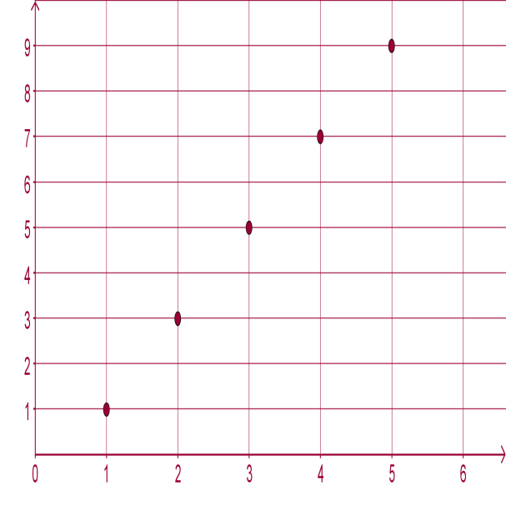
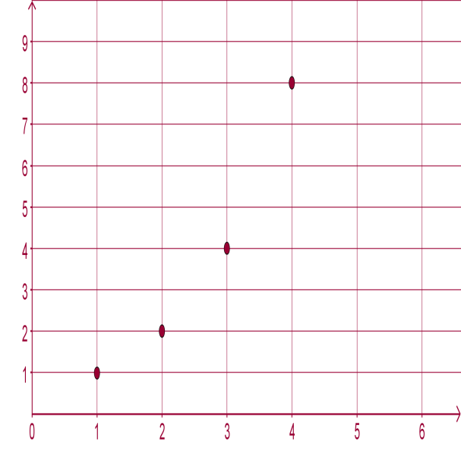
Section A: Student Activity 1
16. The number of pupils in a school increases at the rate of 5% per annum.
When the school opened there were 200 pupils on the roll. How many pupils
will there be in the school on the 10th anniversary of the opening?
17. A novice swimmer can complete the 50m breaststroke in 36s. He follows a
programme designed to increasing improve his performance by 4% each
year. How fast will he complete the 50m breaststroke after six years of the
programme?
18. Tabulate the y coordinate in
each case for the graphs to the
right and decide in each case if
the y co-ordinates form a
geometric sequence.
Give a reason for your answer
in each case.
Graph 1
Graph 2

Slide 13
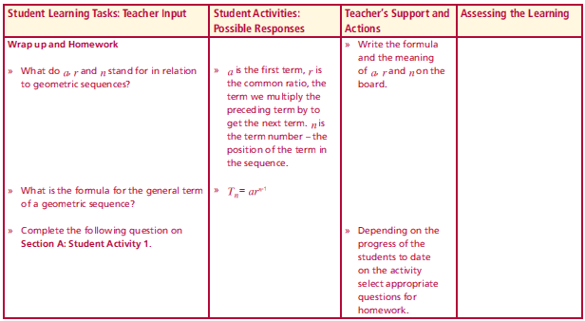
Reflection
What do a, r and n stand for in relation to geometric sequences?
What is the formula for the general term of a geometric sequence?
Lesson interaction

Slide 14
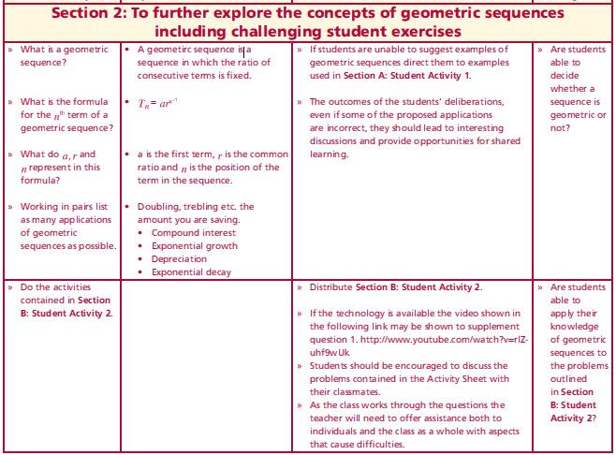
Section B: Introduction
What is a geometric sequence?
What is the formula for the n^{th} term of a geometric sequence?
What do a, r and n represent in this formula?
Working in pairs list as many applications of geometric sequences as possible.
Do the activities contained in Section B: Student Activity 2.
Lesson interaction
Page 22
Page 23

Slide 15
Section B: Student Activity 2
(Calculations must be shown in all cases.)
1. There is a legend that tells how an Indian king promised the inventor of the chessboard a grain of rice for the first square of a chessboard, 2 for the second, 4 for the third, 8 for the fourth square etc. (Note a chessboard has 64 squares). http://www.expert-chess-strategies.com/who-invented-chess.html
a. What weight of rice was on the first square if one grain of rice weighs 20mg?
b. What weight of rice was on the second square if one grain of rice weighs 20mg?
c. What weight of rice was on the fourth square if one grain of rice weighs 20mg?
d. What weight of rice was on the tenth square if one grain of rice weighs 20mg?
e. What weight of was in the last square of the board, if one grain of rice weighs
20mg?
f. Does the weight of rice on consecutive squares of the cheeseboard constitute a geometric sequence? Explain why.

Slide 16
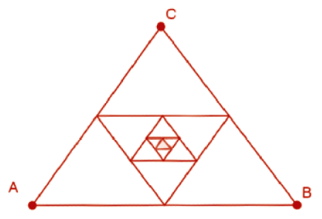
Section B: Student Activity 2
2. As I was going to St. Ives, I met a man with seven wives. Every wife had seven sacks, and every sack had seven cats, every cat had seven kittens.
© http://www.daviddarling.info/encyclopedia/S/St_Ives_problem.html
a. How many wives did I meet?
b. How many sacks did I meet?
c. How many cats did I meet?
d. How many kittens did I meet?
e. Do these numbers constitute a geometric sequence? Explain why.
3. If the perimeter of the equiangular triangle ABC is x cm.
The mid points of the sides are joined to form a smaller triangle
and the process goes on as in the diagram. If the perimeter
of the 6th triangle is 3cm. Find the value of x.
4. If 1,024 tennis players enter a tournament. How many matches must be played in the 6th round if in the tournament the winner of each match moves to the next
round and the loser of each match is removed from the tournament?

Slide 17
Section B: Student Activity 2
5. The first week of July was the busiest week of the year at the Deluxe Hotel. It
had 200 guests that week. In the weeks immediately following this, the bookings
decreased by 5% each week. How many guests did the hotel have in the 10th
week following its busiest week?
6. In a geometric sequences when will the value of terms decrease? When will
they increase?
7. A culture of bacteria doubles every 2 hours. If there are 400 bacteria in the
culture on a given day, how many bacteria will there be at the same time the
following day?
8. If the graph opposite represents the first 4 terms in a
geometric sequence, create a story that could be
represented by the graph.
What values have a and r in the sequence?
T_{n}
n

Slide 18
Section B: Student Activity 2
9. If a, the first term of a geometric sequence is equal to 10 and r, the common
ratio is ½, draw a graphical representation of this geometric sequence.
10. An employee has a starting salary of €20,000 and can choose from two salary
options:
Option 1: A salary increase by 5% each year.
Option 2: A guaranteed increase of €1,000 each year.
a. Which option is initially more beneficial?
b. Which option is more beneficial after 10 years of employment?
c. Explain your reasoning.
11. A line segment is divided into six parts forming a geometric sequence. If the
shortest length is 3cm and the longest is 96cm, find the length of the line
segment. Show your calculations.

Slide 19
Section B: Student Activity 2
12. A local authority decided to control a pest infection in an area by trapping
the pests, it was initially estimated that there were 12,000 of these pests in
the area and the daily rate of trapping is 1% of the number that exist at the
beginning of that particular day.
a. What is the expected number of pests that will be trapped on the first day?
b. What is the expected number of pest that will exist after the 1st day?
c. What is the expected number trapped on the 10th day?
d. What is the expected number of pests that will exist after the 10th day of
trapping?
e. What is the total number of pests trapped after 5 days?
f. What is the population of the pests in this area after 5 days?

Slide 20
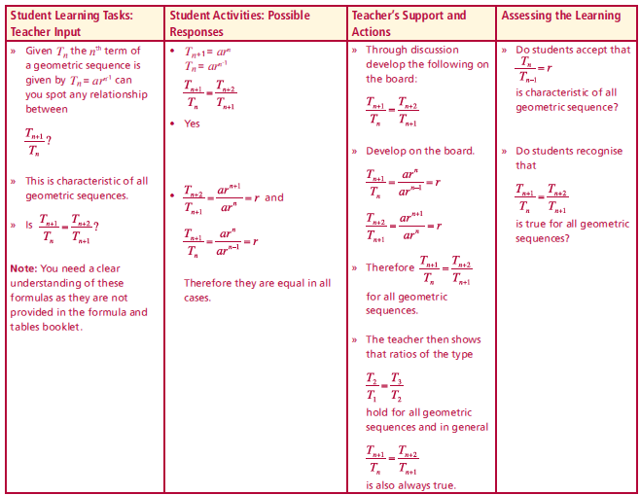
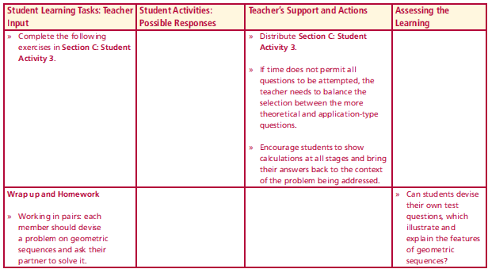
Section C: Introduction
Given $Tn$ the $nth$ term of a geometric sequence is given by $Tn= ar^{n−1}$
can you spot any relationship between
$\frac{T_{n+1}}{T_{n}}$
This is characteristic of all geometric sequences.
Is $\frac{T_{n+1}}{T_{n}}$= $\frac{T_{n+2}}{T_{n+1}}$ ?
Note: You need a clear understanding of these formulas as they are not
provided in the formula and tables booklet.
Complete the following exercises in Section C: Student Activity 3.
Lesson interaction
Lesson interaction

Slide 21
Section C: Student Activity 3
(Calculations must be shown in all cases.)
1. Assuming this pattern continues, determine whether the following are
geometric sequences?
$a$. 75, -25, 5, $b$. 4, 6, 8, 10, $c$. b⁶, b⁵c, b⁴c²,
2. If the first term of a geometric sequence is 1/5 and the fifth term of the same sequence is 81/80, find:
a. r, the common ratio
T₁₀ , the 10th term
3. The first term of a geometric sequence is 6 and the common ratio is 3.
Find T_{n} , the general term.
4. Find r, the common ratio and T_{n}, the general term T_{n} for the following
geometric sequences:
$$a. 64, −96, 144, −216, b. 2, 6, 18, 54,$$
$$c. \frac{2}{3},\frac{1}{3},\frac{1}{6},\frac{1}{12} d. xy, x^{2}y,x^{3}y,x^{4}y$$

Slide 22
Section C: Student Activity 3
5. Insert 3 numbers between 2 and 18 such that the sequence formed is
geometric.
6. Originally Holly and Saoirse were the only employees in a firm. Holly earns €80,000 and the Saoirse earns €10,000. As the firm expands two new positions are created with a pay scale between the two existing staff such that all four yearly salaries will be in geometric sequence. Find the monthly salaries of the two new employees. Show your calculations.
7. In a geometric sequence T₅ = 3 and T₈ = $\frac{3}{8}$, find the common ratio and the first term.
8. If $x − 4 , x + 2$and $3x+ 6$form a geometric sequence, find $x$.

Slide 23
Section C: Student Activity 3
9. Three numbers form an arithmetic sequence. The first term minus the
third term is 8. When the 1st , 2nd and 3rd terms are increased by 3, 5, and 8
respectively, the resulting numbers form a geometric sequence. Find the
common difference of the arithmetic sequence and find the first three
terms of the geometric sequence. Is it true in general that if the terms of a
geometric sequence are increased by a fixed amount the resulting sequence is also geometric.
10. In a firm, all employees have the same starting salary and it increases by a fixed percentage each year. Show the salary pattern of any employee over the first four years of his or her employment. If Joan earns €40,000 and she is in her third year of service and Sally earns €50,000 and is in her fourth year of service. Find the starting salary for employees in this firm.
11. Three numbers of a geometric sequence are $\frac{16}{5},y,\frac{5}{16}$. Find values for $y$.

Slide 24
Section C: Student Activity 3
12. A four year old car is valued at €16,038.00. A year later the same car is valued at €14,434.20. If the value of the car continues to depreciate at a fixed annual rate. Find the original value of the car correct to the nearest euro.

