Slide 1
Random Sampling using RAN#

Slide 2
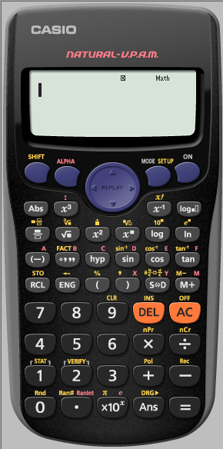
Random Sampling using Ran#
The Ran#: Generates a pseudo random number to 3 decimal places that is less than 1.
i.e. it generates a random number in the range [0, 1]
Ran# is in Yellow

Slide 3
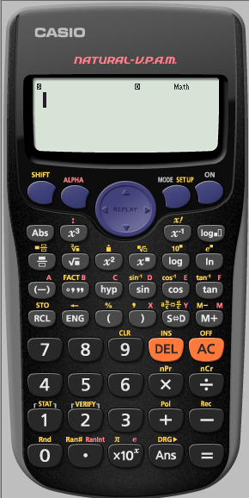
Random Sampling using Ran#

Slide 4
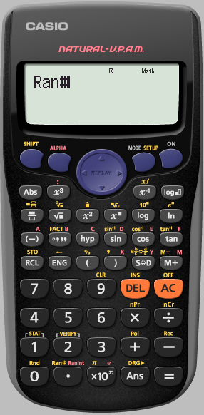
Random Sampling using Ran#
To keep generating a random 3 digit number between
[0,1]
we repeatedly press
=

Slide 5
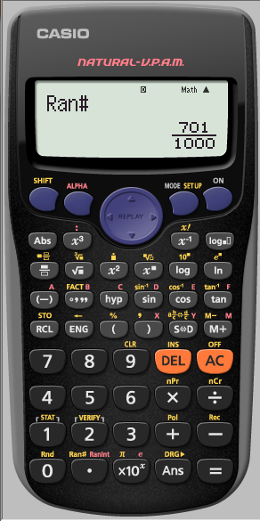
Random Sampling using Ran#

Slide 6
Random Sampling using Ran#
The calculator automatically displays in Natural display.
If we are generating lots of numbers this may become annoying.
We need to SET UP the calculator into Linear Display
(as a single line …Decimals)

Slide 7
Random Sampling using Ran#

Slide 8
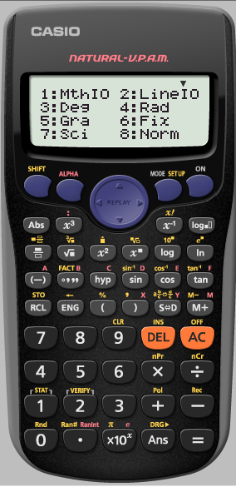
Random Sampling using Ran#
We want it Linear

Slide 9
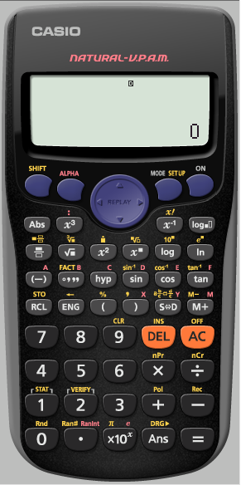
Random Sampling using Ran#
We want a random number again

Slide 10
Random Sampling using Ran#

Slide 11
Random Sampling using Ran#
To keep generating a random 3 digit number between
[0,1]
we repeatedly press
=

Slide 12
Random Sampling using Ran#

Slide 13
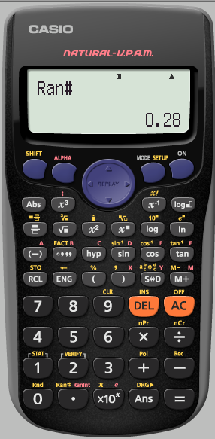
Random Sampling using Ran#

Slide 14
Random Sampling using Ran#
for an interval [1,200]
If we multiply the randomly generated number by 199 then
199 x [0, 1] = [0, 199]
To get it between 1 and 200 we must add 1
199 x [0, 1] + 1 = [1, 200]
But we must first SET UP the calculator to Fix to 0 decimal place

Slide 15
Random Sampling using Ran# for an interval [1,200]
But we must first SET UP the calculator to Fix to 0 decimal place

Slide 16
Random Sampling using Ran# for an interval [1,200]
But we must first SET UP the calculator to Fix to 0 decimal place

Slide 17
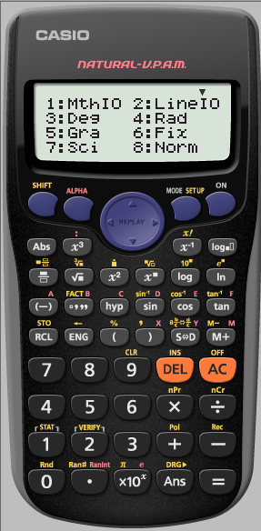
Random Sampling using Ran# for an interval [1,200]
But we must first SET UP the calculator to Fix to 0 decimal place

Slide 18
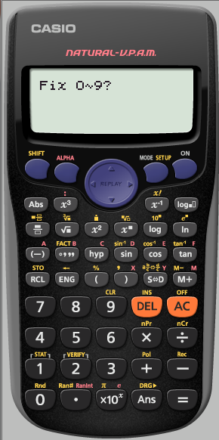
Random Sampling using Ran# for an interval [1,200]
But we must first SET UP the calculator to Fix to 0 decimal place

Slide 19
Random Sampling using Ran# for an interval [1,200]
The calculator tells us it has been
SET UP
To
Fix
We now need to tell it what we want
199 x [0, 1] + 1

Slide 20
Random Sampling using Ran# for an interval [1,200]

Slide 21
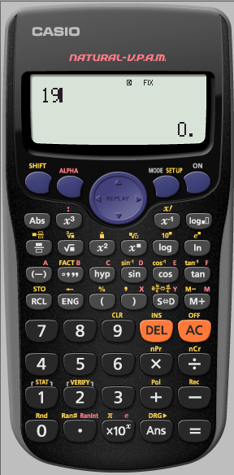
Random Sampling using Ran# for an interval [1,200]

Slide 22
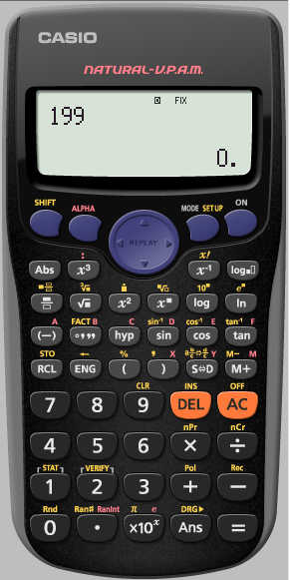
Random Sampling using Ran# for an interval [1,200]

Slide 23
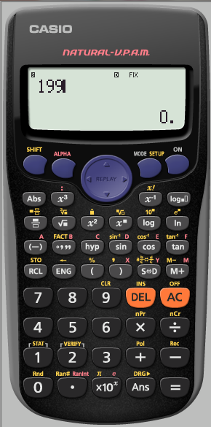
Random Sampling using Ran# for an interval [1,200]

Slide 24
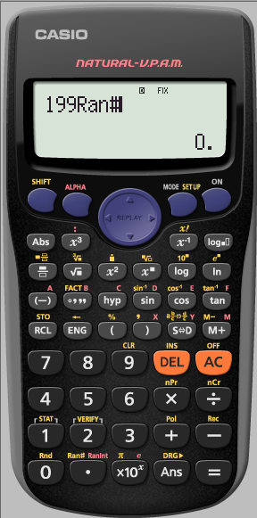
Random Sampling using Ran# for an interval [1,200]

Slide 25
Random Sampling using Ran# for an interval [1,200]

Slide 26
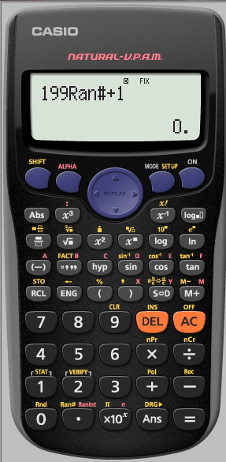
Random Sampling using Ran# for an interval [1,200]

Slide 27
Random Sampling using Ran# for an interval [1,200]

Slide 28
Random Sampling using Ran# for an interval [1,200]

Slide 29
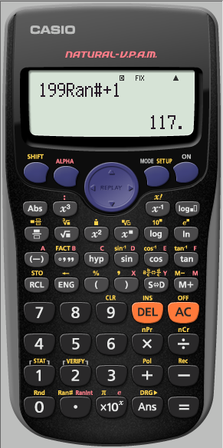
Random Sampling using Ran# for an interval [1,200]

