Slide 1
Inferential Statistics
2015-2016

Slide 2
Overview
L.C. O.L.
Sampling variability
Confidence intervals for population proportion.
Hypothesis testing using confidence intervals
L.C. H.L.
Normal distribution
Sampling variability
Distribution of sample means
Confidence interval for population mean
Distribution of sample proportions
Confidence interval for population proportion
The margin of error
Hypothesis testing using p-values

Slide 3
Inferential Statistics
Leaving Cert. Ordinary Level

Slide 4
Statistical Inference
Ask a question
Census
Gather data
Gather data
Gather data
Sample
Sample
Analyse data
Can we reliably use the results from a single sample to make conclusions about a population?
Draw conclusions

Slide 5
Inferences about proportions

Slide 6
Sampling variability
What proportion of students keep their mobile phone under their pillow at night?

Slide 7
Sampling variability
Make your own statement “The proportion of all students who keep their mobile phone under their pillow at night is _____”
Sample | Statement
1
2
3
4
5
6
7

Slide 8
Sampling variability
Different samples will yield different results (due to random nature of sampling)
How then can we use a single sample to draw conclusions about a population?

Slide 9
Sampling variability

Slide 10
Sampling variability
How can we capture this uncertainty in our statement?
“The proportion of all students who keep their mobile phone under their pillow at night is _____”
The proportion of students who keep their mobile phone under their pillow at night is between 0.1 and 0.45?

Slide 11
A confidence interval
How do we decide on this range if we have one sample only?
How confident can we be that this range captures the population proportion?

Slide 12
The 95% confidence interval
I can be 95% confident that the population proportion lies between
$\begin{matrix}\text{s}\text{ample} \\ \text{proportion}\end{matrix}−\frac{1}{\sqrt{n}}$ & $\begin{matrix}\text{s}\text{ample} \\ \text{proportion}\end{matrix}+\frac{1}{\sqrt{n}}$
Notes:
Students calculate their 95% confident interval

Slide 13
What does 95% confidence mean?

Slide 14
The margin of error
$\frac{1}{\sqrt{n}}$ is often referred to as the margin of error?
Why do you think this is?

Slide 15
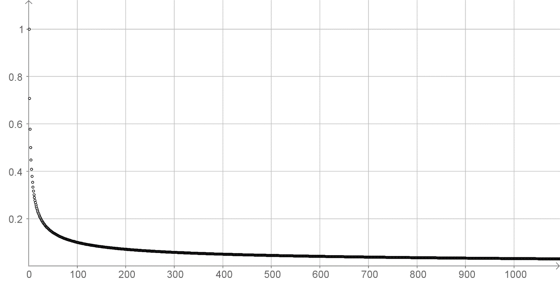
The margin of error
How could you make your margin of error small?
Why should ε depend on n?
ε
n | ε
1 | 1
10 | 0.316
100 | 0.1
500 | 0.045
1000 | 0.032
2000 | 0.022
5000 | 0.014
n

Slide 16
The margin of error
Why might you want to make your margin of error small?

Slide 17
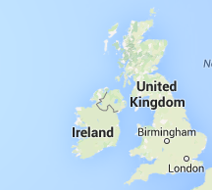
The power of statistics
4.6 million
1.36 billion

Slide 18
Assessment of student understanding

Slide 19
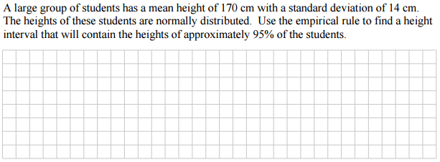
Assessment of student understanding

Slide 20
Hypothesis tests
A political party claims that it has the support of 24% of the electorate. In a sample of 1111 voters, 243 state that they support the party. Is there sufficient evidence to reject the party’s claim, at the 5% significance level?
Step 1. State the null & alternative hypotheses
$H_{0}:$ 0.24 of the electorate support the party
$H_{A}:$ The proportion of the electorate that support the party is not 0.24
$H_{A}:$ 0.24 of the electorate do not support the party
The term “null hypothesis” comes from the idea of a “null effect” or “no change” so $H_{0}$ should be stated as such i.e. as a statement of no change.
Null Hypothesis
$H_{0}$: p$=$0.24
$H_{A}$: p$≠$0.24
intermediate step to help students with language

Slide 21
Hypothesis tests
Step 2. Build a 95% confidence interval for the population proportion.
Step 3. Make conclusion based on whether hypothesised proportion is inside or outside the confidence interval.
I am 95% confident that the population proportion lies between $\frac{243}{1111}−\frac{1}{\sqrt{1111}}$ and $\frac{243}{1111}+\frac{1}{\sqrt{1111}}$.
i.e. the 95% confidence interval for the population proportion is: $0.1887≤p≤0.2487$
Since $p=0.24$ is within the 95% confidence interval I fail to reject the null hypothesis.
There is insufficient evidence to reject the party’s claim at the 5% significance level.

Slide 22
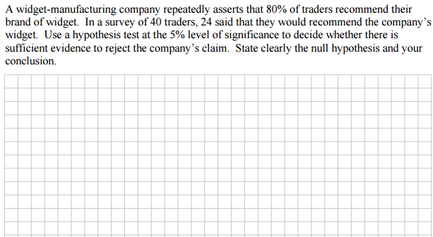
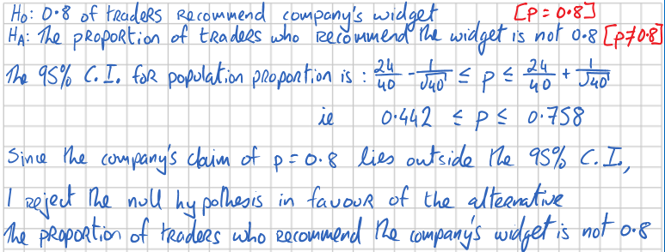
Hypothesis tests

Slide 23
Inferential Statistics
Leaving Cert. Higher Level

Slide 24
Statistical Inference
Ask a question
Census
Gather data
Gather data
Gather data
Sample
Sample
Analyse data
Can we reliably use the results from a single sample to make conclusions about a population?
Draw conclusions

Slide 25
Prior knowledge

Slide 26
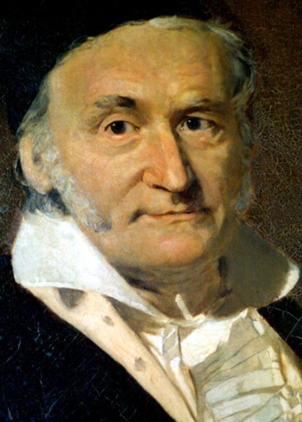
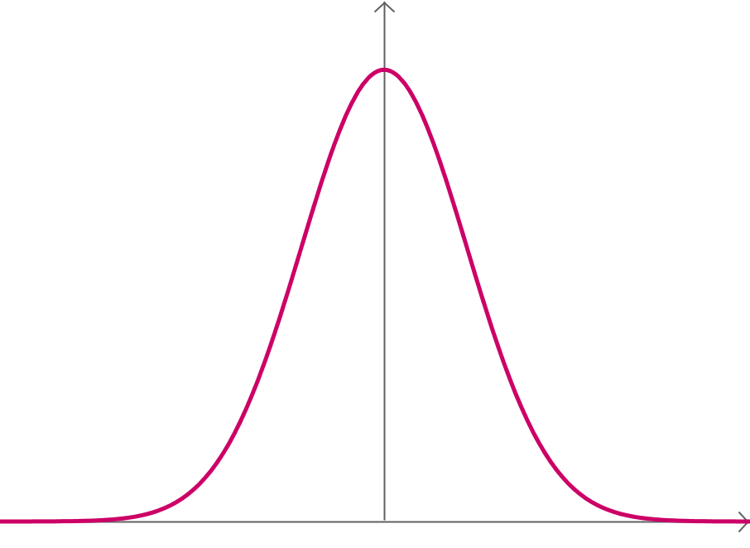
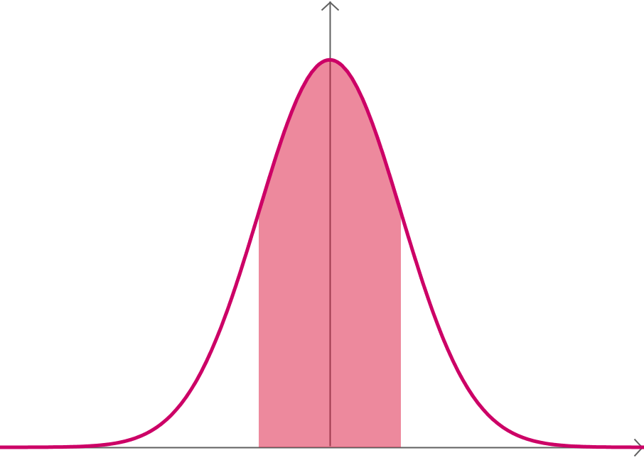
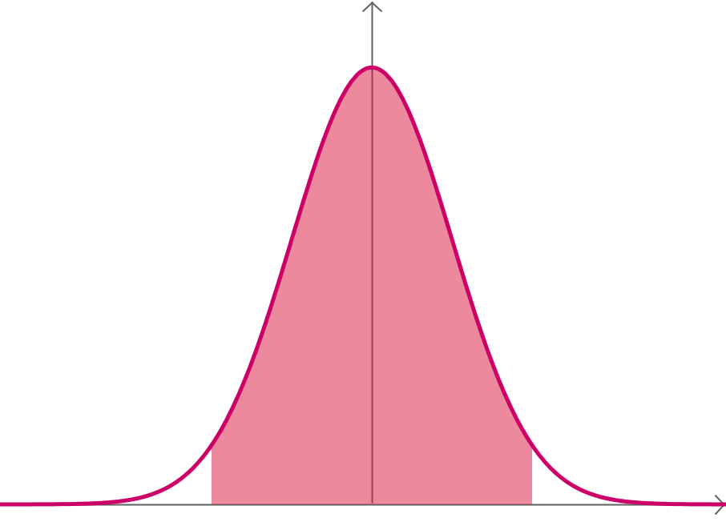
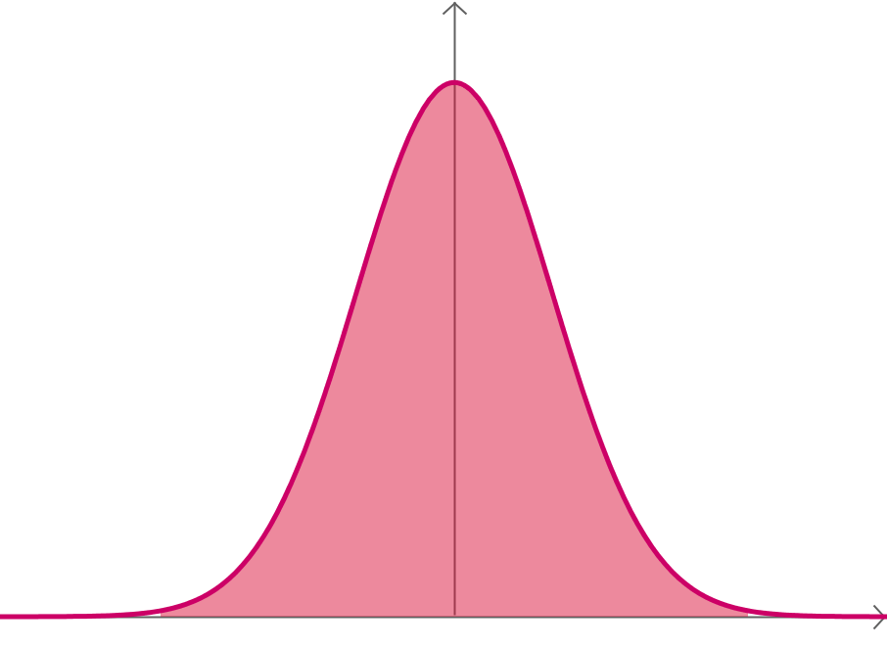
The Normal Distribution
de Moivre
Gauss
Laplace
Quételet
$$z=\frac{x−μ}{σ}$$

Slide 27
The Normal Distribution
The heights of Irish males is normally distributed with a mean of 176 cm and a standard deviation of 6.5 cm.
What proportion of Irish males have heights between 169.5 cm and 182.5 cm?
What proportion of Irish males have heights between 166.5 cm and 185.5 cm?
What proportion of Irish males have heights greater than 190 cm?
What proportion of Irish males have heights equal to 190 cm?
If I choose an Irish male at random, what is the probability he will have a height greater than 190 cm?
If I choose an Irish male at random, what is the probability he will have a height of 190 cm?

Slide 28
Sampling variability
A good understanding of sampling variability lays the foundations for
confidence intervals
hypothesis testing
Sketching the distribution of the sample statistic is a key skill students should develop

Slide 29
Inferences about means

Slide 30
Sampling variability
What is the mean schoolbag weight for Irish secondary-school students?
4.9
4.5
5.2
5.3

Slide 31
Sampling variability
Make your own statement “The mean schoolbag weight for all Irish post-primary students is _____”
Sample | Statement
1
2
3
4
5
6
7

Slide 32
Sampling variability
Sampling variability means we cannot equate the results from a single sample with those for a population.
$$μ≠\overline{x}$$

Slide 33
The distribution of sample means
In spite of this we can still use a single sample to make a valid statement about a population
To do so we need to understand all the possible means we can get when we choose a sample.

Slide 34
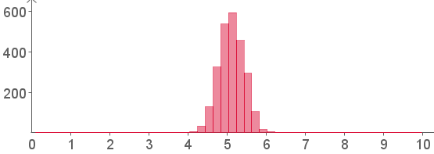
The distribution of sample means
Different samples give different means but the distribution of sample means is normal (for large sample sizes).

Slide 35
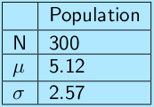
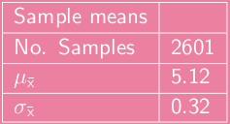
The distribution of sample means
The centre of the distribution ($μ_{\overline{x}}$) is identical to the population centre ($μ$).

Slide 36
The distribution of sample means
The distribution is more compact than the population.

Slide 37
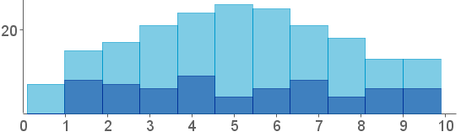
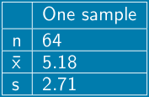
The distribution of sample means
Why is the distribution of sample means more compact than the population?

Slide 38
The distribution of sample means
How does the spread of the distribution of sample means compare to the population?
$$\frac{2.57}{0.32}≅8$$
$$σ_{\overline{x}}=\frac{σ}{\sqrt{n}}$$

Slide 39
The 95% confidence interval
This means I can say with 95% confidence my $\overline{x}$ value lies within 1.96 standard deviations of the centre of my distribution($μ_{\overline{x}}$).
This means I can also say with 95% confidence that the centre of my distribution($μ_{\overline{x}}$) lies within 1.96 standard deviations of my $\overline{x}$ value.

Slide 40
The 95% confidence interval
I can say with 95% confidence that $\overline{x}$ lies within $1.96σ_{\overline{x}}$ of $μ_{\overline{x}}$.
I can say with 95% confidence that $μ_{\overline{x}}$ lies within $1.96σ_{\overline{x}}$ of $\overline{x}$.
I can say with 95% confidence that $μ$ lies within $1.96σ_{\overline{x}}$ of $\overline{x}$.

Slide 41
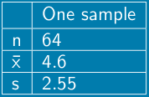
Constructing a 95% confidence interval
I can say with 95% confidence that 4.6 lies within $1.96\frac{2.57}{\sqrt{64}}$ of $μ$
I can say with 95% confidence that $μ$ lies within $1.96\frac{2.57}{\sqrt{64}}$ of 4.6
$$\frac{2.57}{\sqrt{64}}$$
Use $σ$ for building confidence interval if you know its value. Otherwise use s.
$$μ$$
$$μ_{\overline{x}}$$
$$4.6−1.96\frac{2.57}{\sqrt{64}}≤μ≤4.6+1.96\frac{2.57}{\sqrt{64}}$$

Slide 42
Constructing a 95% confidence interval
$$\frac{2.57}{\sqrt{64}}$$
$$\frac{2.55}{\sqrt{64}}$$
$$μ$$
$$4.6−1.96\frac{2.55}{\sqrt{64}}≤μ≤4.6+1.96\frac{2.55}{\sqrt{64}}$$

Slide 43
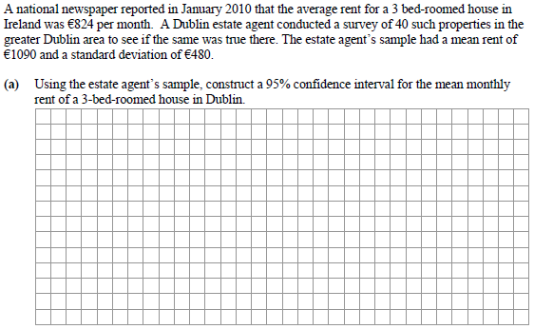
Assessment of student understanding

Slide 44
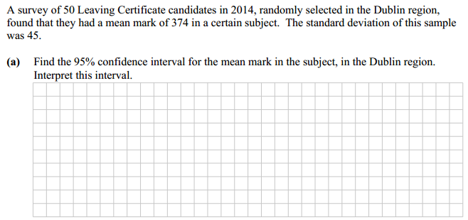
Assessment of student understanding

Slide 45
Summary
Due to sampling variability I cannot say $μ=\overline{x}$.
Due to the normal shape of the distribution of sample means I can say with 95% confidence that $μ$ lies within $1.96σ_{\overline{x}}$ of $\overline{x}$.
$$\overline{x}−1.96\frac{σ}{\sqrt{n}}≤μ≤\overline{x}+1.96\frac{σ}{\sqrt{n}}$$

Slide 46
Inferences about proportions

Slide 47
Sampling variability
What proportion of students keep their mobile phone under their pillow at night?

Slide 48
Sampling variability
Make your own statement “The proportion of all students who keep their mobile phone under their pillow at night is _____”
Sample | Statement
1
2
3
4
5
6
7

Slide 49
Sampling variability
Sampling variability means we cannot equate the results from a single sample with those for a population.
$$p≠\hat{p}$$

Slide 50
The distribution of sample proportions
In spite of this we can still use a single sample to make a valid statement about a population
To do so we need to understand all the possible proportions we can get when we choose a sample.

Slide 51
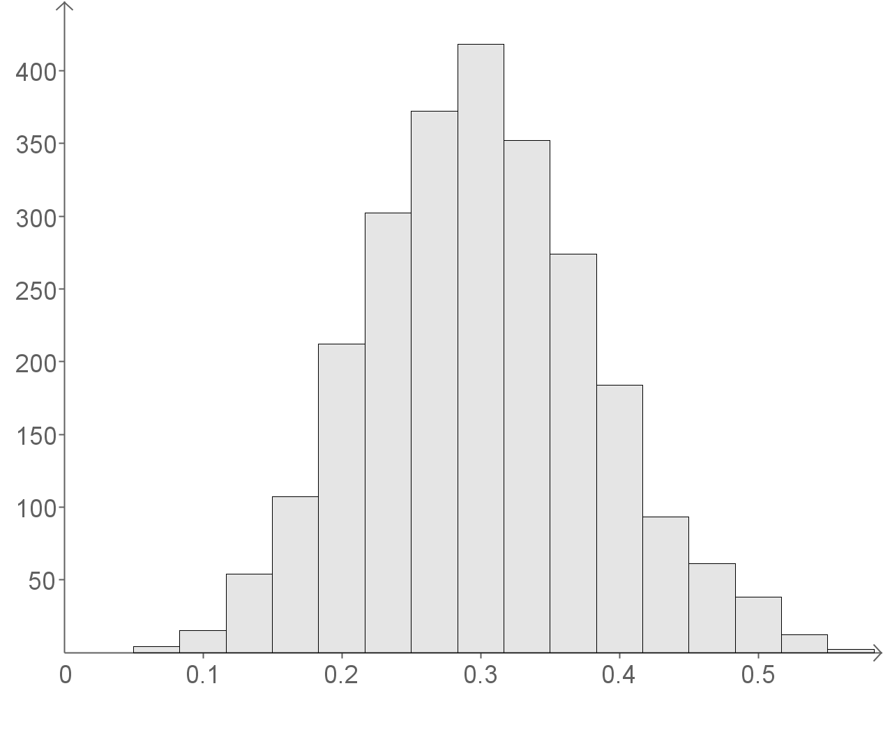
The distribution of sample proportions
Different samples give different proportions but they all follow a normal distribution.

Slide 52
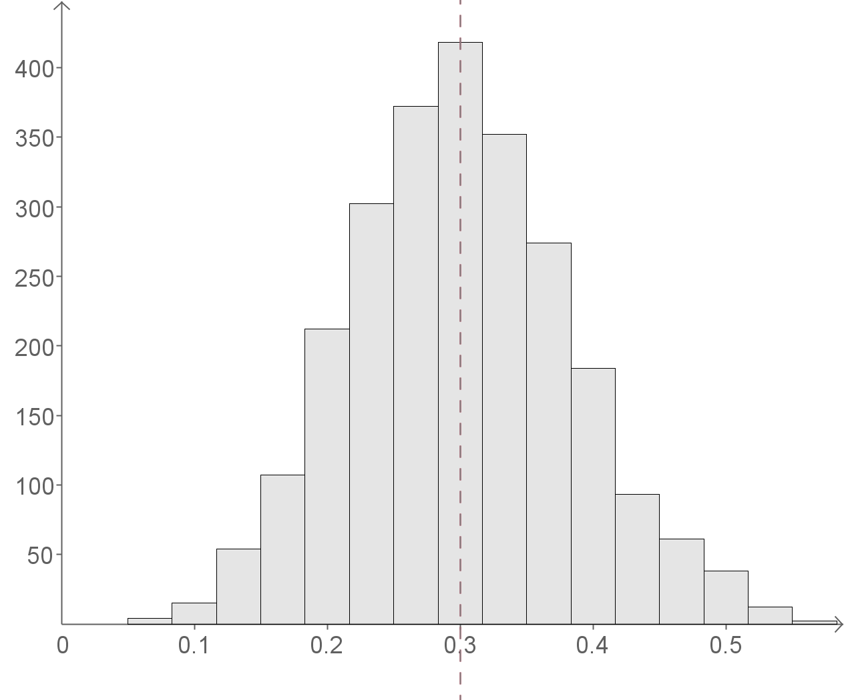
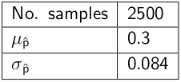
The distribution of sample proportions
The centre of the distribution ($μ_{\hat{p}}$) is identical to the population proportion ($p$).

Slide 53
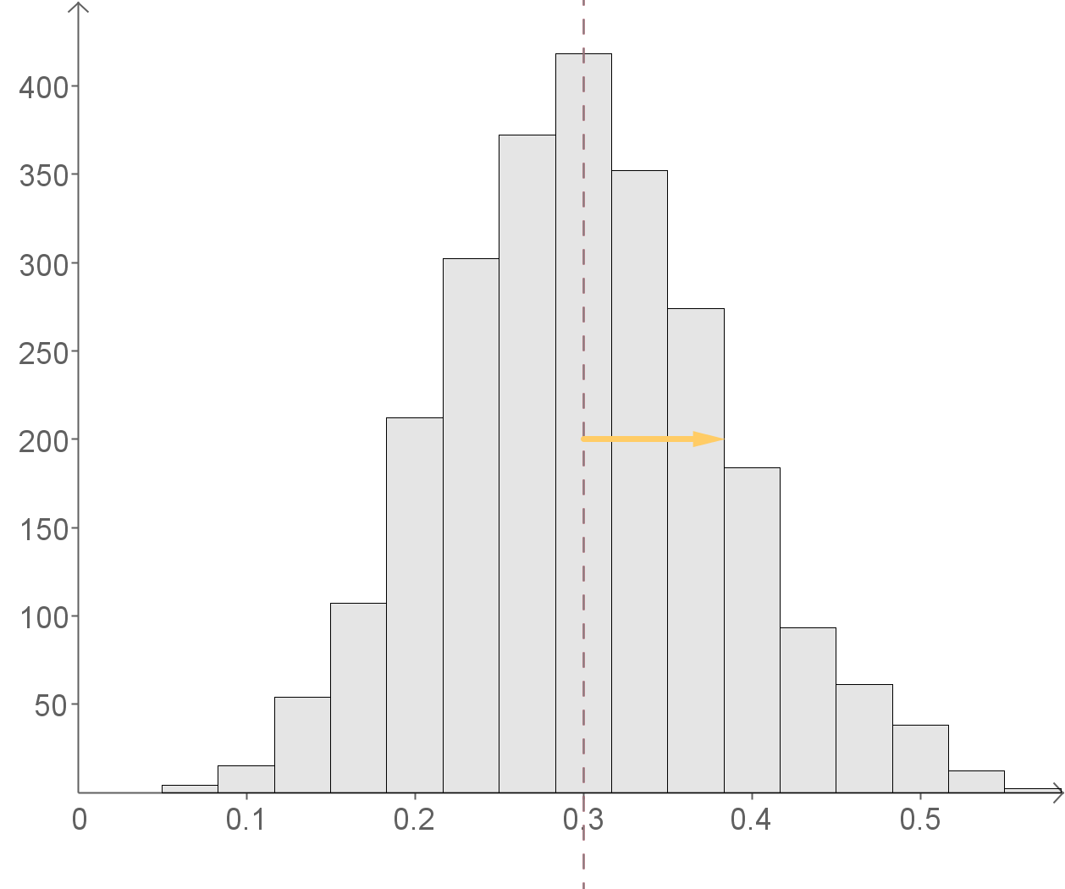
The distribution of sample proportions
The standard deviation of the distribution is given by $σ_{\hat{p}}=\sqrt{\frac{p(1−p)}{n}}$

Slide 54
The 95% confidence interval
This means I can say with 95% confidence that my $\hat{p}$ value lies within $1.96$ standard deviations of the centre of the distribution.
This also means I can say with 95% confidence that the centre of the distribution lies within $1.96$ standard deviations of my $\hat{p}$ value.

Slide 55
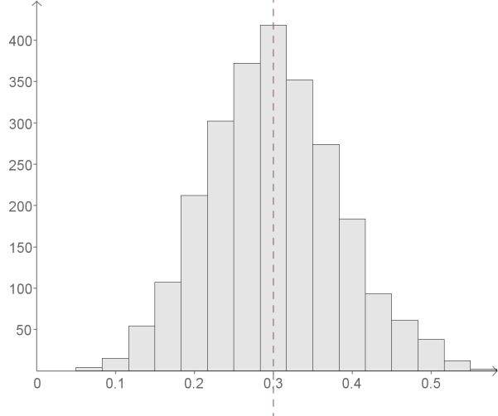
The 95% confidence interval
I can say with 95% confidence that $\hat{p}$ lies within $1.96σ_{\hat{p}}$of $μ_{\hat{p}}$.
I can say with 95% confidence that $μ_{\hat{p}}$ lies within $1.96σ_{\hat{p}}$ of $\hat{p}$.
I can say with 95% confidence that $p$ lies within $1.96σ_{\hat{p}}$of $\hat{p}$.

Slide 56
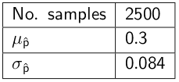
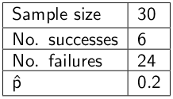
Constructing a 95% confidence interval
I can say with 95% confidence that 0.2 lies within $1.96\sqrt{\frac{(0.2)(0.8)}{30}}$ of $p$.
I can say with 95% confidence that $p$ lies within $1.96\sqrt{\frac{(0.2)(0.8)}{30}}$ of 0.2.
$$\sqrt{\frac{(0.2)(0.8)}{30}}$$
Use $p$ for building confidence interval if you know its value. Otherwise use $\hat{p}$.
$$μ_{\hat{p}}$$
$$p$$

Slide 57
Constructing a 95% confidence interval
The 95% confidence interval for the population proportion is:
$$0.2−1.96\sqrt{\frac{\left(0.2\right)\left(0.8\right)}{30}}≤ p ≤0.2+1.96\sqrt{\frac{(0.2)(0.8)}{30}}$$

Slide 58
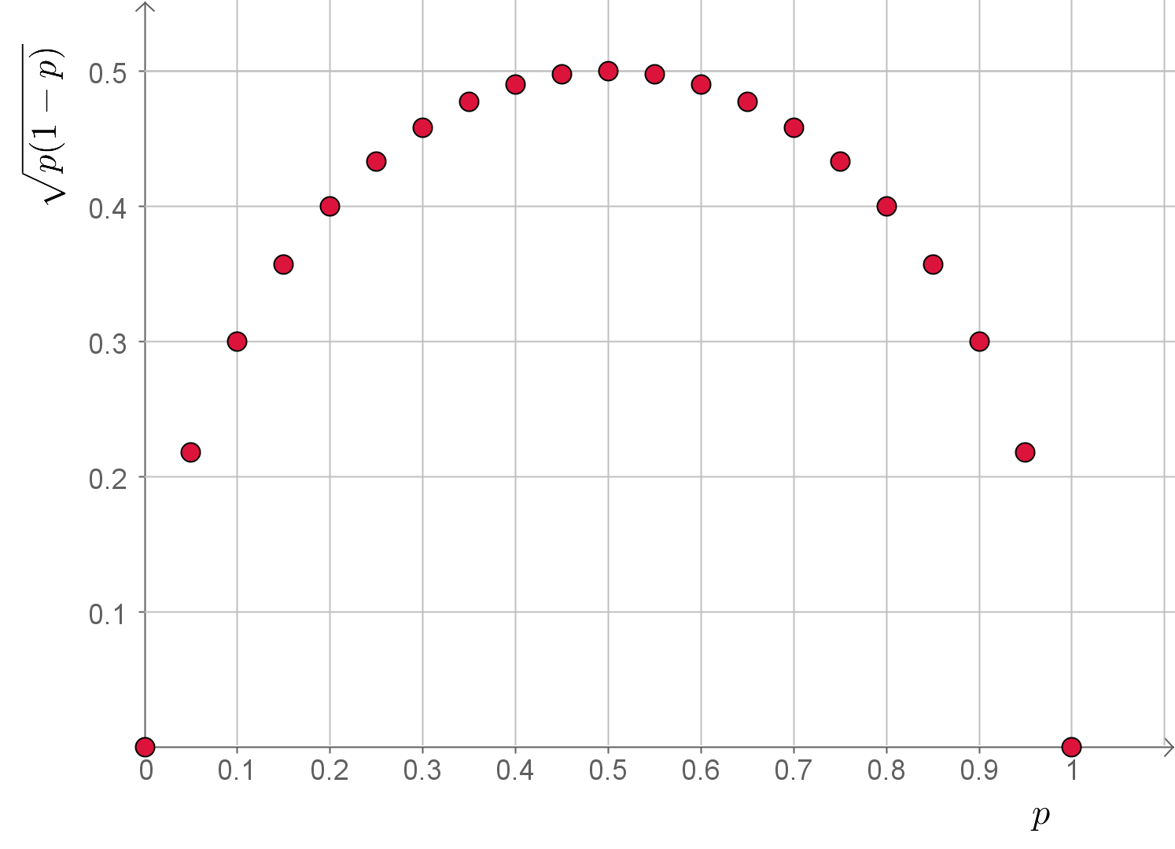
The margin of error
$1.96\sqrt{\frac{\left(p\right)\left(1−p\right)}{n}}≤\frac{1}{\sqrt{n}}$

Slide 59
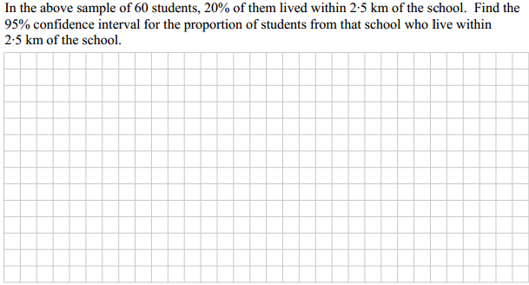
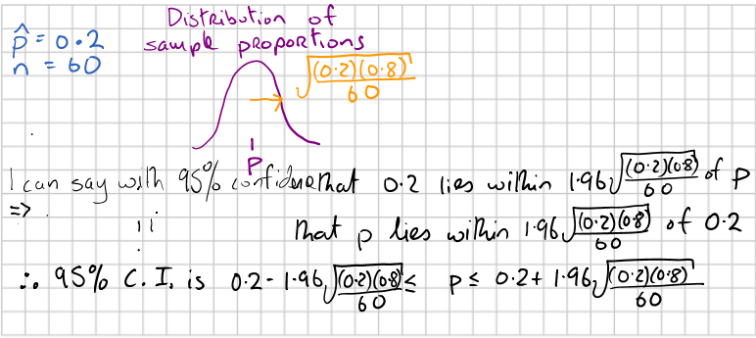
Assessment of student understanding

Slide 60
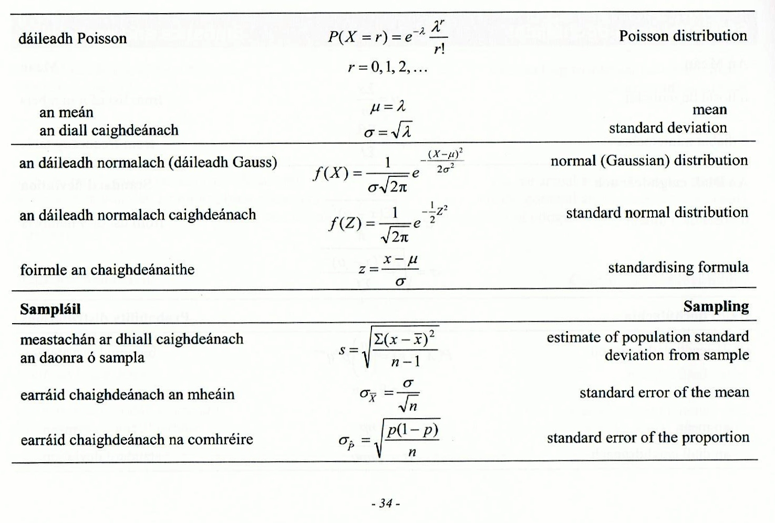
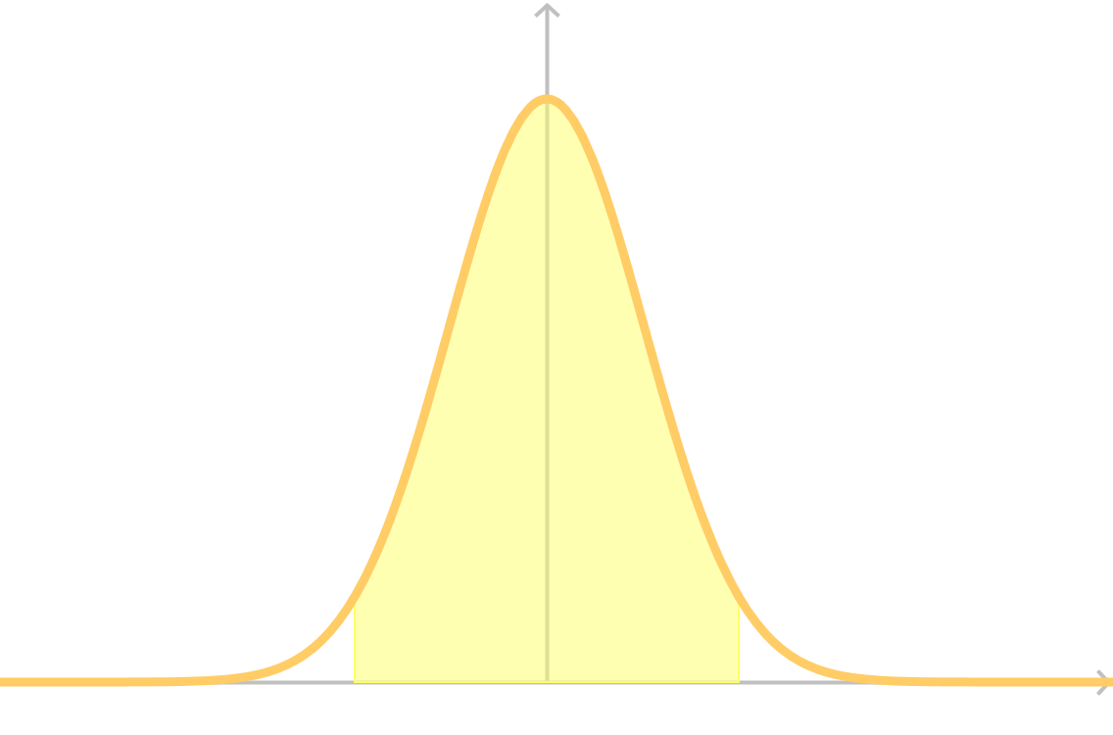
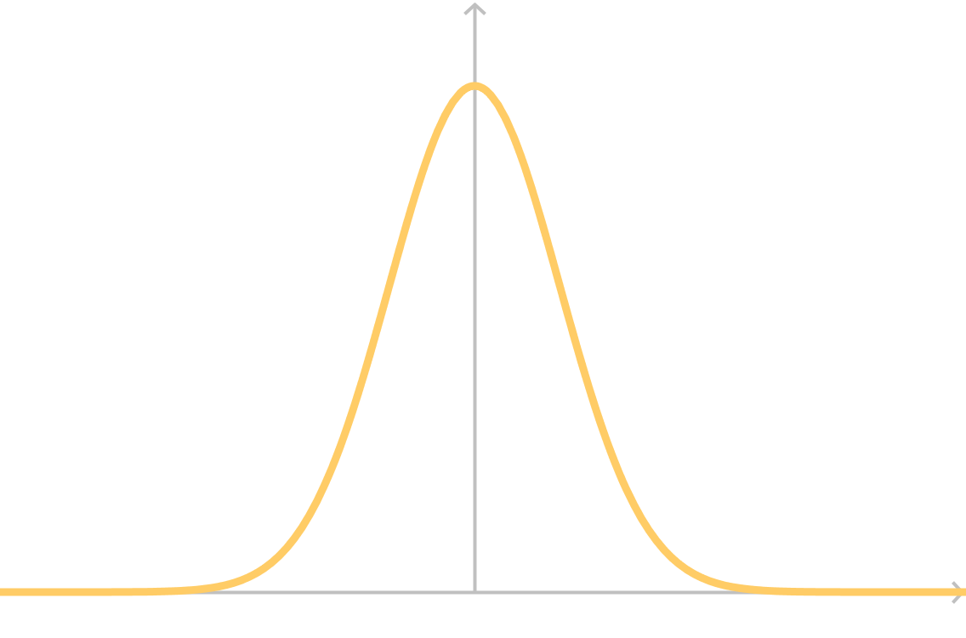
Summary
Means
I can say with 95% confidence that $μ$ lies within $1.96σ_{\overline{x}}$ of my $\overline{x}$ value.
Proportions
I can say with 95% confidence that $p$ lies within $1.96σ_{\hat{p}}$ of my $\hat{p}$ value.
$$σ_{\hat{p}}=\sqrt{\frac{\left(p\right)\left(1−p\right)}{n}}$$
Formulae
$$σ_{\overline{x}}=\frac{σ}{\sqrt{n}}$$
$$μ_{\overline{x}}=μ$$
$$μ_{\hat{p}}=p$$

Slide 61
Hypothesis testing using p-values
Hypothesis tests are based on understanding the properties of the distribution of the sample means (or sample proportions).

Slide 62
Hypothesis testing using p-values
The mean amount of time spent daily on homework & study by Leaving Cert. students in 2013-2014 was 5.4 hours with a standard deviation of 1.8 hours.
A guidance counsellor surveys 50 Leaving Cert. students in his school during 2014-2015 and finds that the mean amount of time spent on homework is 5.1 hours.
By carrying out a hypothesis test at the 5% significance level, determine if the results for 2014-2015 are consistent with those for 2013- 2014.

Slide 63
Hypothesis testing using p-values
H₀: The mean amount of time spent studying by Leaving Cert. students in 2014-2015 is 5.4 hours.
H₁: The mean amount of time spent studying by Leaving Cert. students in 2014-2015 is not 5.4 hours.

Slide 64
The language of a hypothesis test
The term “null hypothesis” comes from the idea of a “null effect” or “no change” so $H_{0}$ should be stated as such i.e. as a statement of no change
H₀: The mean amount of time spent studying by Leaving Cert. students in 2014-2015 is 5.4 hours
The mean amount of time spent daily on homework & study by Leaving Cert. students in 2013-2014 was 5.4 hours with a standard deviation of 1.8 hours.
A guidance counsellor surveys 50 Leaving Cert. students in his school during 2014-2015 and finds that the mean amount of time spent on homework is 5.1 hours.

Slide 65
The language of a hypothesis test
The term “null hypothesis” comes from the idea of a “null effect” or “no change” so $H_{0}$ should be stated as such i.e. as a statement of no change
$H_{0}:$ The proportion of properties in negative equity in 2012 is $\frac{145 414}{474 136}$
$p:$ proportion of properties in negative equity in 2012
$H_{0}:$ $p=\frac{145 414}{474 136}$

Slide 66
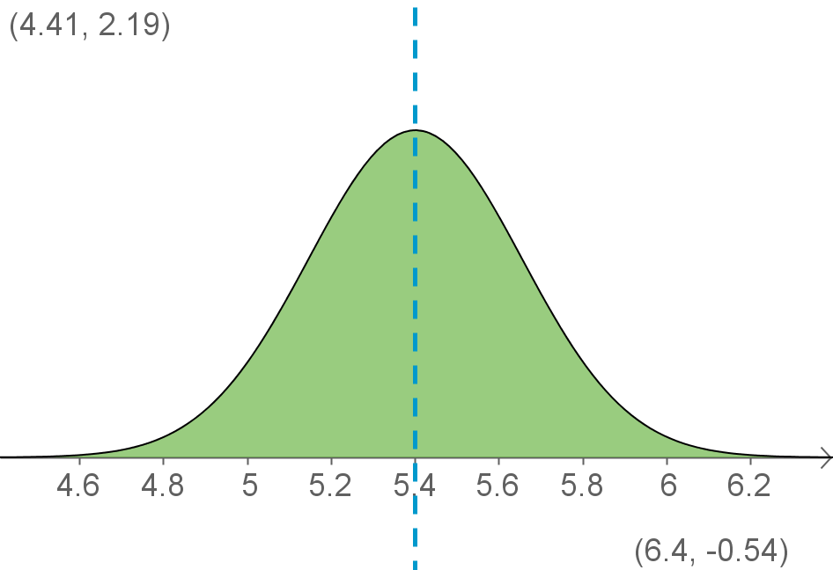
Hypothesis testing using p-values
If H₀ is true we’d expect the distribution of sample means to be:
$$σ_{\overline{x}}=\frac{1.8}{\sqrt{50}}$$
$$μ_{\overline{x}}=5.4$$

Slide 67
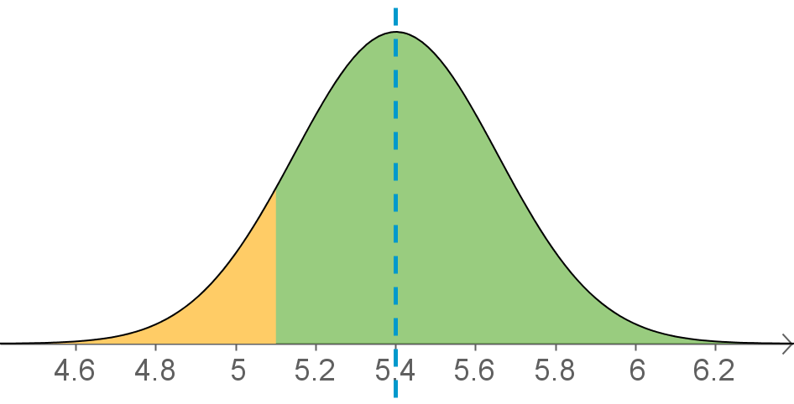
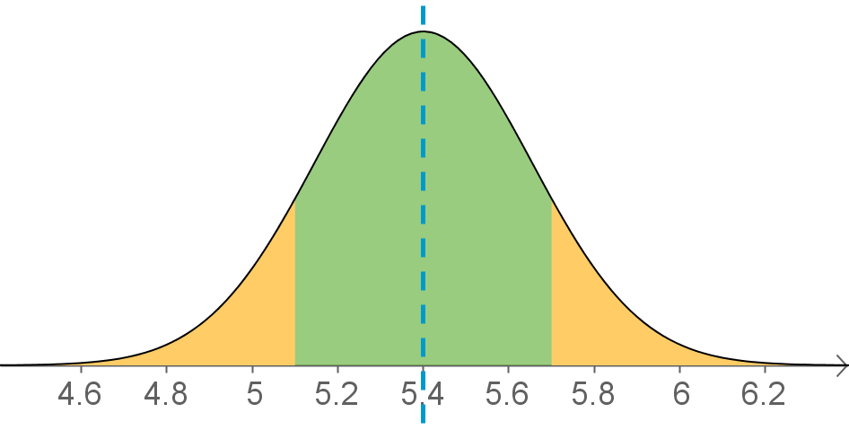
Hypothesis testing using p-values
If H₀ is true how likely am I to get a sample mean of 5.1 due to variability?
Because of the hypothesis I need to determine how likely I am to get a sample mean of 5.1 or 5.7?
Because of the properties of the normal distribution I need to determine how likely I am to get a sample mean of less than (or equal to) 5.1 or greater than (or equal to) 5.7.

Slide 68
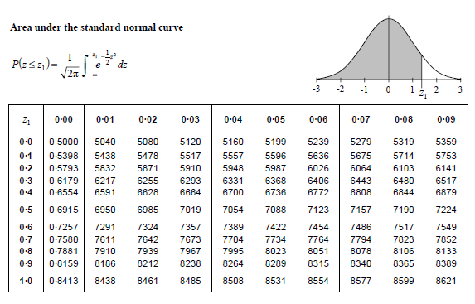
Hypothesis testing using p-values
Use z-scores to determine this probability
$$\left|z\right|=\frac{5.4−5.1}{\frac{1.8}{\sqrt{50}}}=1.18$$
$$P\left(\left|z\right|≥1.18\right)=2(1−0.8810)$$
$P\left(\left|z\right|≥1.18\right)=$0.238

Slide 69
Hypothesis testing using p-values
If this probability is really small, this implies that the sampling distribution is unlikely to be centred on the hypothesised value (assuming the given standard deviation)
How small is small?
5%
0.05

Slide 70
What does the p-value mean?
probability of getting results at least as unusual as the observed mean given that the null hypothesis is true.

Slide 71
What does the level of significance mean?
The probability boundary around which you either reject or fail to reject the null hypothesis. If p $>$ significance level, fail to reject the null hypothesis. If p $<$ significance level, reject the null hypothesis.
The probability of rejecting the null hypothesis even if it’s true.

Slide 72
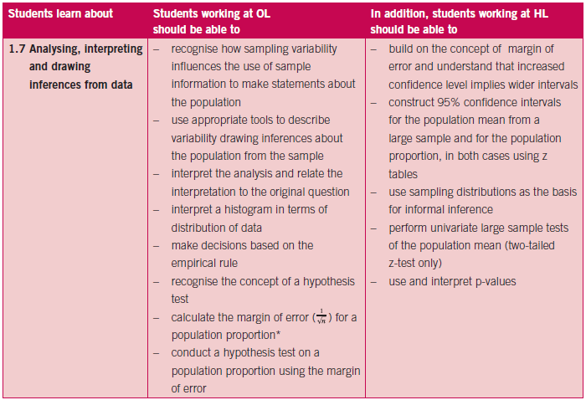
Assessing student understanding
The syllabus

Slide 73
Assessing student understanding
The syllabus

Slide 74
Alternative approach using p values
The syllabus

Slide 75
Alternative approach using p values
Use $p$ if known. Otherwise use $\hat{p}$.
The syllabus

Slide 76
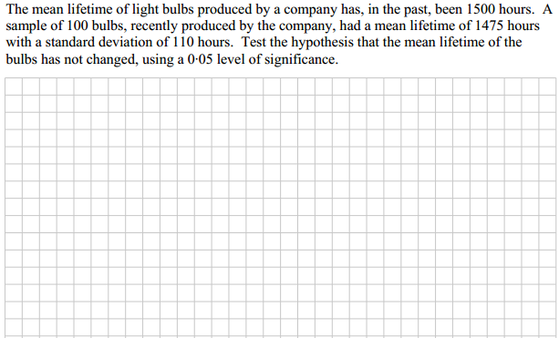
Assessing student understanding
Use $σ$ if known. Otherwise use s.

Slide 77
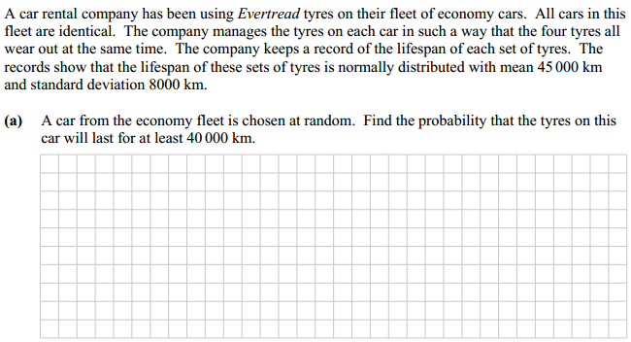
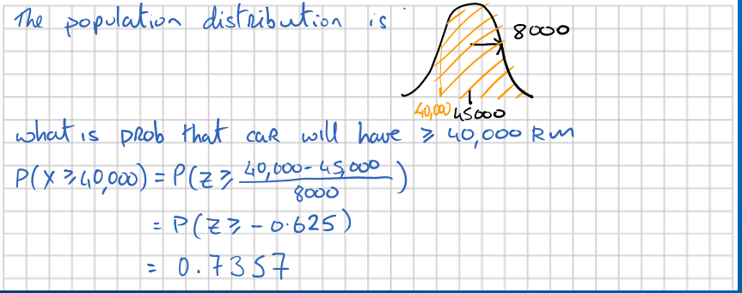
Assessing student understanding

Slide 78
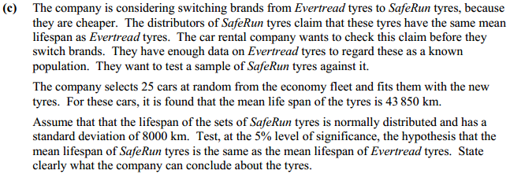
Assessing student understanding

Slide 79
Assessing student understanding

Slide 80
Summary
Hypothesis testing is built on a good understanding of
z-scores
the distribution of the sample statistic

