Slide 1
Shifting
&
Scaling Quiz

Slide 2
Activity 2
Graph | Function | Local Maximum/Minimum
1
2
3
4
5
6
7
8
9
10
35

Slide 3
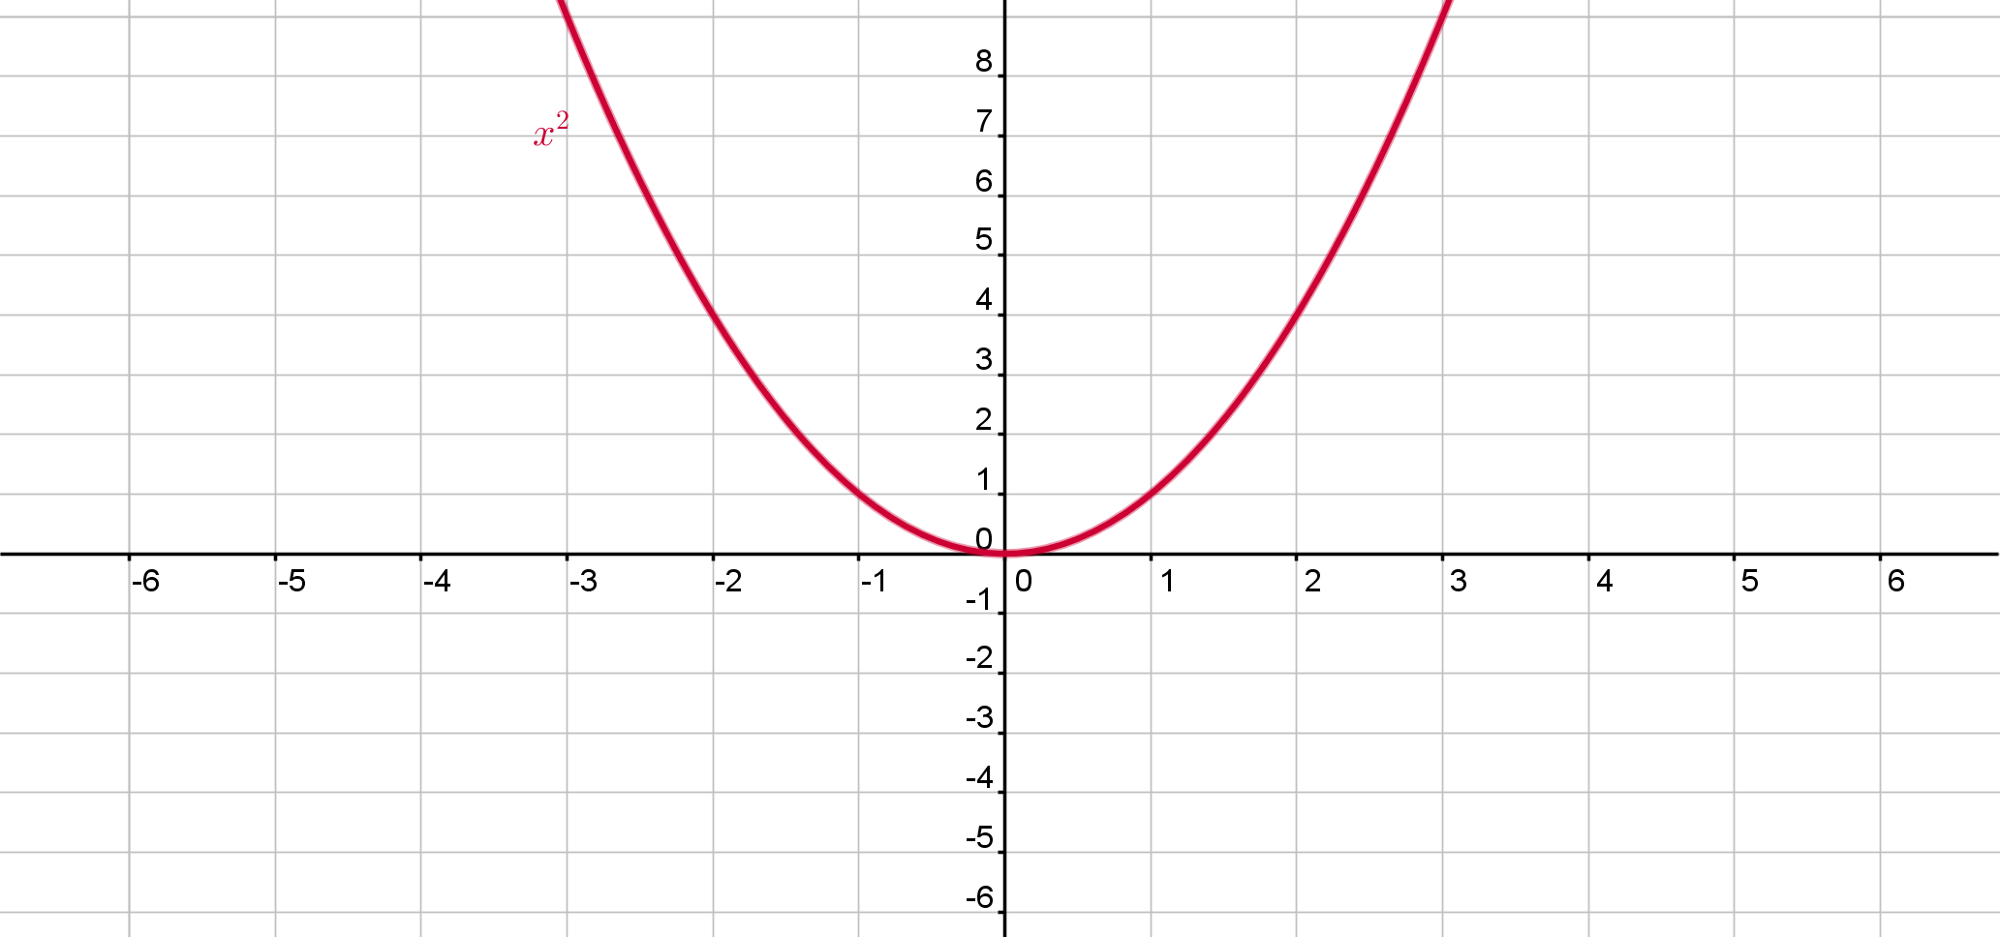
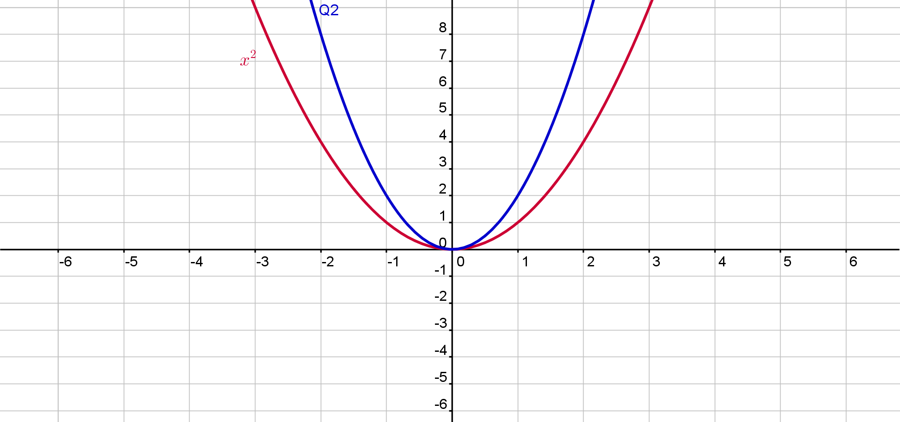
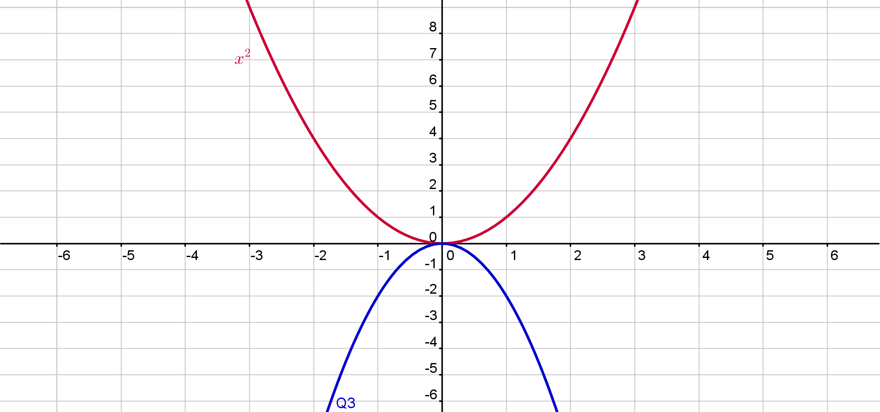
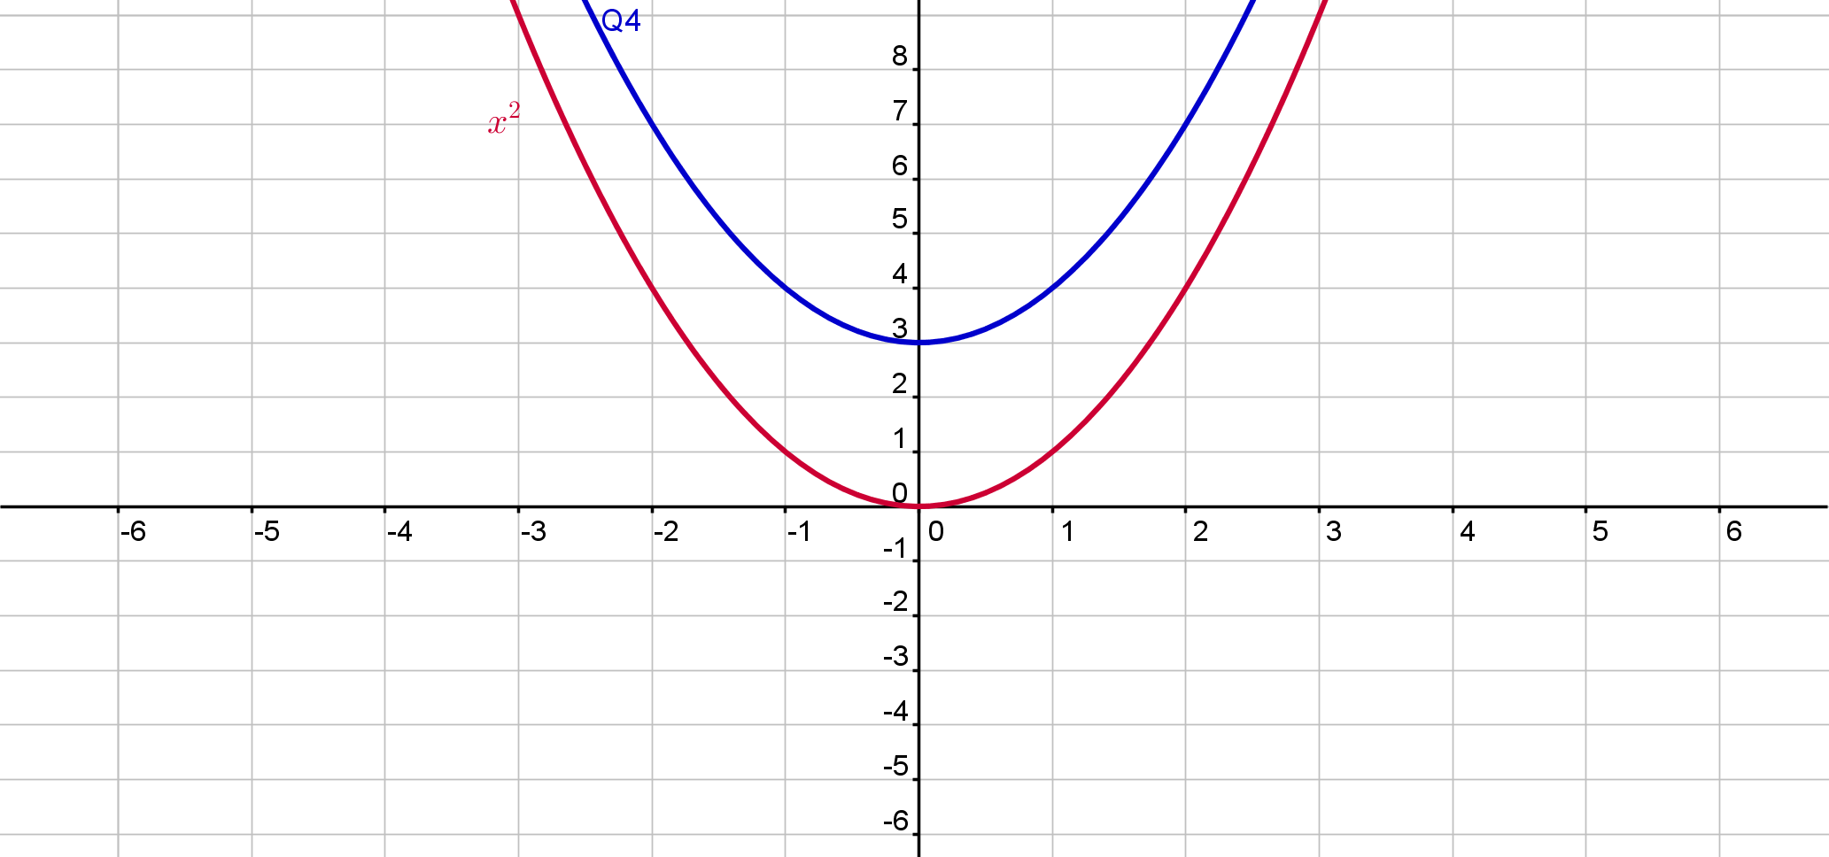
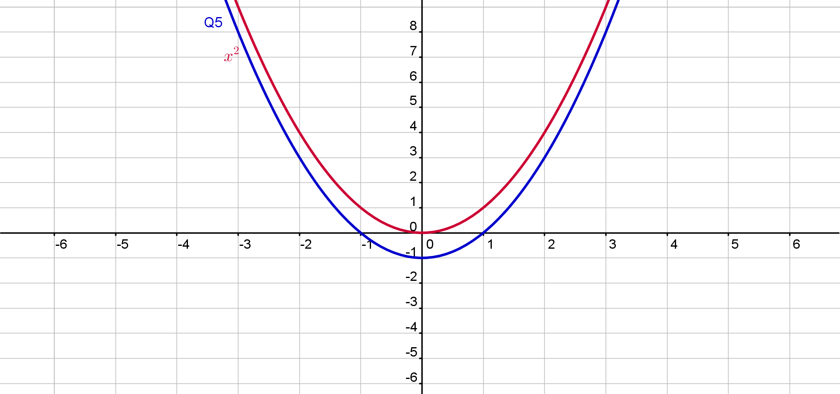
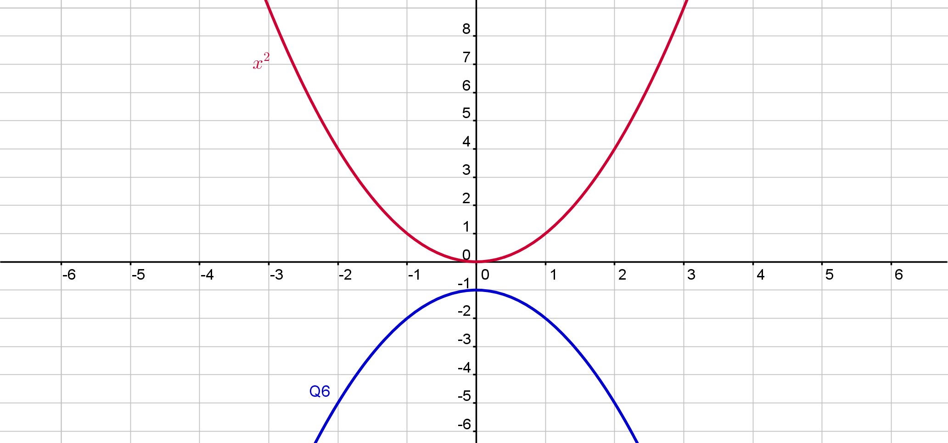
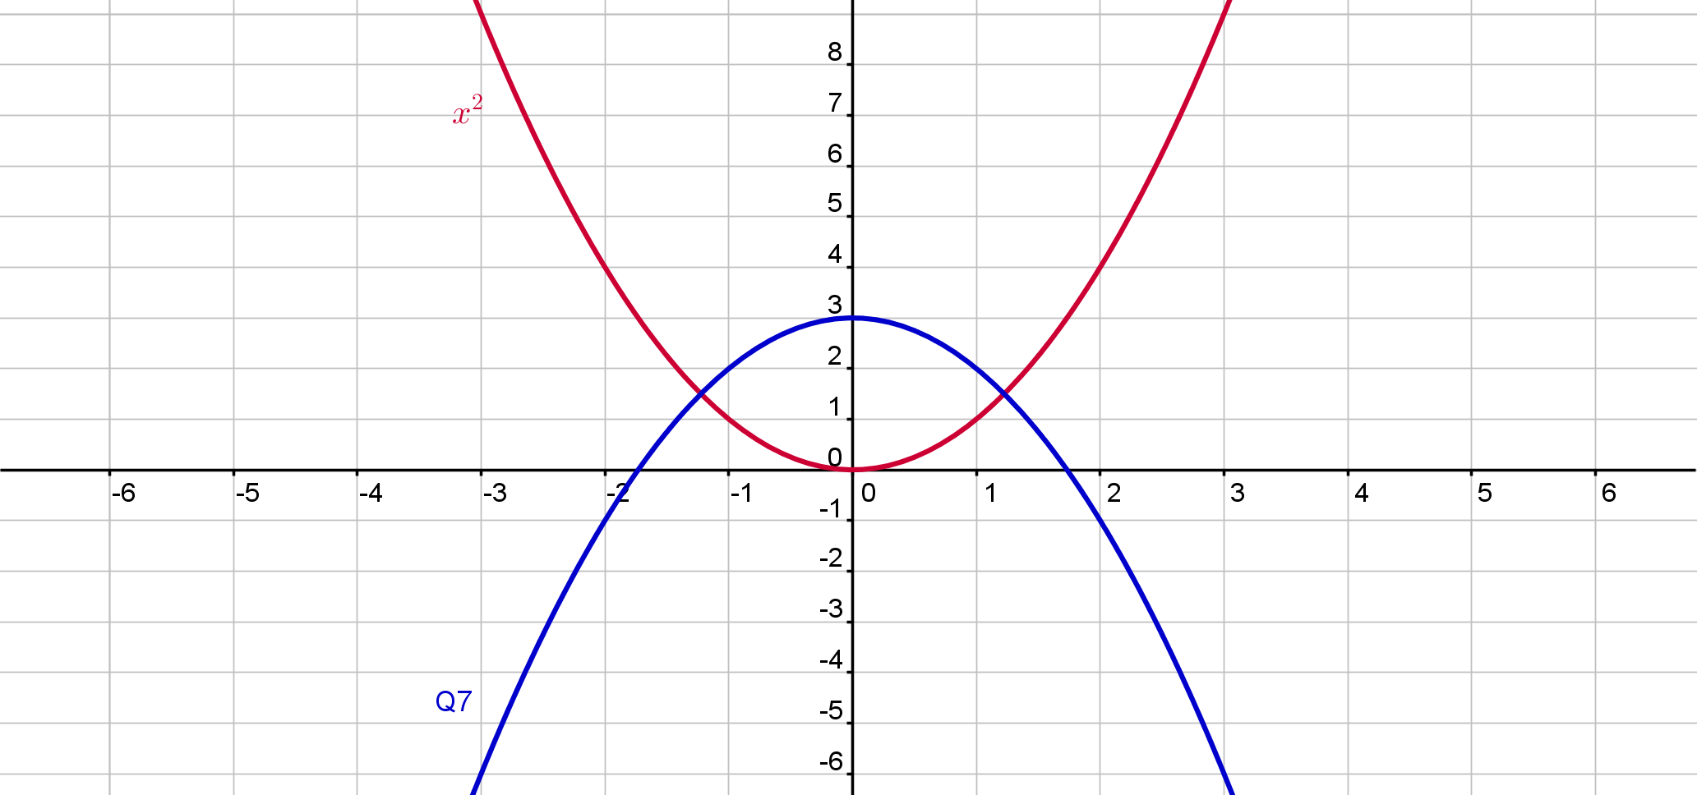
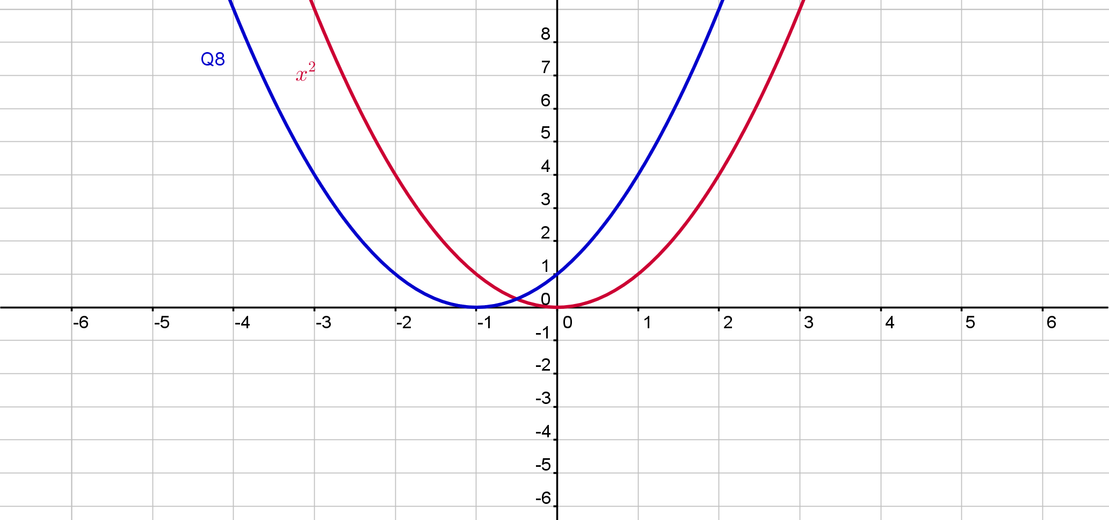
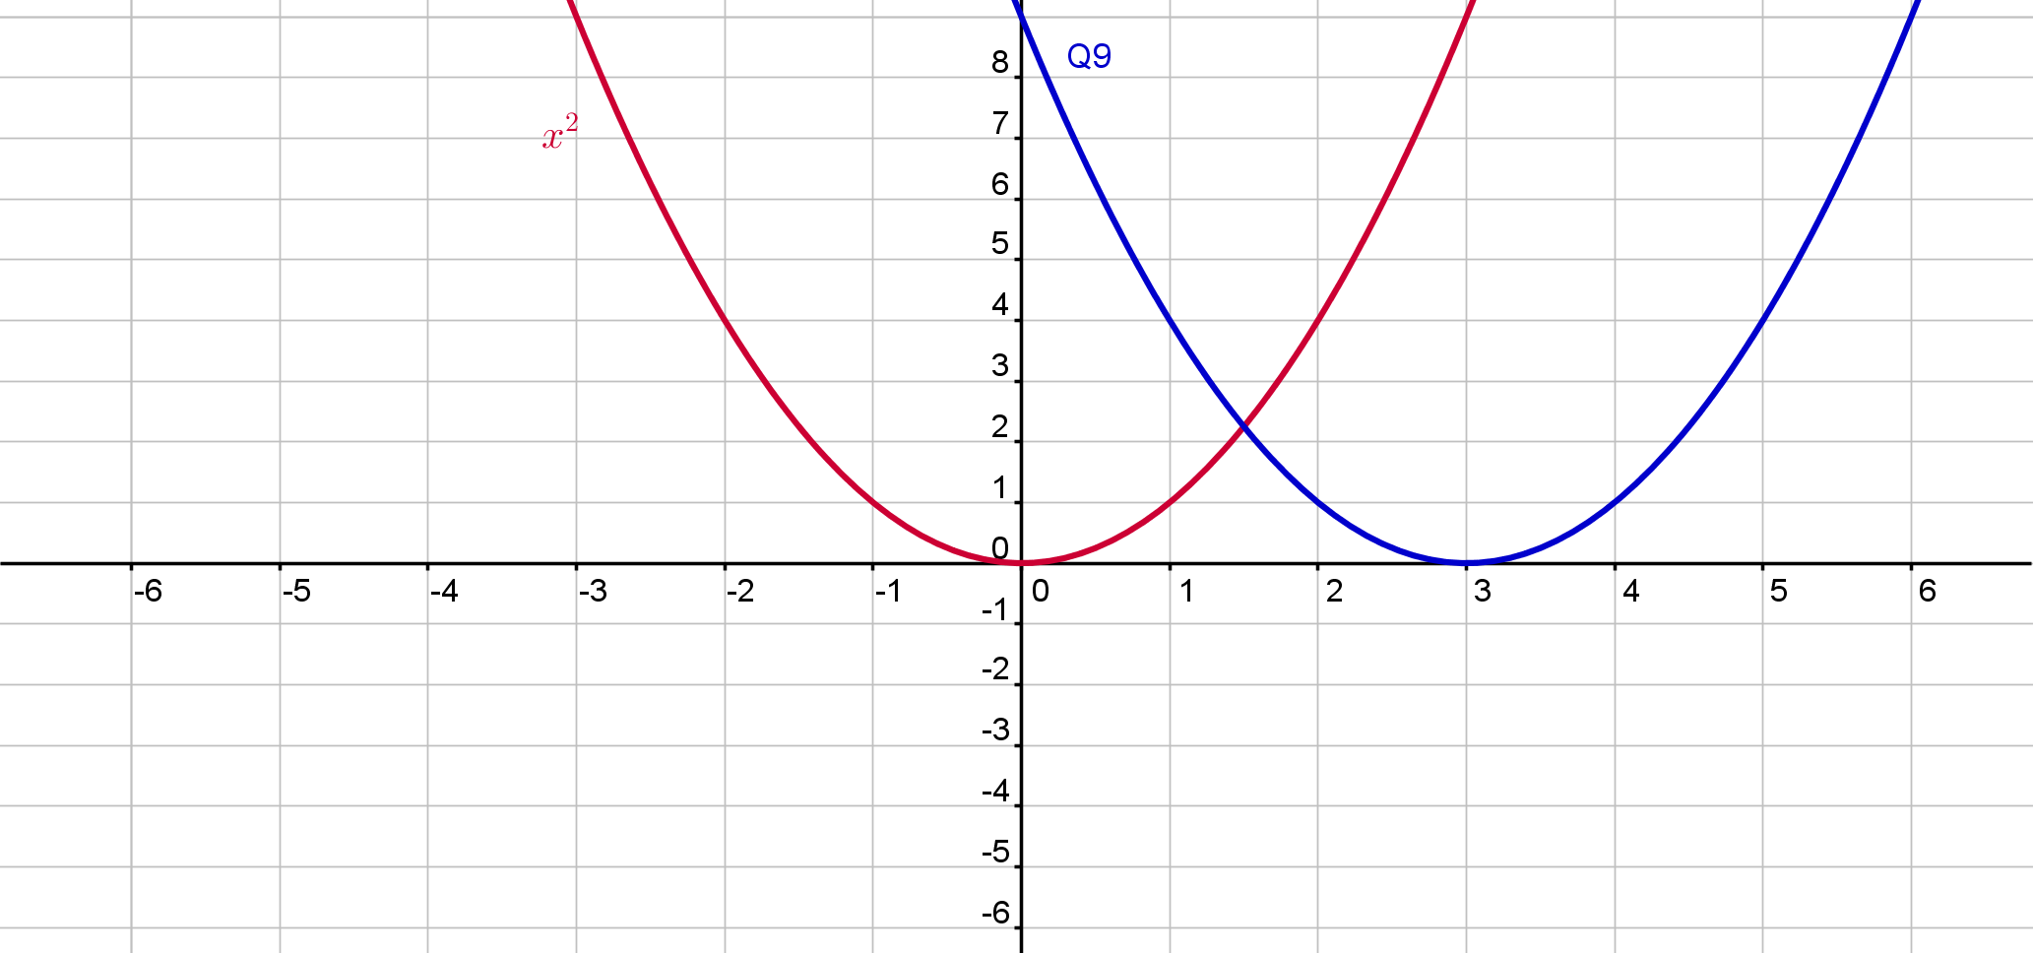
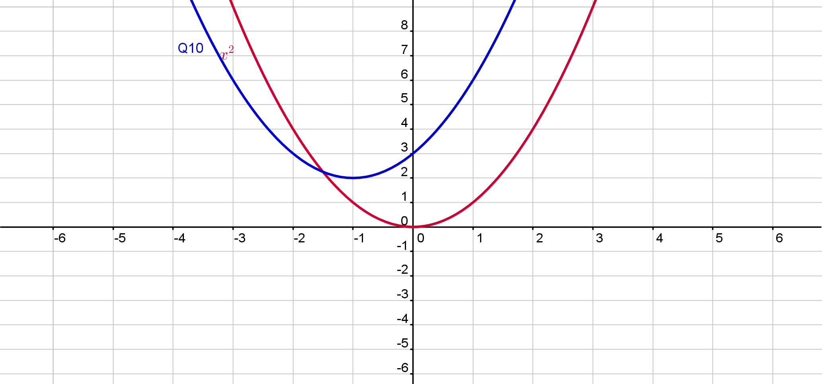
Activity 2
35

Slide 4
Activity 2
Graph | Function | Local Maximum/Minimum
1 | $$f\left(x\right)=x^{2}$$ | Local min (0,0)
2 | $$f\left(x\right)={2x}^{2}$$ | Local min (0,0)
3 | $$f\left(x\right)={−2x}^{2}$$ | Local max(0,0)
4 | $$f\left(x\right)=x^{2}+3$$ | Local min (0,3)
5 | $$f\left(x\right)=x^{2}−1$$ | Local min (0,-1)
6 | $$f\left(x\right)={−x}^{2}−1$$ | Local max (0,-1)
7 | $$f\left(x\right)={−x}^{2}+3$$ | Local max (0,3)
8 | $$f\left(x\right)={(x+1)}^{2}$$ | Local min (-1,0)
9 | $$f\left(x\right)={(x−3)}^{2}$$ | Local min (3,0)
10 | $$f\left(x\right)={(x+1)}^{2}+2$$ | Local min (-1,2)

Slide 5
Activity 2
Graph | Function | Local Maximum/Minimum
1 | $$f\left(x\right)=x^{2}$$
11
12
13
14
15
16
17
18
19
20
35

Slide 6
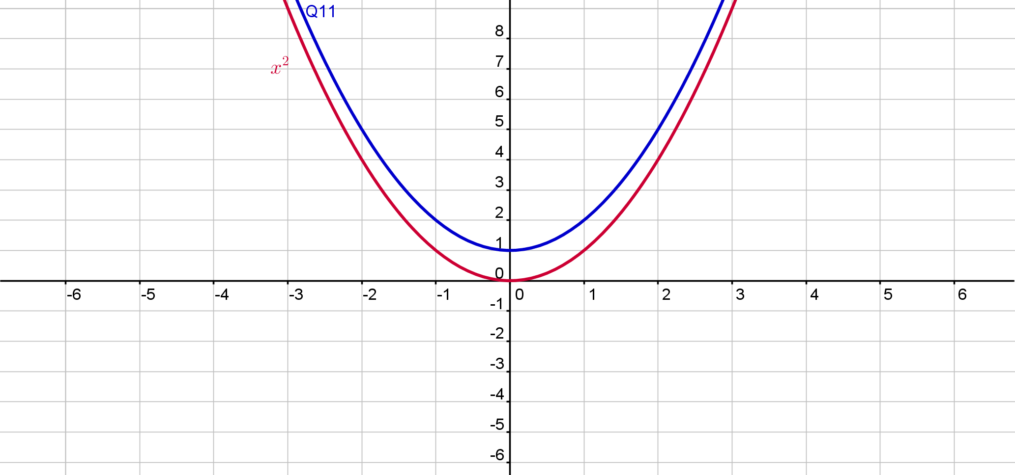
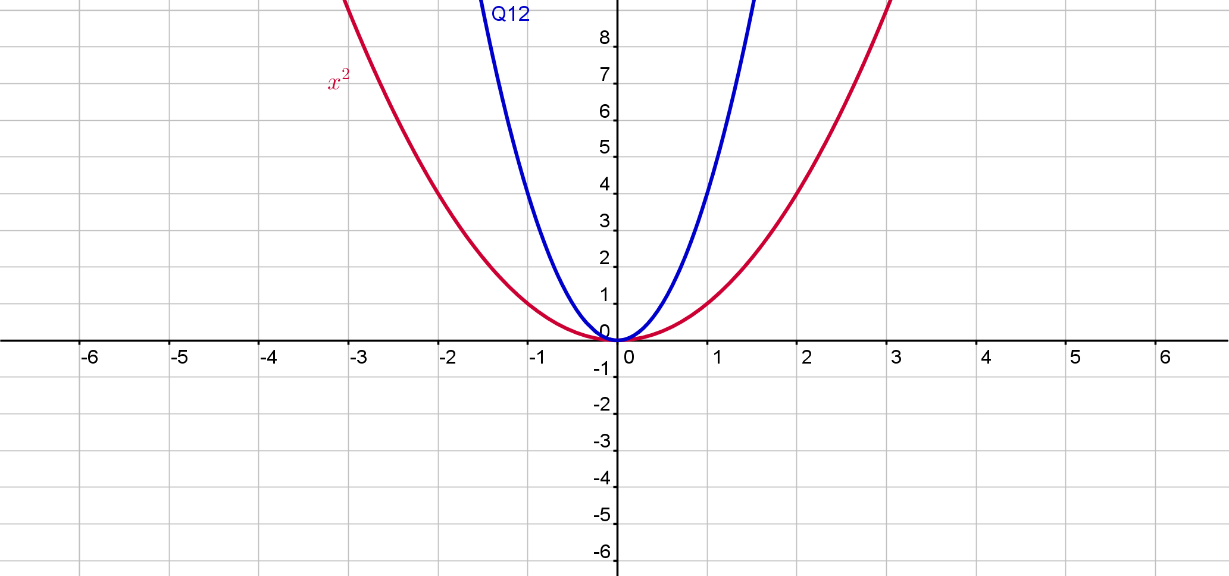
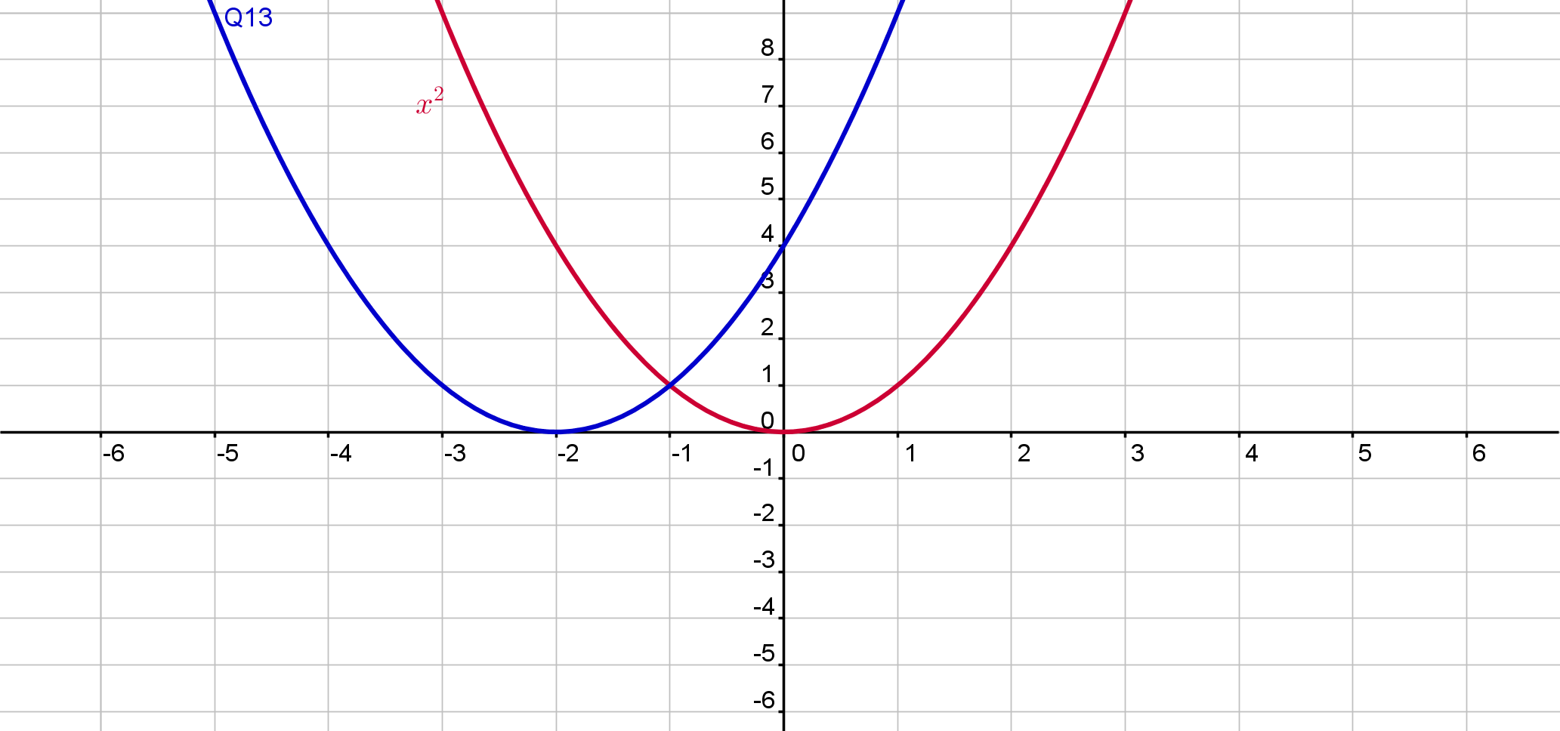
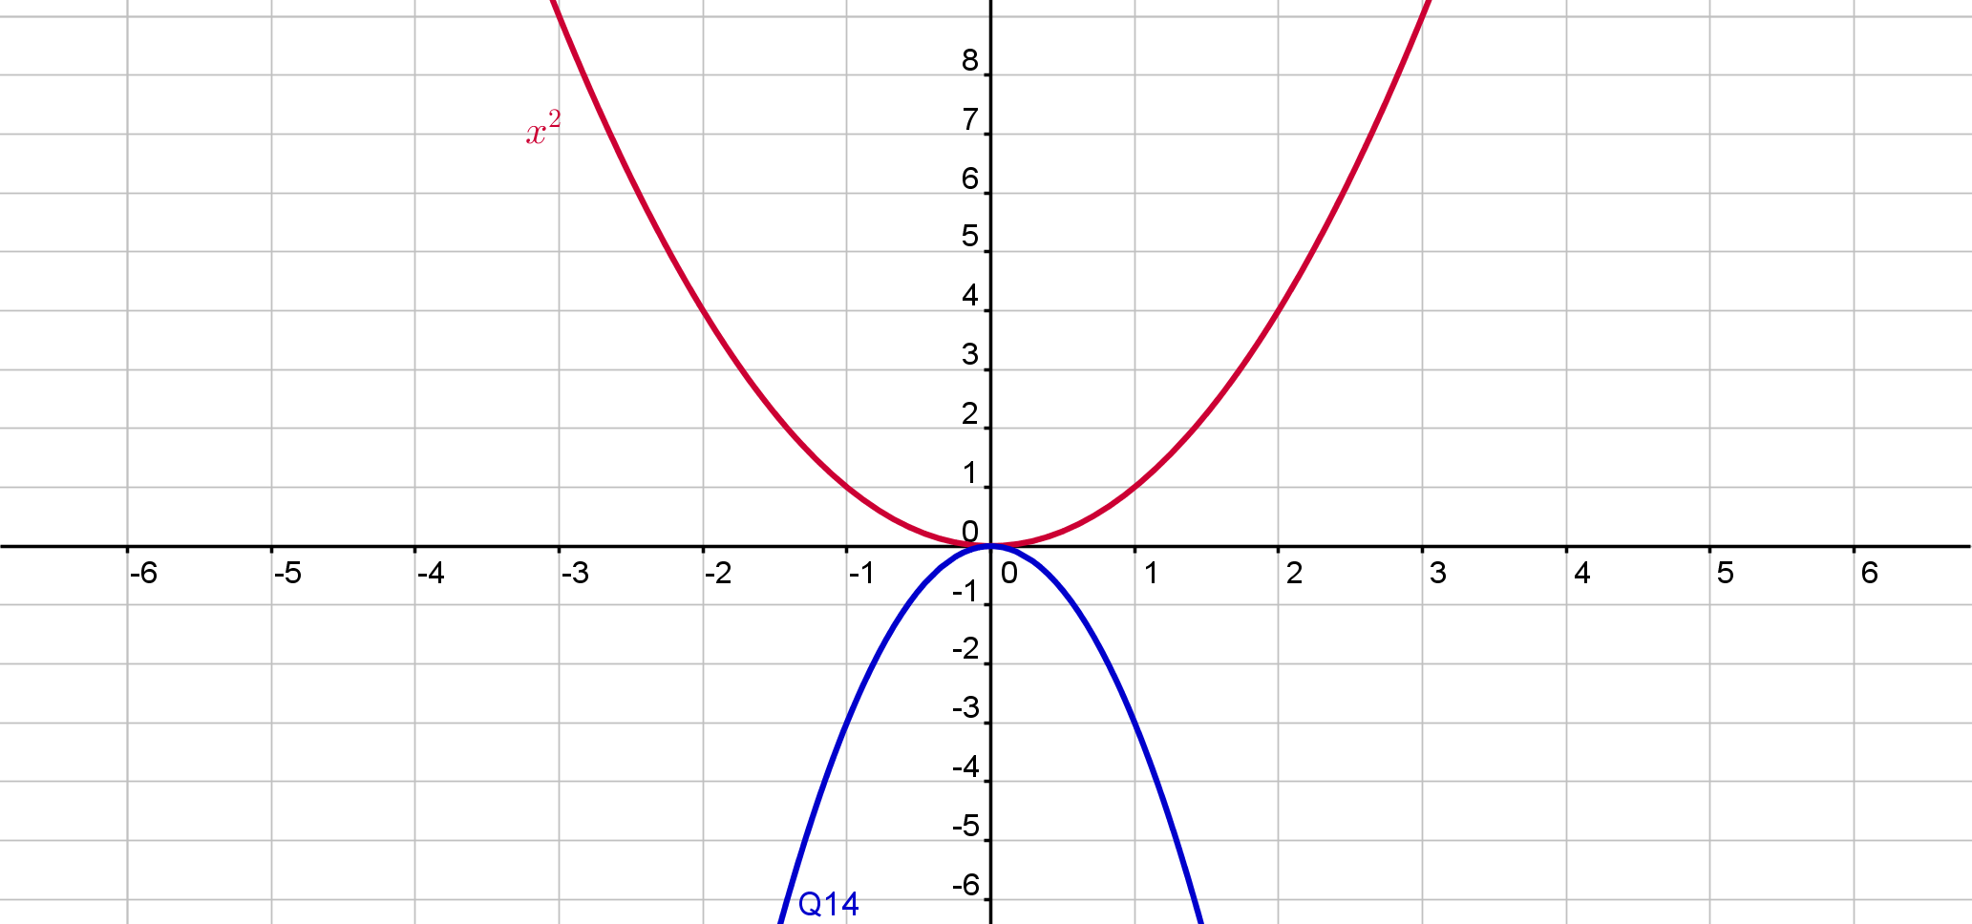
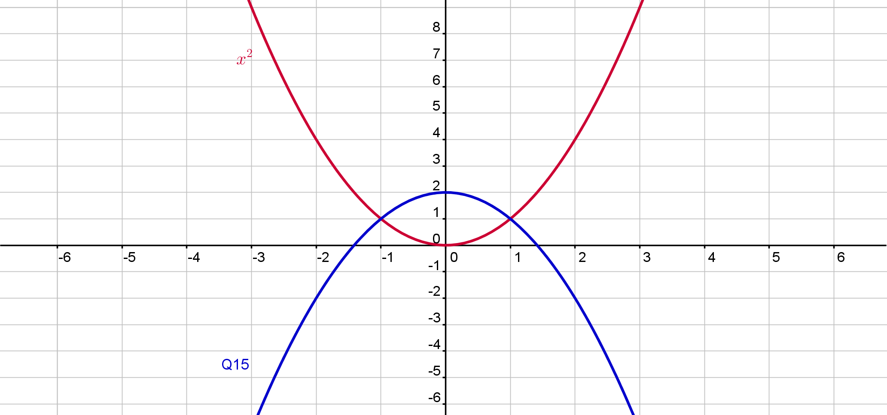
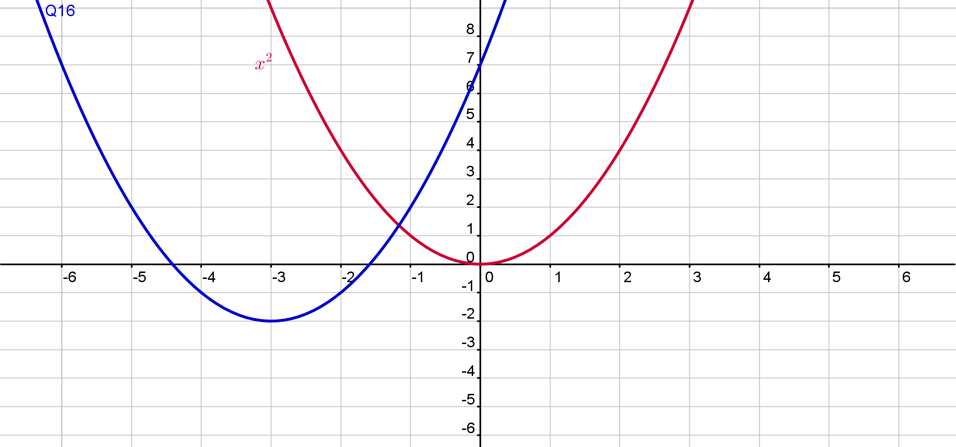
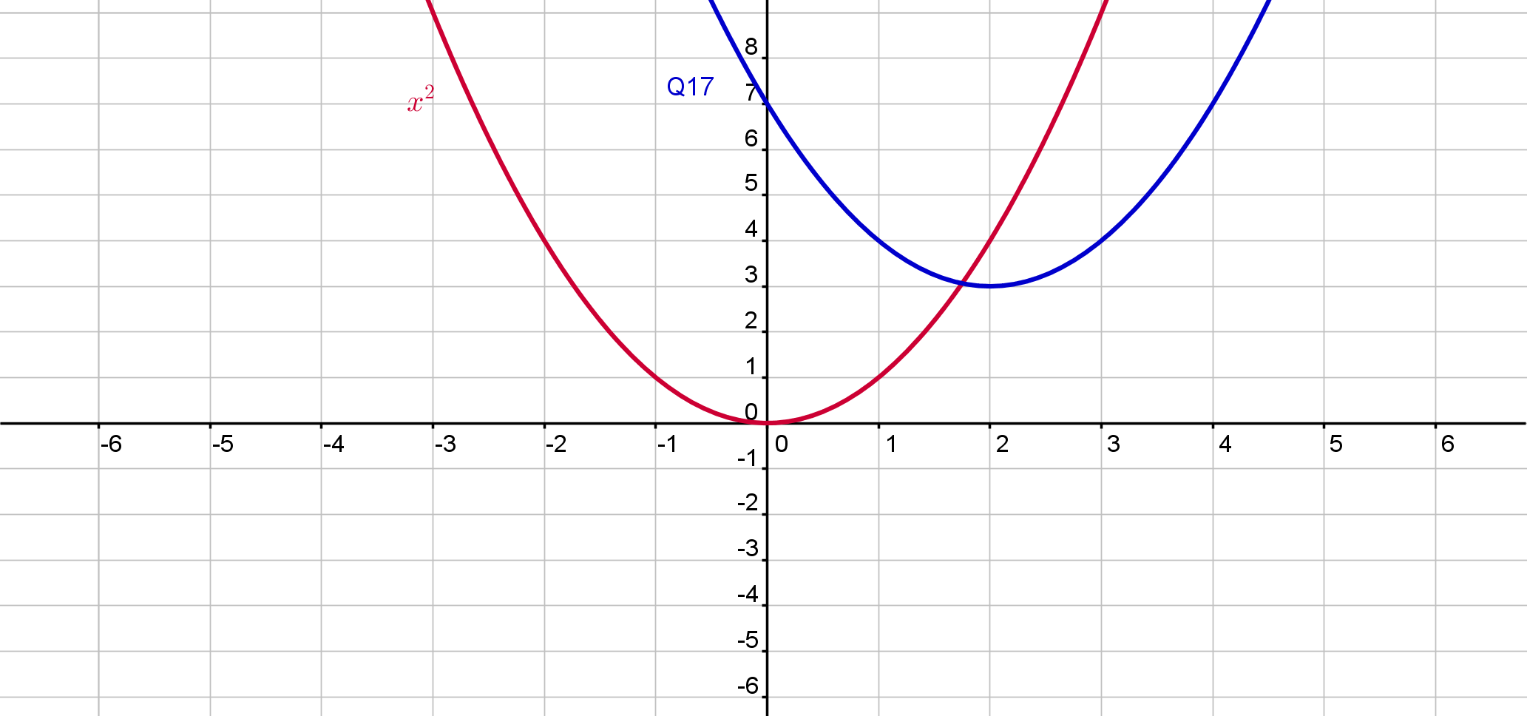
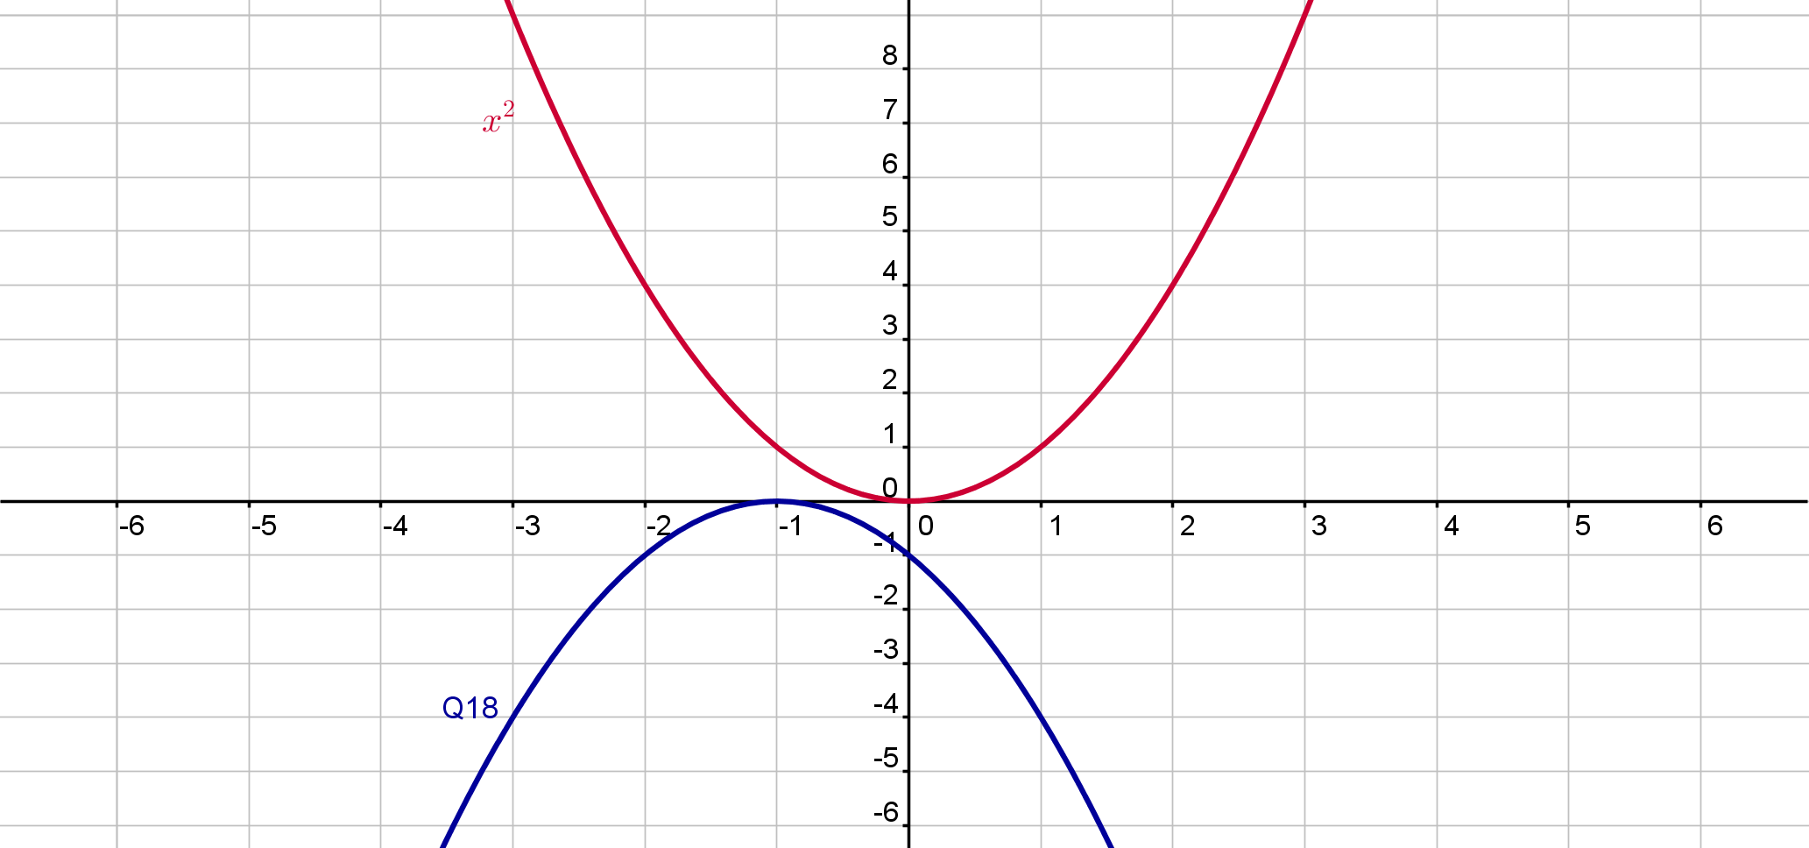
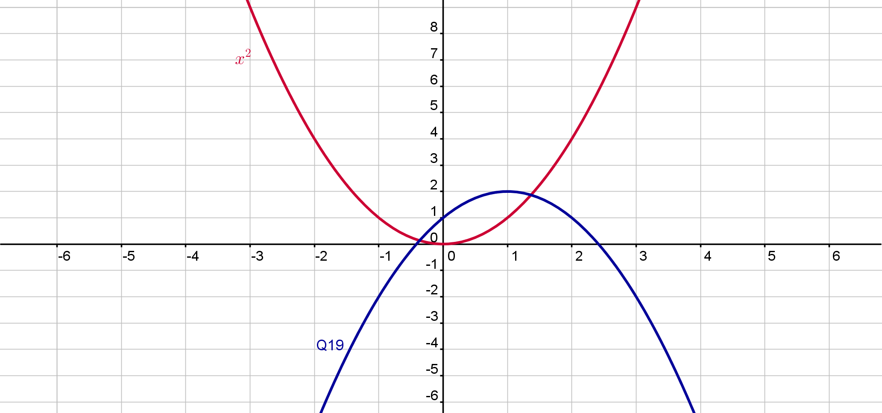
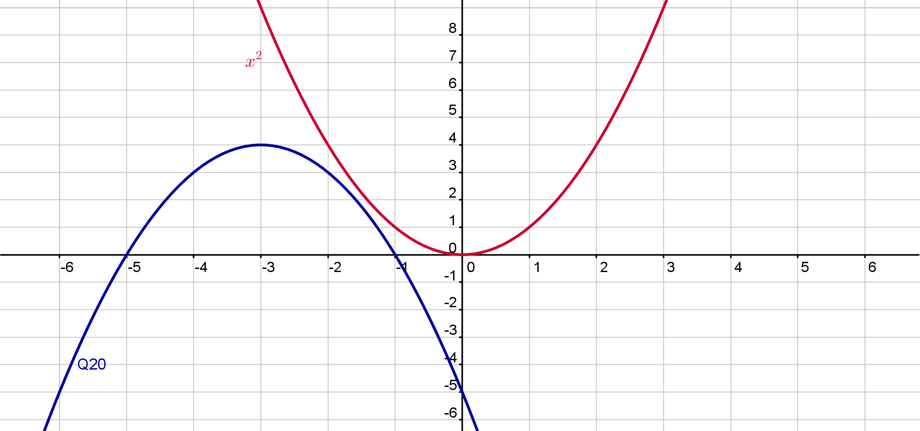
Activity 2
35

Slide 7
Activity 2
Graph | Function | Local Maximum/Minimum
1 | $$f\left(x\right)=x^{2}$$
11 | $$f\left(x\right)=x^{2}+1$$ | Local min (0,1)
12 | $$f\left(x\right)={4x}^{2}$$ | Local min (0,0)
13 | $$f\left(x\right)={(x+2)}^{2}$$ | Local min (-2,0)
14 | $$f\left(x\right)={−3x}^{2}$$ | Local max (0,0)
15 | $$f\left(x\right)={−x}^{2}+2$$ | Local max (0,2)
16 | $$f\left(x\right)={(x+3)}^{2}−2$$ | Local min (-3,-2)
17 | $$f\left(x\right)={(x−2)}^{2}+3$$ | Local min (2,3)
18 | $$f\left(x\right)=−{(x+1)}^{2}$$ | Local max (0,-1)
19 | $f\left(x\right)=−{(x−1)}^{2}$+2 | Local max (1,2)
20 | $f\left(x\right)$=$−{\left(x+3\right)}^{2}+4$ | Local max (-3,4)
35

Slide 8
Activity 2
Graph | Function | Local Maximum/Minimum
21
22
23
24
35

Slide 9
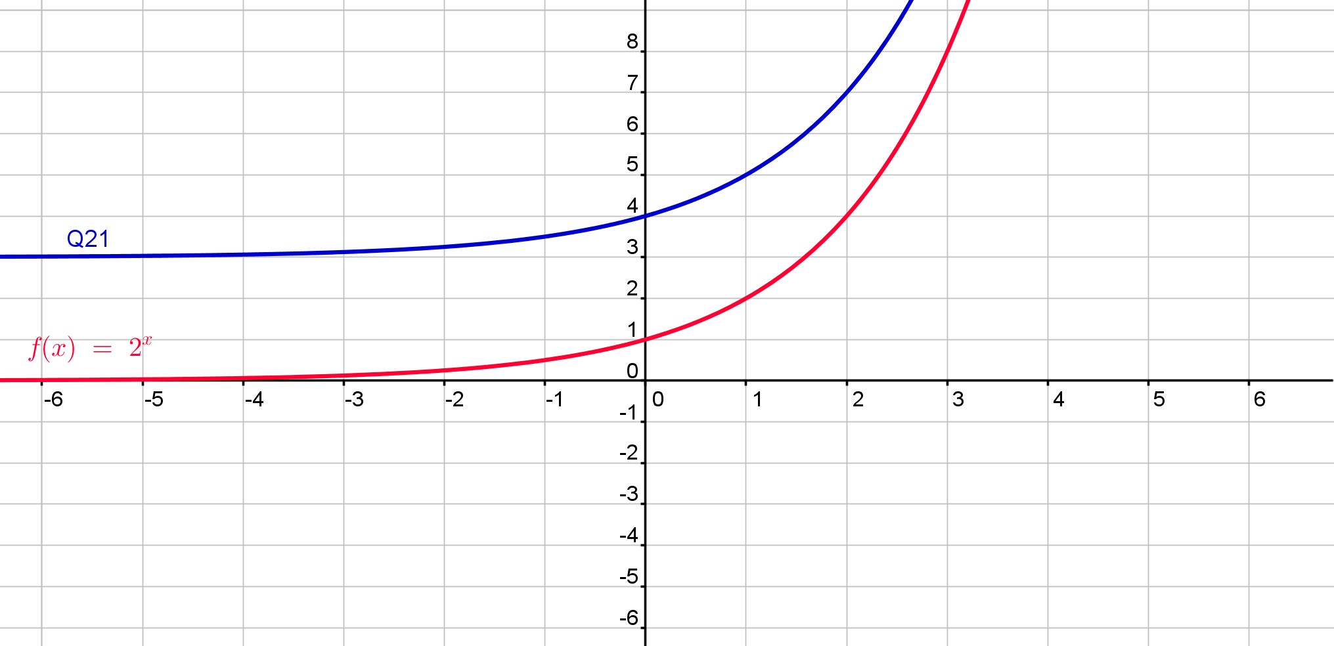
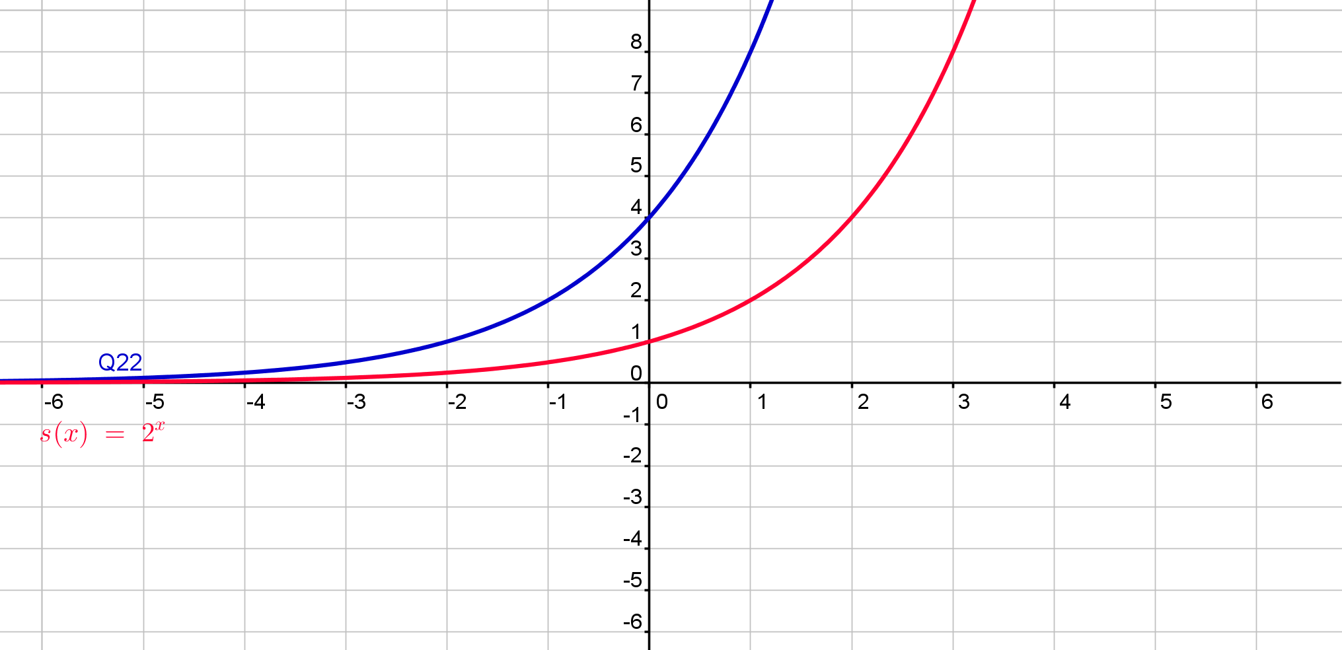
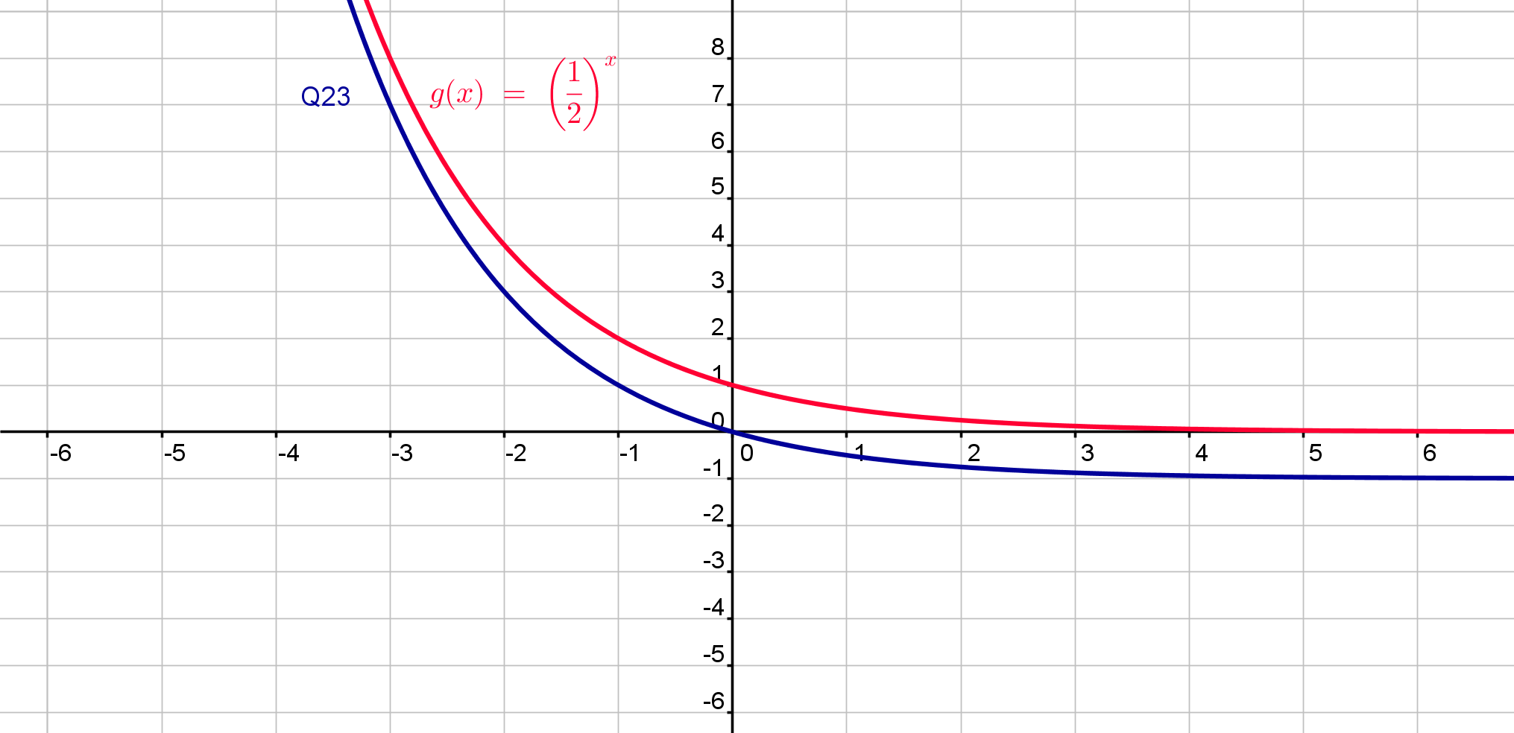
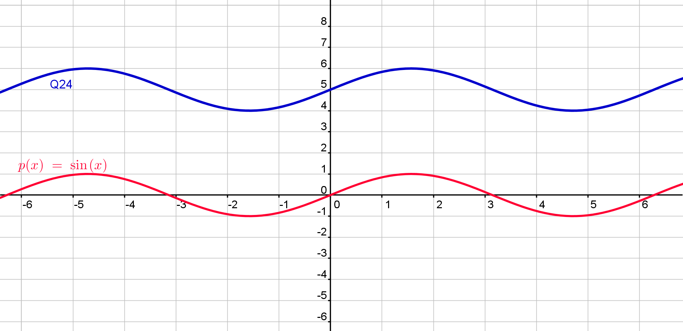
Activity 2
35

Slide 10
Activity 2
Graph | Function | Local Maximum/Minimum
21 | $$f\left(x\right)=2^{x}+3$$
22 | $$f\left(x\right)=4{(2}^{x})$$
23 | $$f\left(x\right)={\left(\frac{1}{2}\right)}^{x}−1$$
24 | f(x)=sin(x)+5
35

